Slide 1
JOINT STRATEGIC NEEDS ASSESSMENT 2019
ESSEX
SNAPSHOT
PREPARED BY
PUBLIC HEALTH INTELLIGENCE TEAM
RESEARCH & INSIGHT
ESSEX COUNTY COUNCIL
JANUARY 2020
Notes:
Information taken from Essex JSNA – refers to Essex LA (Southend & Thurrock also have JSNAs which will include similar information)

Slide 2
JOINT STRATEGIC NEEDS ASSESSMENT 2019
Top things to know about the population of Essex
18.9%
are aged
0-15 Years
60.6%
are aged
16-64 Years
20.5%
are aged
65 +
Total Population
= 1.47 million
(Mid Year Population Estimates 2018)
At the time of the 2011 Census
Colchester
The population has
increased by 22,242
people /1.54% since
2011; Slower than the rate of growth for England of 5.95%
48.9%
male
90.8%
had the largest population in 2018 with 192,523 residents
of residents
were White British
9.2%
Maldon
identfied as
Black or Minority
Ethnicities (BAME)
incuding white non-British
51.1%
female
had the smallest population in 2018 with 64,425 residents
(Mid Year Population Estimates 2018)
Old Age Dependency Ratio
Households with
dependent children
22.8%
Lone Parent Family
households
9.7%
Households solely occupied by over 65s
23.7%
Households of over 65s who live alone
13.1%
lone Occupier households
28.4%
There are an estimated of 335.6 people aged 65+ per 1000 working age people in Essex. This is higher than the England rate of 286.8.
(2011 Census)
(Population projections: 2016 Based)

Slide 3
JOINT STRATEGIC NEEDS ASSESSMENT 2019
Top things to know about Access to Services & Wider Determinants of Health
Average Travel Times by Walking or Public Transport
Compared to the England average (83.8%) , all CCGs in Essex had lower levels of patients reporting positive experiences with their GP
33.9% of residents live in areas classified as rural.
66.1% live in areas classified as Urban.
19.4 minutes
11.6 minutes
to 8 key services
3
to a GP surgery
45.4 minutes
areas* had travel times to a hospital of 60 minutes or more
This classification is based on where residents are living
rather than the georgrpahy of the area as a whole.
to a hospital
(*Maldon, Tendring & Braintree)
£618.6
30 LSOAs
3 LAs
Average weekly income for full-time workers
52,833 households (8.64%) were in fuel poverty in 2016
(England Average £574.9)
are in the 10% most deprived areas nationally
have an average rank in the bottom 40% nationally
13,100 households with dependent children (2.8%) were classed as workless in 2017
Male residents earned on average £130 (19.5%) more per week than female residents
Part-time workers earned an average of £182.10
per week; lower than the England Average of £187.3
(IMD 2019)
89,381 children (10%) were eligible for free school meals in 2018
72.1%
63.3%
of pupils achieved grade 9-4 in English and Maths GCSE (a good pass) in 2018
achieved grade 9-5 English and Maths GCSE (a strong pass) in 2018
23.9%
of children
achieved a good level of development at the Early Years Foundation Stage in 2018
of adults aged 16+ have no formal qualifications
21,803 household were on housing waiting lists in 2018/19; equivalent to 3.54% of all households in the Essex County Council Area.
67 people were recorded as rough sleeping in 2018, equivalent to 1.08 rough sleepers to every 10,000 households in the area.
England average (2.01 per 10,000) East of England (1.88)
(England Average 71.5%)
40.7%
(England + Eastern Region Average 22.5%)
This is 1.5% lower than 2017
(England Average = 59.7%, 39.9%)

Slide 4
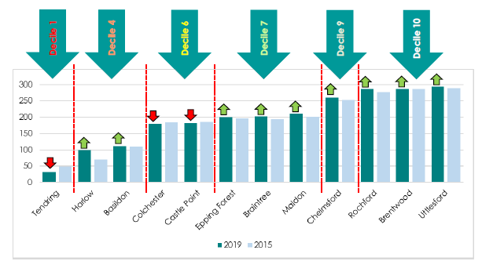
JOINT STRATEGIC NEEDS ASSESSMENT 2019
Top things to know about deprivation in Essex
More than 123,000 (8.6%) Essex residents live in areas which amongst England’s most deprived 20%; double the number in 2007
14,800 Older People live in the 20% most deprived of neighbourhoods
38,600 children live in the most deprived 20% of neighbourhoods
236 LSOAs in 40% most deprived
30 LSOAs in 10% most deprived
The most deprived LSOA in England remains within Tendring
Harlow saw a substantial reduction in the proportion of residents impacted by deprivation compares to 2015

Slide 5
JOINT STRATEGIC NEEDS ASSESSMENT 2019
Top things to know about Lifestyles Choices
Reception Year (age 4-5 years)
Year 6 (age 10-11 years)
In 2017/18:
0.8% of children were classified as underweight.
21.1% were classified as overweight (including obese)
8.59% were classed as Obese (including severely obese)
In 2017/18:
32% were classified as overweight (including obese)
17.9% were classed as Obese (including severely obese)
(England Average = 34.2%, 20.1%)
(England Average = 0.98%, 22.38%, 9.53%)
3 areas; (Harlow 37.5%); Tendring (36.3%); and Maldon (34.6%) had levels of excess weight above the national average for this year group
The proportion of adults aged over 16 years in the county meeting the recommended fruit and vegetable intake of 5 portions on a ‘usual day’ was 55.96% in 2016/17, lower than the England average of 57.44%.
Only 6 of the 12 district boroughs were equal to or higher than the national average.
In Essex in 2016/17 63.6% of adults were classed asoverweight or obese, slightly higher than the England average of 61.3%.
7 of the 12 district areas also had obesity rates above the national average
The rate of alcohol-related hospital admissions across Essex in 2017/18 was 1935.7 per 100,000 population (England = 2224.8)
13.8% of residents aged 18+ are current smokers.
(England = 14.87%)
29.5% identified as Ex-Smokers
56.7% have never smoked
The age-standardised mortality rate from drug misuse per 100,000 population across the whole of Essex was 3.63 over the period of 2015 - 2017. (England = 4.33)
Alcohol-related mortality was estimated to be 41.90 per 100,00,0, lower than that for England (46.15)

Slide 6
JOINT STRATEGIC NEEDS ASSESSMENT 2019
JOINT STRATEGIC NEEDS ASSESSMENT 2019
Top things to know about Lifestyle
Top things to Know About Physical Activity & Inactivity
286,400 (23.9%) Essex residents are inactive
(less than 30 minutes per week)
24.8% - England average
There has been a 2% point increase
in physical activity since 2015-16...
37,300 more people active
11,400 less people inactive
5 districts have inactivity levels higher than the Essex and national averages
There have been significant increases in activity in Braintree, Maldon and Tendring but a decrease in Southend-on-Sea
Inactivity in Essex increases with deprivation
National Trends:
Highest level of activity and lowest level of inactivity ever recorded
More older adults, those with a disability or long term health condition and women active
More people walking and doing adventure sports
Inactivity levels increase with age with the sharpest increase at 75+
20% in least deprived quintile
31% in most deprived quintile

Slide 7
JOINT STRATEGIC NEEDS ASSESSMENT 2019
Top things to know about Mental Health
12.49% of people aged 18+ report having depression and/or anxiety across Essex
(England= 13.74%)
CCG level data suggests that Colchester and Tendring (North East Essex CCG) have the highest levels of common mental health conditions in Essex(14.3%) whilst Braintree, Maldon and Chelmsford (Mid Essex CCG) have the lowest.
The prevalence of any mental health disorder among children aged between 5 to 16 years across Essex was 8.71 in 2015, slightly lower than the prevalence for England (9.23).
General Practice Patient Survey (GPPS; NHS England) in 2016/17
Severe Mental Health conditions
Severe mental health conditions include schizophrenia, bipolar affective disorder and other psychoses.
In 2017/18, the prevalence of these as recorded on general practise disease registers across Essex was 0.80. This is lower than the prevalence for severe mental health conditions for England (0.94).
At a District Level only Tendring (1%) was estimated as having a rate of severe mental conditions above the national average, whilst Uttlesford had the lowest (0.63%)
Self Harm
Suicide
Emergency hospital admissions for intentional self-harm was 156.98 in 2017/18. This is significantly lower than the rate for England (185.48).
Women (201.7) in Essex were 1.8 times more likely to be admitted to hospital for intentional self-harm than men (113.5) but had generally had a lower admissions rate than the average for England (235.3).
The mortality rate per 100,000 population from suicide and injury of undetermined intent was 10.88 in 2015/17 (England 9.57).
The rate among males across Essex was 16.90 and 5.31 among
females, both of which slightly higher than the rate for England (14.69 male; 4.69 female).
(Highest: Maldon= 23.6 per 100,000; lowest: Epping Forest at 7.26)

Slide 8
JOINT STRATEGIC NEEDS ASSESSMENT 2019
Top things to know about Life Expectancy
and Mortality
Life Expectancy at Birth
Life Expectancy at 65
Healthy Life Expectancy
Life expectancy at birth in Essex (2015-2017) was 83.3 years for females and 80.2 years for males.
England: Females = 83.1 years, Males =79.6 years)
The ONS estimates that the inequality in life expectancy at birth between most and least deprived areas is of 6years for females & 7.7 years for males.
Life expectancy at age 65 (the number of additional years a person could expect to live) was 21.2 years for females and 18.9 years for males. England: F = 21.1 years, M = 18.8 years)
The ONS estimates that the inequality in life expectancy at 65 between most and least deprived areas is 3.2 years for females & 4.2 years for males.
Males from birth have a healthy life expectancy of 64.53 years whilst females were slightly lower at 64.18 years .
This means that a male born during this period would expect to spend15.6 years (19.5% of their life expectancy) in ""Not GoodHealth"" compared females with 19.12 years (23% of their life expectancy).
Mortality
Breast Cancer Mortality
Across the county The top three biggest causes of mortality for both sexes were:
cancer (131 per100,000)
cardiovascular diseases (62.6 per 100,000)
and respiratory diseases(30.8 per 100,000)
the rates for all three were lower than the England averages
Mortality rates for breast cancer (All persons rate = 11.22;
Female only rate: 26.6) were higher than the average for England (10.6; 20.6) at a county level
8 out of 12 Districts have breast Cancer mortality rates for women which were higher than the national average.
Cancer Mortality
Deaths on Roads
From 2015-17 Public Health England recorded 5314 deaths from cancer
under the age of 75, equal to a premature mortality rate of 131 deaths per
100,000 people. Whilst this is lower than the average for England (135) for
both sexes, whilst three areas at District level (Basildon, Castle Point and
Tendring) have mortality were observed to have rates above both the county and England averages.
Deaths caused by road traffic accidents in Essex saw 51.3 deaths per 100,000 between 2015-17 (England= 40.8).
9 areas had rates which higher (Lowest: Rochford = 36.2; Highest: Epping Forest =78.8).
The rate of children killed on seriously injured on roads was also higher than average at 18.8 per 100,000 compared to 17.4 nationally.

Slide 9
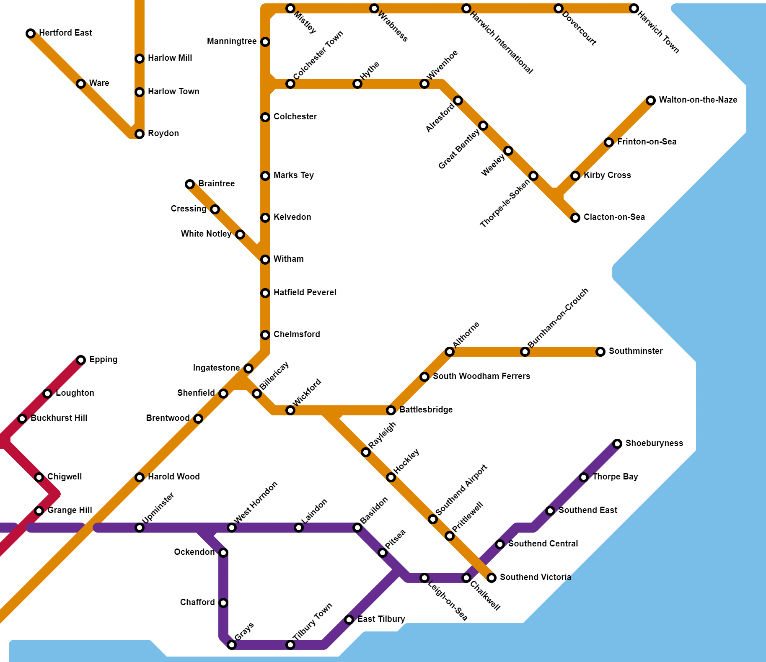
78
82
76
76
76
79
Life Expectancy
At birth (2013-17)
82
73
75
77
81
82
82
Average (Essex – female): 80.2
Average (England - male): 79.5
84
82
82
80
79
Highest
Chigwell: 88
80
68
77
76
Within just 2 stops the average life expectancy of an Essex citizen has been reduced by 14 years.
Lowest
Clacton-on-Sea: 68
81
81
84
86
80
86
82
84
79
84
88
82
83
77
78
2 stops on the Central line can shave 9 years off the average life expectancy of a citizen in Essex.
77
76
Greater Anglia
73
C2C line
83
76
74
80
76
82
Central line
Source: Public Health England

