Slide 1

Essex Local Delivery Pilot
Tackling physical inactivity across Essex

Slide 2
Sport England LDP Programme

Slide 3




PHYSICAL
“PHYSICAL ACTIVITY IS NOT JUST ABOUT ORGANISED COMMUNITY LEISURE”
Dr William Bird
Opportunities to be more active
*source: Intelligent Health, 2019

Slide 4
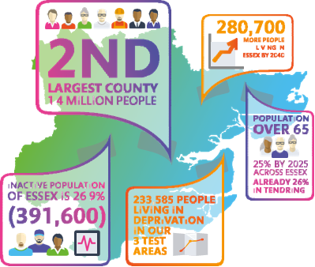

THE ESSEX CONTEXT
LARGE TWO TIER COUNTY
WHOLE SYSTEM CHANGE APPROACH
ALREADY STARTED
DIFFERENT PLACES, DIFFERENT
CHALLENGES
  Long-term coastal deprivation
  Poor urban design post World War II
  New housing putting pressures on
  services

Slide 5
Physical Inactivity levels, Deprivation, and economic cost

Slide 6
ESSEX LOCAL DELIVERY PILOT PRIORITIES
PRIORITIES
PRINCIPLES
PRINCIPLES
Increase Physical Activity
Asset Based Community Development
Co-Production
Families
Older People
Mental Health
Realign Systems Budgets
Social Movements
Basildon
Colchester
Tendring
Shared Visions
Engage Unusual Suspects
Distributed Leadership
Deprived Communities
Robust Evaluation and Sharing Learning
WHOLE SYSTEM CHANGE
Innovation and Risk
Education| Community| Planning and Infrastructure|
Social Care| Health| Community Safety | Workplace

Slide 7


To get real scale we need:
System Change

Slide 8

LDP INVESTMENT PROCESS AND CRITERIA
LOCAL IMPLEMENTATION
GROUPS
LOCAL INVESTMENT
PLANS
Focus on outcomes, sustainability, learning
Place based and co-produced with local people
Test and learn OR replication/scaling
Levers other funds and resources
Clarity about impact on:
  System setting
  Target Audience
  All proposals closely supported by LDP team (design and delivery)
All funding proposals for Basildon, Colchester and Tendring developed and approved by the implementation group

Slide 9


Slide 10
Essex LDP Whole System Model

Slide 11
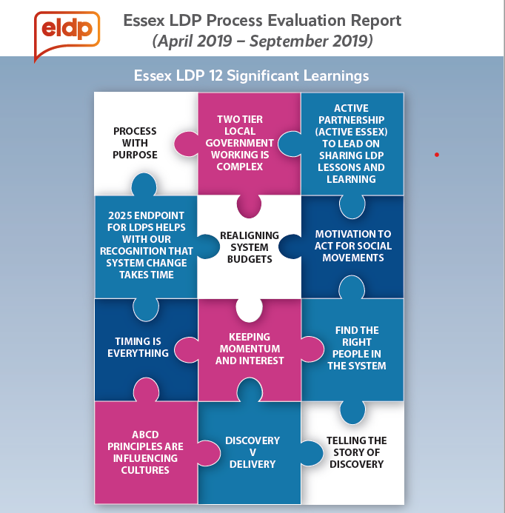

Slide 12
LATEST LDP NEWS
Extended to 2025
New evaluation consortium appointed headed up by University of Essex
Six month process evaluation (April – September)
New LDP plans and implementation groups and networks for Basildon, Colchester, and Tendring
New micro-grants scheme about to be tested in our three pilot areas (grants up to £2500 to stimulate social movements and ABCD)
New data and insight team
New comms strategy
Tested a new summer holiday hunger and physical activity programme
Action Research ‘Test and Learn’ report – 17 different interventions

