Slide 1
and why they fit together
Physical Activity
Social prescribing
Kimberley White
Physical Activity Social Prescribing Lead

Slide 2
Regional Physical Activity and Health Lead role
Advocate for physical activity
Build relationships
Channel information
Provide leadership
Empowering innovative partnerships that embed physical activity into social prescribing, so more people can feel the benefits of, and advocate for, an active life.
Notes:
I’m one of 7 regional leads funded by Sport England to work across England to embed physical activity in social prescribing.
As a new area of work, I’ve spent a lot of the last six or so months working out what embedding physical activity into social prescribing really means in practice. Splitting my time between the regional role and more local work here in Essex.

Slide 3
Social Prescribing in the East
Regional core group led by NHSEI
Voluntary community
faith and social enterprise sector
Notes:
My role is part of a cross-sector partnership with NHSE Improvement, alongside the National Academy for Social Prescribing, arts, health, nature, money and pensions service in a regional core team. There’s a lot of resource and energy going into social prescribing at the moment, both from the NHS and the community side with all of these different partners working in this space. A key part of my role is ensuring these connect together for physical activity and I’ll be the link between what is going on nationally, regionally and locally.
In the last 9 months, I’ve been busy building relationships with a wide range of partners to ensure that physical activity is advocated for wherever possible and to really understand the opportunities to embed physical activity into social prescribing system. Adding to it, not duplicating.

Slide 4
“If physical activity were a drug, we would refer to it as a miracle cure, due to the great many illnesses it can prevent and help treat.”
UK Chief Medical Officers, 2019
Notes:
The guidelines state that for good physical and mental health, adults should aim to be physically active every day. Any activity is better than none, and more is better still. Beyond prevention, there is good evidence to demonstrate that regular physical activity can benefit patients with a number of diseases.
As we moved through the slides today its really important that whilst we might reference physical activity we also mean movement in general, the benefit for people moving more is just as important

Slide 5
Notes:
Being physically active doesn’t just mean going to the gym and dressing in lycra, there are many ways to be active and just moving more, being more active doesn’t mean having attend structured exercise it can be chair based movement at home or walking around the house/garden theres so many ways to encourage people to just get moving.

Slide 6
Regular physical activity provides a range of physical and mental health, and social benefits, many of which are increasing issues for individuals, communities and society.
These include:
• reducing the risk of many long-term conditions
• helping manage existing conditions
• ensuring good musculoskeletal health
• developing and maintaining physical and mental function and independence
• supporting social inclusion
• helping maintain a healthy weight
• reducing inequalities for people with long-term conditions

Slide 7
Notes:
Around 1 in 3 (34%) of men and 1 in 2 (42%) of women are not active enough for good health.
Men are more likely to report being active at the recommended level than women.
Physical activity varies with age and life stage. People tend to get less active with age, especially in older years.
And people with disabilities or long-term conditions are twice as likely not to be active enough for good health.
It’s well known that if you have a long term condition being more active will help you to manage the condition more effectively and stop progression, leading on to other benefits such as lower medication use, less pain, and increased overall quality of life

Slide 8
Notes:
Whilst we talk about physical activity its important to remember that moving more and using our own resistance in body weight is just as important.
There are 3 elements of the physical activity guidelines:
strengthening activity
cardiovascular activity
sedentary time
-The additional benefit of balance and flexibility exercises for older adults. Exercises that improve leg strength, balance and coordination can help people maintain and improve muscle strength and avoid falls as they age
-A combination of moderate, vigorous and very vigorous intensity activity
-Adults should aim to minimise the amount of time spent being sedentary, and when physically possible should break up long periods of inactivity with at least light physical activity. There have been notable developments in the evidence base for the health effects of sedentary time in adults

Slide 9
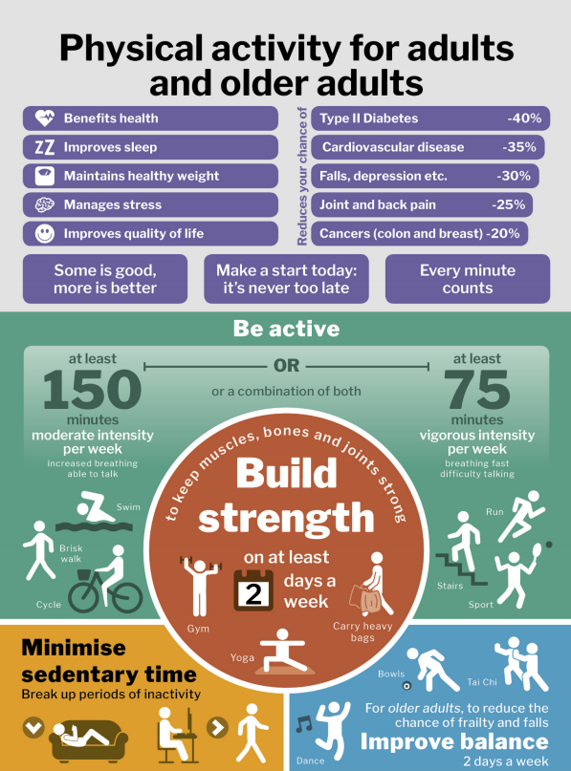
Notes:
what does that look like on a daily and weekly basis

Slide 10
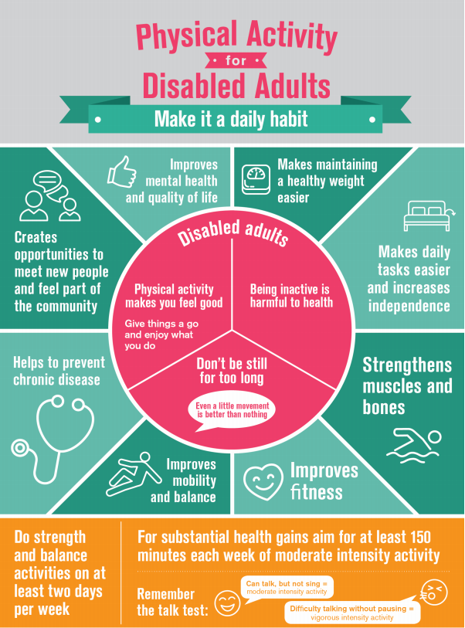
Notes:
Additional guidance documentation

Slide 11
Why are we bothered….
In the United Kingdom, physical inactivity is the fourth greatest cause of ill health with negative impacts on health, social and economic outcomes for individuals and communities.
It is responsible for 1 in 6 UK deaths, which is equivalent to smoking. Importantly, up to 40% of long-term conditions could be prevented if everyone met the UK Chief Medical Officer’s physical activity recommendations.
Physical inactivity costs the UK £7.4billion annually, costing the NHS £1 billion

Slide 12
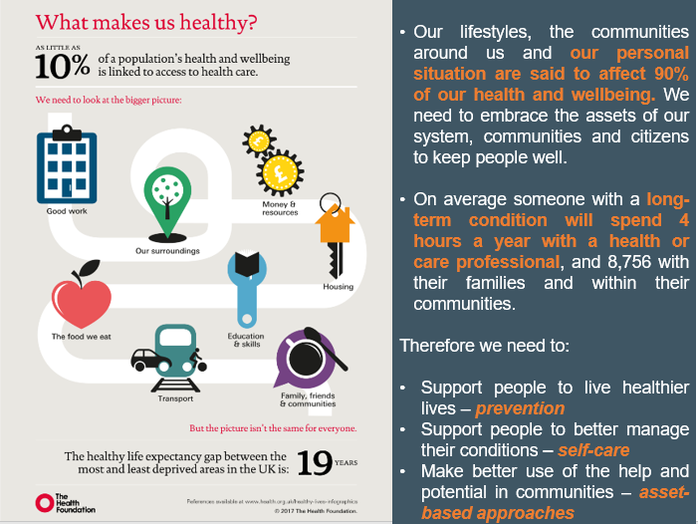
Notes:
Start with the 10%
So how could that possible look like from a PA perspective. We know that people are not going to become more active just because we tell them to do so. We know people need to be ready for change. So how do we get individuals to realise the benefits for the physical and mental health through increased activity levels without telling them to become more active, to live healthier lives and understand the importance of moving more and the impact it has on our lifespan – To enable them to live longer healthier?
And this is where you in your role can help support the wider determinates of health and incorporating daily physical activity.

Slide 13
Power of movement
We are undefeatable video - https://youtu.be/F6UBGjxw9QE

Slide 14
Long term conditions
One in 3 adults in England live with a long-term health condition and they are twice as likely to be amongst the least physically active. However, evidence shows that regular physical activity can help prevent or manage many common conditions such as type 2 diabetes, cardiovascular disease and some cancers. It also helps keep symptoms under control, prevent additional conditions from developing, and reduce inequalities.
Notes:
Physical activity is as good or better than treatment with drugs for many conditions, such as type 2 diabetes and lower back pain, and has a much lower risk of any harm. Physical activity can also benefit those who have MSK conditions. However, many people with MSK conditions often mistakenly believe that physical activity will make their conditions worse. The more conditions you have, the more you need to improve the core aspects of fitness.
It’s well known that if you have a long term condition being more active will help you to manage the condition more effectively and stop progression, leading on to other benefits such as lower medication use, less pain, and increased overall quality of life

Slide 15
LTC considerations when being more active
Start slowly and build up gradually.
Listen to body – Make the most of the good days
Don’t run before you can walk
Hydration – before during and after
Medication – take it, have it, understand it
Watch the joints/ balance
Notes:
the key thing here is, anything more than what you did yesterday counts

Slide 16
Notes:
Making Every Contact Count is about altering how we interact with people through learning how to recognise opportunities to talk to people about their wellbeing.
It aims to create an open environment where clients feel comfortable and able to address a number of issues other than that which they may have 'presented' with. It also encourages the professional to make connections and ask lateral questions, enabling them to signpost the resident to other services which may help with underlying or other related issues, which is at the core of social prescribing

Slide 17
Having a good MECC conversation is about
Spotting opportunities to talk to people about their wellbeing
Being able and confident to start a conversation about a wellbeing matter
Being able and confident to deal with any issues that arise
Quickly assessing the motivation a person has to take action to improve their wellbeing (e.g. taking a small step that will help them)
Providing information that will help the person decide what they want to do
Encouraging people to take actions to help themselves
Signposting to relevant services when required

Slide 18
Notes:
Moving Medicine is an initiative led by the Faculty of Sport and Exercise Medicine UK, in partnership with PHE and Sport England. It is a digital toolkit for clinicians and allied health professionals that is part of the Moving Healthcare Professionals programme, and has been developed in collaboration with experts, professional bodies and charities representing patients and healthcare professionals in each disease area. There is some really good content around having conversations and those small contacts to make a difference.
Lets have a look at a 2-3 minute conversation around diabetes

Slide 19
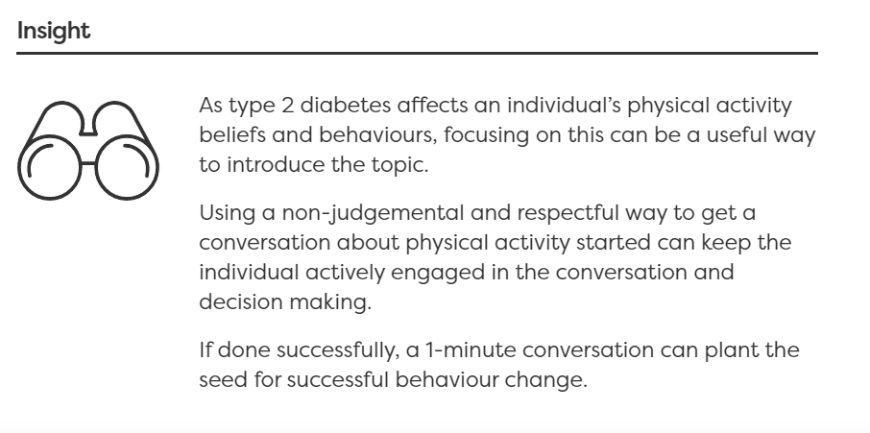
Notes:
Using non judgemental language and delivering it a respectful manner keeps an individual interested in that you have to say, its about planting the seeds for change you are not going to change someone there and then in that minute but it might start things turning for them

Slide 20
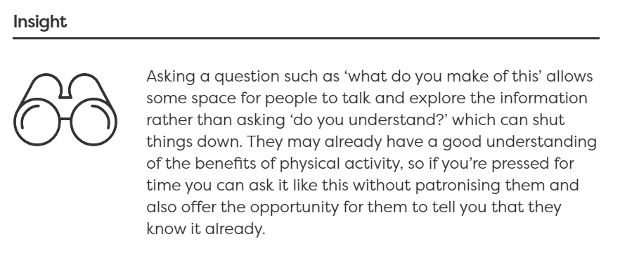
Notes:
How you ask a question allows the client to have some space to think and explore instead of you just handing over the information.

Slide 21
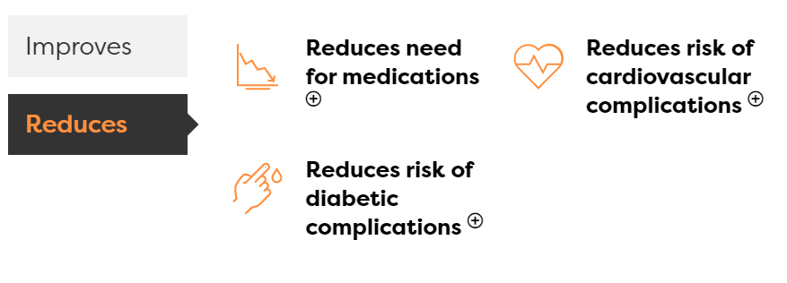

Slide 22
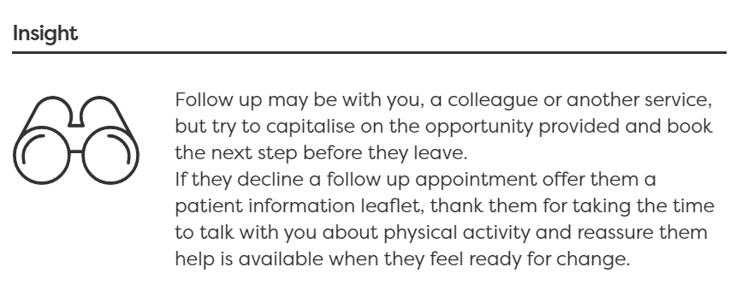
“In the meantime I could give you some further information to read if that would be of interest”
Patient info finder - Moving Medicine

Slide 23
Longer conversations
Open the conversation – Would you be happy to spend 4-5 minutes talking about something that can make a big difference to your future health and wellbeing?
Asses impact of the condition - How has your … affected your physical activity levels and the things you enjoy?
Find out what they already know - What do you know about the benefits of physical activity in people with …. ?
Share benefits - Can I share some other things people find beneficial to see what you make of them.
Encourage reflection - What do you make of what I have just said?
Make it personal - What would be the top 2-3 reasons for you personally becoming more active, if you decided to?
Summarise without adding - Can I summarise what I think you have said?
Ask the key question - So, what do you think you will do?
Agree a plan - Can I share with you some things people find helpful when making a plan?
Arrange Follow up - How would you feel about coming back another time to build on the thoughts and ideas you’ve shared with me today?
Signpost support - There are some great, free resources available here and on other websites by people who understand what it’s like living with your condition if you’d be interested to have a look
More examples - Find the right consultation - Moving Medicine

Slide 24
Barriers
“I JUST DON’T HAVE TIME TO EXERCISE”
“AFTER A BUSY DAY I DON’T HAVE ENOUGH ENERGY TO EXERCISE”
“GOING TO THE GYM IS SO BORING”
“I HATED PE AT SCHOOL, AND STILL DON’T LIKE EXERCISE”
“I’VE GOT FAMILY OBLIGATIONS”
“I DON’T WANT TO END UP INJURED”
“I CAN’T AFFORD TO GET INVOLVED IN EXERCISE CLASSES AND GYMS”
“I DON’T WANT TO BE SEEN TRYING OUT THINGS OR BEING LAUGHED AT”
“I DON’T REALLY KNOW WHERE TO START”
“I DON’T HAVE THE RIGHT EQUIPMENT OR CLOTHES”
“I’M SELF-CONSCIOUS ABOUT HOW I LOOK”
“I’M TOO OLD TO START EXERCISING”
“I`M TIRED AFTER WORK TO THINK ABOUT DOING ANYTHING ELSE”
Notes:
how many of these have we heard when we start talking to clients about trying to be a bit more active,

Slide 25
Lack of Time; Monitor activities for one week and identify at least three, 30-minute slots you could be use for physical activity. Select activities that you can fit into your home or work routine so you’re not wasting time, Walking around the local community, climbing stairs at the office or exercising while you watch TV are all good options.
Lack of motivation and/or energy; Plan ahead, schedule physical activity for specific times/days and then it can be checked off the todo list. Group activities or set classes help motivate and keep people accountable to attend.
Family obligations; Exercise with your kids -- go for a walk together, play tag or other running games, have a kitchen disco or a dance off, get everyone involved
Lack of resources/equipment - Select activities that require minimal facilities or equipment, such as walking, jogging, jumping rope or calisthenics. Identify inexpensive, convenient resources in your community, such as parks and recreation programs, worksite wellness groups, walking clubs, etc.
Tired; Find a time when your energy is at its highest, increasing the amount of physical activity you do will actually increase your energy. Do as much as you can. Every step counts. If you're just starting out, start with 5-10 minutes a day and add more, little by little.
Age; Fitness is just as important as you get older. Look upon your retirement as an opportunity to become more active instead of less. You may find that you have more time for gardening, walking the dog and playing with your grandchildren.
Notes:
Discussion; what responses would you come up with for the barriers
Don’t discount your everyday activities. You may be more active than you think. Housekeeping or mowing the lawn counts as activity. Being active is more than just planned exercise.
Starting slowly is important and so is choosing activities that you enjoy. Over time, the activities you do will get easier. You will even find that you can increase the duration and/or intensity.

Slide 26
LTC barriers/Considerations
pain before, during or after physical activity
feeling tired before, during or after physical activity
breathlessness before, during or after physical activity
lack of motivation
not knowing what types of activity are right for them or their condition
fear of hurting themselves
feeling embarrassed
feeling unsafe in public spaces
Notes:
People with long-term conditions experience both internal and external barriers to exercise. Internal barriers come from within those with long-term conditions themselves, and external barriers are factors external to those with long-term conditions, which make it harder for them to exercise and barriers around suitability, practicality and the logistics of the whole thing. Many people with LTC cite the barriers to being more active instead of seeing the benefits to being.

Slide 27
Wider impact of being more physically active
Notes:
In addition to supporting good physical and mental health and functioning, regular physical activity also contributes to a range of wider social, environmental and economic benefits for individuals, communities and wider society. Addressing physical activity can also benefit a broad range of wider priorities at a local level, such as reducing air pollution and increasing social cohesion.
Wider benefits come primarily from physical activities undertaken in a community setting such as walking, cycling, active recreation, sport and play. They include:
-improved learning and attainment
-increasing productivity in the workplace
-managing stress
-self-efficacy
-improved sleep
-the development of social skills
-better social interaction
The relevance and importance of these benefits vary according to life stage and other factors

Slide 28
Your place in all this…
increase your knowledge of individuals’, communities’ and populations’ needs related to physical activity
use the resources and the services available in the health and wellbeing system to promote physical activity
incorporate physical activity conversations and brief advice into routine care
understand specific activities or interventions that can prevent physical inactivity and signpost to their local offers
help create a culture and process of physical activity within their workplaces
providing high-quality brief interventions for physical activity behaviour changes
being familiar with the important messages
Notes:
healthcare professionals play a unique role in supporting people living with, or at risk of developing, long-term health conditions to get more physically active

Slide 29
Active Partnerships
Active Norfolk
activenorfolk.org
Ryan Hughes - ryan.hughes@activenorfolk.org
Living Sport
Livingsport.co.uk
Michael Firek - michael.firek@livingsport.co.uk
Active Suffolk
activesuffolk.org
Laura Spooner - laura.spooner@eastsuffolk.gov.uk
Team Beds and Luton
Teambedsandluton.co.uk
Johnathon Rudland - Johnathan@teambedsandluton.co.uk
Active Essex
activeessex.org
Kimberley White – Kimberley.white@activeessex.org
Herts Sport Partnership
Sportinherts.org.uk
Will Slemmings - w.slemmings@herts.ac.uk
Notes:
There are 43 Active Partnerships across England who work collaboratively with local partners to create the conditions for an active nation, using the power of sport and physical activity to transform lives.
By adopting a collaborative whole system approach, Active Partnerships seek to make active lifestyles the social norm for everyone and address the worrying levels of inactivity in society.

Slide 30
Signposting
We are undefeatable - Ways to Move - We Are Undefeatable
Canals and River Trust walking - Canal Walks | River Walks Near Me | Canal & River Trust (canalrivertrust.org.uk)
This Girl Can - Home Exercise - This Girl Can & WAYS TO GET ACTIVE - This Girl Can
Fishing - https://anglingtrust.net/getfishingforwellbeing
Walking - Walking for Health - Walking for Health | Home
Free Fitness - Get fit for free - NHS (www.nhs.uk)
Park Run Practice - https://r1.dotdigital-pages.com/p/49LX-52M/parkrunpractice

Slide 31
Further training and development
PHE, Health Education England and Sport England have developed a physical activity and health e-learning course, which is hosted on the e-Learning for Healthcare hub. The course covers;
-the UK CMOs’ physical activity guidelines
-the underpinning evidence base
-how to incorporate the guidelines into their daily clinical care
Physical Activity and Health - e-Learning for Healthcare (e-lfh.org.uk)
Physical activity in the treatment of long term conditions (bmj.com)

Slide 32
What Next….
Further evaluation on Knowledge and confidence
What would you like to see me cover?
Future planning of delivery
Disseminating of information – local and regionally

Slide 33
Final Thoughts
Every conversation you have with people about physical activity is important in supporting behavioural change over the life course
Brisk walking can be easily incorporated into everyday life for many people and is an acceptable form of physical activity
The least active individuals stand to gain the most from even a small increase in physical activity
Exercises shouldn’t be framed as six weeks, but forever. It only reinforces it as a short term thing
Being active can be as important as taking medications in mild to moderate depression and many long term conditions.

Slide 34
Thank you…
Kimberley.white@activeessex.org
Notes:
Please get in touch if you have any questions or want to know any more, we will be following up with a short exit survey around what we can do with next one of these to support you and what topics you would like to see.

