Slide 1
Funding
Lee Monk lee.monk@activeessex.org
Hollie Wood Hollie.Wood@activeessex.org

Slide 2
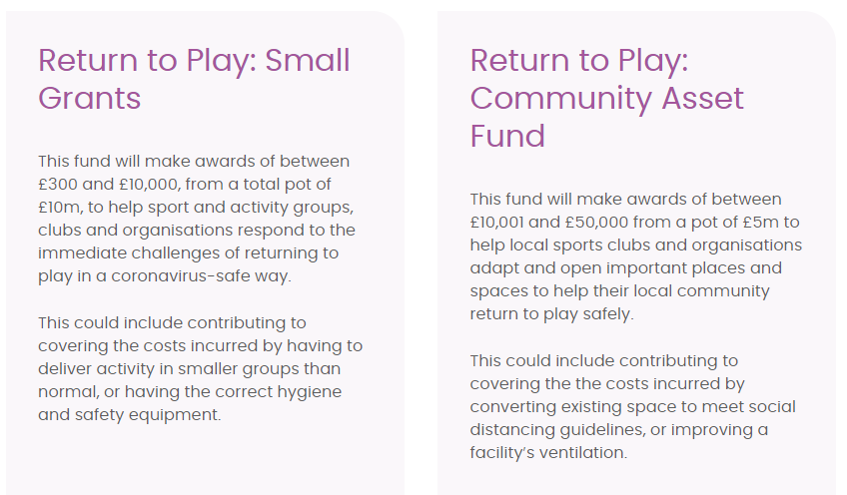
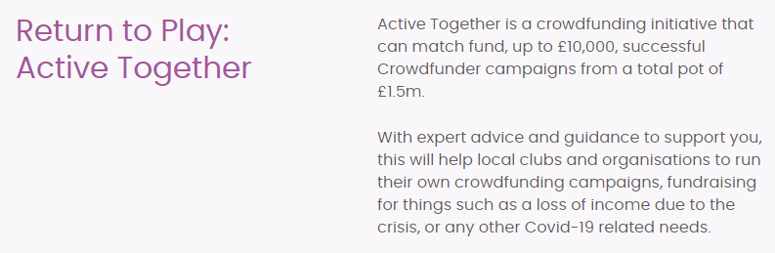
Sport England Return To Play Funding Opportunities
Return to Play: Active Together
Return to Play: Small Grants
Return to Play – Community Asset Fund

Slide 3
Grants for Essex Businesses and Organisations
Business Grants
There are 4 different business grants from central government that is being administered by local authorities that clubs maybe eligible for:
Businesses in the retail, hospitality and leisure sectors are to receive a one-off grant worth up to £9,000, the Chancellor has announced.(Announced January 5th)
Localised Restriction Support Grant – (Open) Businesses impacted while in Tier 2
Localised Restriction Support Grant – (Closed) Non-discretionary "National Lockdown" Grant
Additional Restrictions Grants- A discretionary scheme to help businesses which have had to close, or been able to trade, but have been severely affected by the COVID-19 restrictions, regardless of whether they pay business rates.
Businesses/ clubs are advised to read the questions carefully and follow the guidance on the form where provided – (some LA’s have reported that they are currently finding a high volume of businesses who have not completed their Business Rates Reference number on the form despite the instructions for this field being quite clear). Below are links to the 14 local authority’s business grants pages.
Basildon | Harlow
Braintree | Maldon
Brentwood | Rochford
Castlepoint | Southend
Chelmsford | Tendring
Colchester | Thurrock
Epping Forest | Uttlesford

Slide 4
Funding Opportunities
National Lottery Community Funds
Description: After being paused due to the coronavirus crisis, the National Lottery Awards for All, Reaching Communities, and Partnerships funding programmes are open for applications again.
Awards for All - a quick way to apply for smaller funds
Reaching Communities - apply for larger amounts of money to create positive change in your community
Partnerships - apply for larger amounts of money to create change in your across your community with other organisations
Application deadline: rolling

Slide 5
Funding Opportunities
National Lottery Grants and Resilience Loans for Heritage
This National Lottery funding is part of our ongoing commitment to support the UK’s heritage sector respond to the impacts of coronavirus (COVID-19), to adapt and thrive again.
The project funding – for grants between £3,000 to £100,000 – will provide financial assistance for organisations working with heritage to build their resilience.
The new interest free loans – available for sums between from £50,000 to £250,000 – are aimed at organisations looking to restart and develop their income generating potential.
Deadline: 14th February
Warburtons Families Matter Community Grants Programme
Description: Small grants are available for local projects, activities and organisations that have charitable aims and that will be of real direct benefit to families in England, Scotland and Wales. Application deadline: 08/02/2021
Made by Sport is raising awareness of the many Clubs in Crisis in reaction to the detrimental effect that COVID-19 has had on grassroots sports organisations and clubs up and down the country. To be in with a chance of winning up to £5,000 in cash support for your club, please visit the made by sport website here.
Mid and South Essex Community Partnership Grants
Description: Grants are available to voluntary and community organisations with health and social care links to help people in Mid and South Essex who have been affected by the coronavirus/COVID-19 pandemic. Application deadline: 27/01/2021

Slide 6
Funding Opportunities
Newby Trust - Covid-19 Fund
Description: The Trust has designated a Special Fund for smaller registered charities to provide support during the COVID-19 pandemic. Priority will be given to existing and recent grant recipients and to charities working in the areas of homelessness, food supplies, domestic violence, mental health, young people and older people.Grants of up to £5,000 may be made to cover core costs or to fund operational changes made in response to the crisis. Application deadline: rolling
Tesco Bags of Help - COVID-19 Emergency Fund
Description: Tesco Bags of Help has created COVID-19 emergency fund with a streamlined application and payment process. The single payment award of £500 will be made for organisations supporting vulnerable groups, as part of their emergency response in supporting local communities. Typically, the fund will support organisations who have experienced increased demand, disrupted services and been forced to set up new/adapted services. Application deadline: rolling
Tudor Trust
Description: Grants are available to smaller community-led groups that support people at the margins of society in the UK, encouraging independence, inclusion and integration. Application deadline: rolling
Grants for Grassroots Children and Youth Clubs
A grant of up to £500 to help with club reopening costs related to Covid-19 (applications open from 13/01/2021-22/02/2021)
Youth Covid-19 Support Fund
Description: The £16.5 million Youth Covid-19 Support Fund, which was announced in November 2020, is open to grassroots youth clubs, uniformed youth groups, and national youth and umbrella organisations, to help to mitigate the impact of lost income during the winter period due to the coronavirus pandemic, and ensure services providing vital support can remain open. Application deadline: 12th February

Slide 7
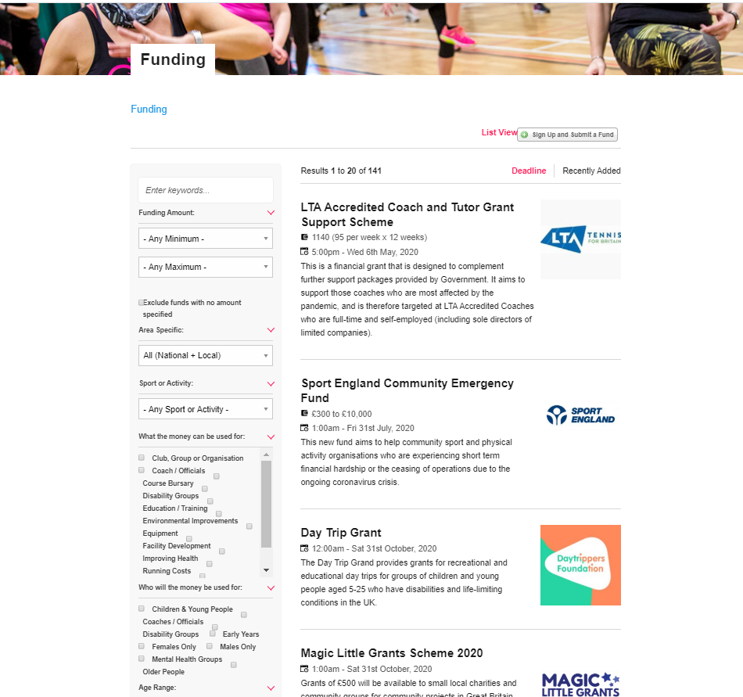
Funding
Check out the Active Essex funding finder here
The Charity Excellence Framework have a free COVID19 funder database which can be accessed here
Some National Governing Bodies have sport specific funds. We are constantly updating our funding finder but make sure you check your NGB website for the latest updates and sport specific funds.
Clubmatters have a number of resources and ideas to help you generate income and fundraise.

Slide 8
Fit for Funding Webinar
Fit for Funding (recorded May 2020) https://youtu.be/V-wYEE6dVkA
Listen to the recording of our fit for funding webinar
Aimed at sport, physical and mental health clubs, groups and organisations who currently offer, or are looking to provide physical activity opportunities to their local community.
On the webinar, we cover:
How to develop an effective funding application
The do’s and don’ts when applying for funds
Where to apply and what’s available (delivered May 2020)
Follow up support from Active Essex

Slide 9
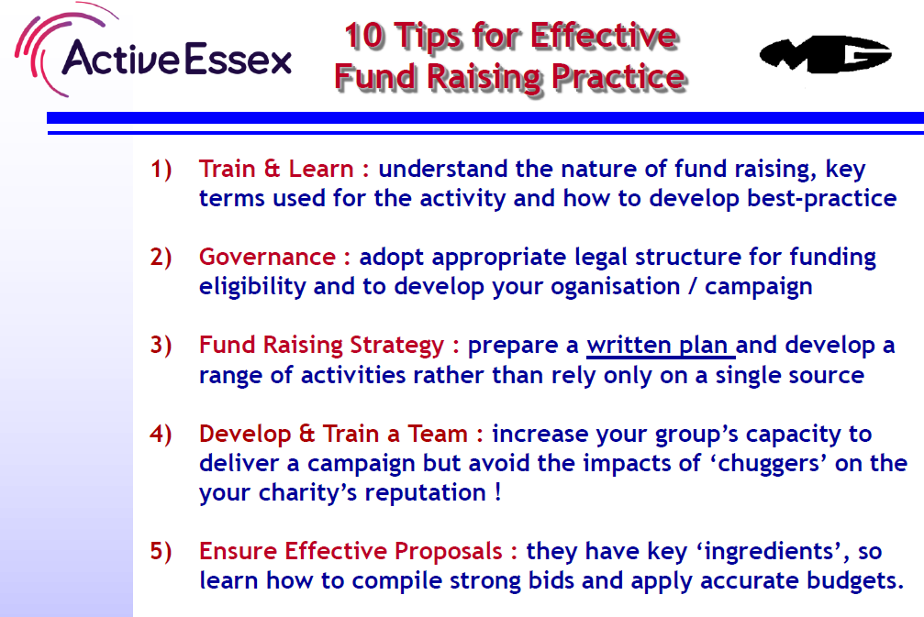
Funding

Slide 10
Funding

