Slide 1
Essex Local Delivery Pilot: Monthly evaluation update
December 2020
The University of Essex Evaluation Consortium

Slide 2
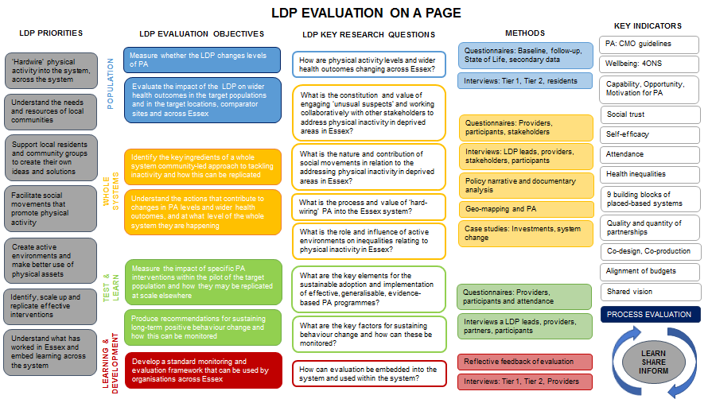

Slide 3
Contents
Actions from last time
Process evaluation and whole systems
Population
Test and Learn
Learning and Development
Recommendations and Actions
Further information

Slide 4
1. Actions from October

Slide 5
October Actions – LDP team (core, delivery)
Action | Status
Logic model for system level intervention/activities, e.g. ABCD, community Hub, Active environments- Tendring- ideally 1 month prior to start | None received as yet
Confirm when and how follow-up data can be collected from Essex Assembly | Awaiting details
Confirm date for workshop on reflections on process learning report | 15th Dec?
Any more recommendations for system level interviews for hard-wiring, active environment, social movements and unusual suspects research questions by 16th November | Ongoing
Discuss approach to mapping the system and confirm with evaluation by 23rd November | Awaiting details
Complete mapping of LDP activities/investments to LDP on a page | Ongoing

Slide 6
Key evaluation activities for October
Activity | Status
PEM evaluation commence and finalise remaining components | Elements started
State of Life launch | Survey is live
Workshop for Process Learning report | Core team leading
Conduct and analyse interviews with stakeholder in the whole system | Ongoing
Qualitative analysis for whole systems research | Ongoing
Further ‘closer look’ work about embedding evaluation | Ongoing
Collect follow-up data from Essex Assembly | Incomplete
Continue with Test and Learn data collection | Ongoing

Slide 7
2. Process evaluation and whole systems

Slide 8
Whole Systems evaluation
Qualitative analysis of interviews for four whole systems research questions ongoing
Evaluation of various ‘interventions’ in discussion stages (e.g., Additional Heritage grant, Pedal Power Essex, ABCD)
PEM
  All elements of evaluation are finalised and live (or ready for start of workstreams yet to start delivery)
Whole systems survey for core team is live

Slide 9
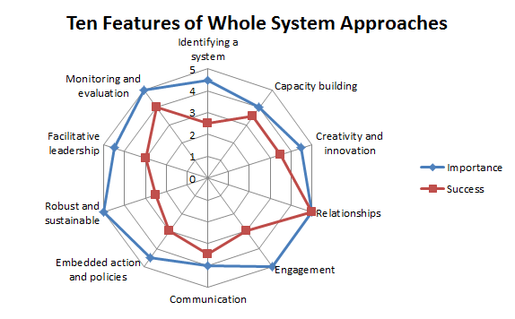
Core team whole systems survey (very preliminary results)
How important each feature is perceived to be for the Essex LDP whole systems work (5 = Extremely important)
How successful the Essex LDP has been in implementing each feature (5 = Extremely successful

Slide 10
Whole system recommendations
Logic models should be completed for all system level programmes/initiatives/interventions
The LDP team should produce a map of the system

Slide 11
3. Population

Slide 12
State of Life/Reference data
Over 600 responses since 19th November (over 3000 since April)
Majority from postcodes in Essex
Over 250 residents of Basildon, Colchester and Tendring (33% in IMDs 1-4) in November
Data collection will stop ~14th December

Slide 13
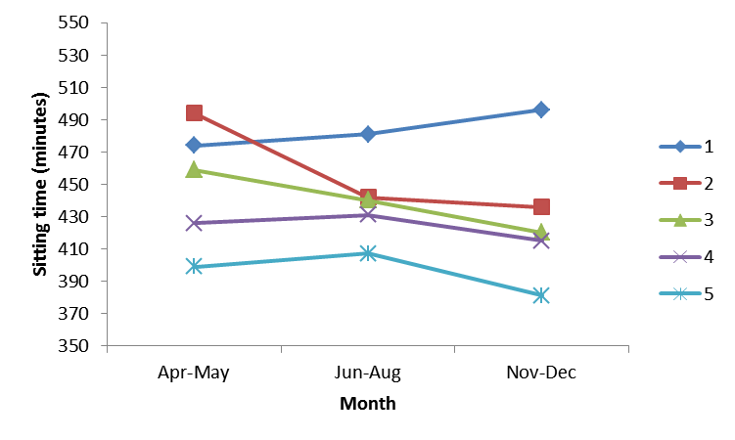
Preliminary finding – A trend for individuals in more deprived areas to spend more time sitting compared to individuals in less deprived areas.
Lines show deprivation quintiles (i.e., line 1 represents IMDs 1 and 2).

Slide 14
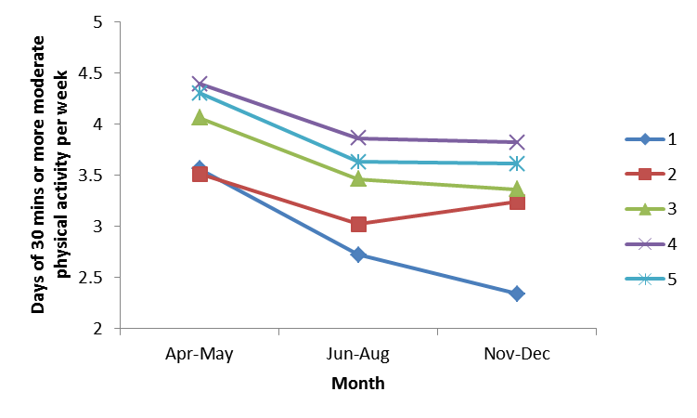
Trend in a similar direction for number of days of moderate physical activity per week but decrease appears greater in those in higher deprivation.
Lines show deprivation quintiles (i.e., line 1 represents IMDs 1 and 2).

Slide 15
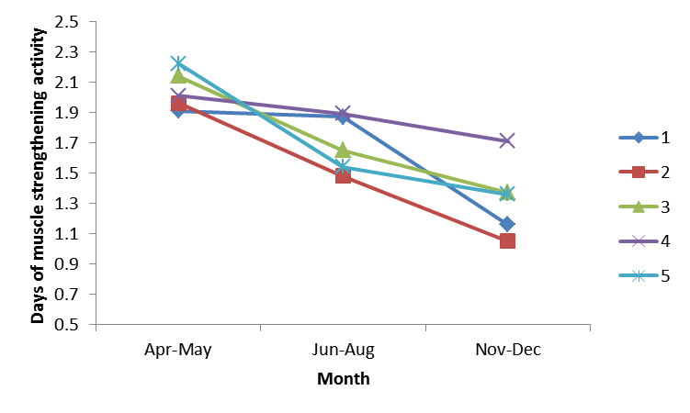
The pattern is less clear for muscle strengthening activity.
Lines show deprivation quintiles (i.e., line 1 represents IMDs 1 and 2).

Slide 16
Population Recommendations
LDP should continue to target areas of high deprivation (IMDs 1-4) to tackle physical (in)activity and reduce inequalities
LDP team should consider whether reducing sitting time is an explicit outcome of interest

Slide 17
4. Test and Learn

Slide 18
Providers report that microgrant investments are making a difference
“The improvement to mental wellbeing has been immediate and lasting, with some residents getting their first exercise in eight months as a direct result of this intervention.”
“Better balance and coordination noticed by staff.”
“One of the users, who is blind and has sensory issues with being touched, and has been unable to attend his twice-weekly trampoline sessions since March, appeared to become somewhat overwhelmed with happiness as soon as his body touched the trampoline.”
“The children have really enjoyed the sessions and the improvements which have been made can be seen in their other PE lessons and other areas of learning. We have seen an improvement in behaviour management.”

Slide 19
Higher level investments are benefitting from collaborative working
69% of interventions have been develop with organisations working in partnerships
On average, the lead organisation has worked alongside 4 other organisations
23% of partnerships are newly formed
Types of partnerships typically vary from working together as a formal team through to more informal arrangements but with common programme goals
Partnerships are typically rated as very-extremely effective

Slide 20
The benefits of collaboration
“Partnership working has been key to all aspects of planning and delivery for [intervention]. Genuine collaboration and coproduction is essential to make an impact on the system.”
“There are different perspectives and cultures but we have formed a strong and trusting relationship. In this last week, we have overcome some significant challenges together.”
“I had already aligned one of my senior staff to a [intervention], but now have plans for another one of my senior team to work hand in hand with the [partner organisation] lead on a day to day basis to increase our joint effort and capacity and galvanise an even more integrated approach.”

Slide 21
Test & Learn Recommendations
Essex LDP should continue to facilitate opportunities for organisations to come together to share ideas and best practice, with a view to forming partnerships to tackle physical inactivity.

Slide 22
5. Learning and Development

Slide 23
Embedding evaluation remains an issue
Co-production of evaluation plans is time-consuming
Receiving timely provider and participant responses remains a challenge with less than 50% of participants providing a true baseline

Slide 24
Evaluation reflections/learnings
Evaluation needs to be embedded early in process of developing interventions with clear governance process
Important for interventions to specify key outcomes, which are well defined
Reflective logs appear well accepted (especially in PEM) and could be used more widely
Key learnings from interventions are shaping future developments (e.g., Street Tag)

Slide 25
Learning and development recommendations
Evaluation should continue to be embedded and intervention providers encouraged and supported to provide data in a timely manner

Slide 26
6. Recommendations and Actions

Slide 27
Recommendations
Logic models should be completed for all system level programmes/initiatives/interventions
The LDP team should produce a map of the system
LDP should continue to target areas of high deprivation (IMDs 1-4) to tackle physical (in)activity and reduce inequalities
LDP team should consider whether reducing sitting time is an explicit outcome of interest
Essex LDP should continue to facilitate opportunities for organisations to come together to share ideas and best practice, with a view to forming partnerships to tackle physical inactivity.
Evaluation should continue to be embedded and intervention providers encouraged and supported to provide data in a timely manner

Slide 28
Actions – LDP teams
Advise on priorities for any bespoke evaluations by 15th January
Logic models for system level intervention/activities, e.g. ABCD, community Hub, Active environments- Tendring- ideally 1 month prior to start
Confirm when and how follow-up data can be collected from Essex Assembly by 19th December
Any more recommendations for system level interviews for hard-wiring, active environment, social movements and unusual suspects research questions by 19th December
Discuss approach to mapping the system and confirm with evaluation team by 19th December
Complete mapping of LDP activities/investments to LDP on a page

Slide 29
Key evaluation activities for next month
Analyse State of Life (Nov/Dec) data
Conduct and analyse interviews with stakeholder in the whole system
Qualitative analysis for whole system research questions
Further ‘closer look’ work about embedding evaluation
Collect and analyse follow-up data from Essex Assembly
Continue with Test and Learn data collection and analysis
Draft annual report

Slide 30
7. Further information
If you require any further information relating to the content of this report, or have any particular questions, please contact us using the details below:
Email: essexldpevaluation@essex.ac.uk

