Slide 2
Outline of Day
Welcome and introductions
Aims
Skills, Qualities and Knowledge of a Leader
Communication and Problem Solving Skills
Delivering a session to include IDEAS, STEP and SMILES
Planning A Session
Planning Time
Delivery of Activities
Summary
History of the Commonwealth Games
Commonwealth Games Legacy
Festival Planning

Slide 3
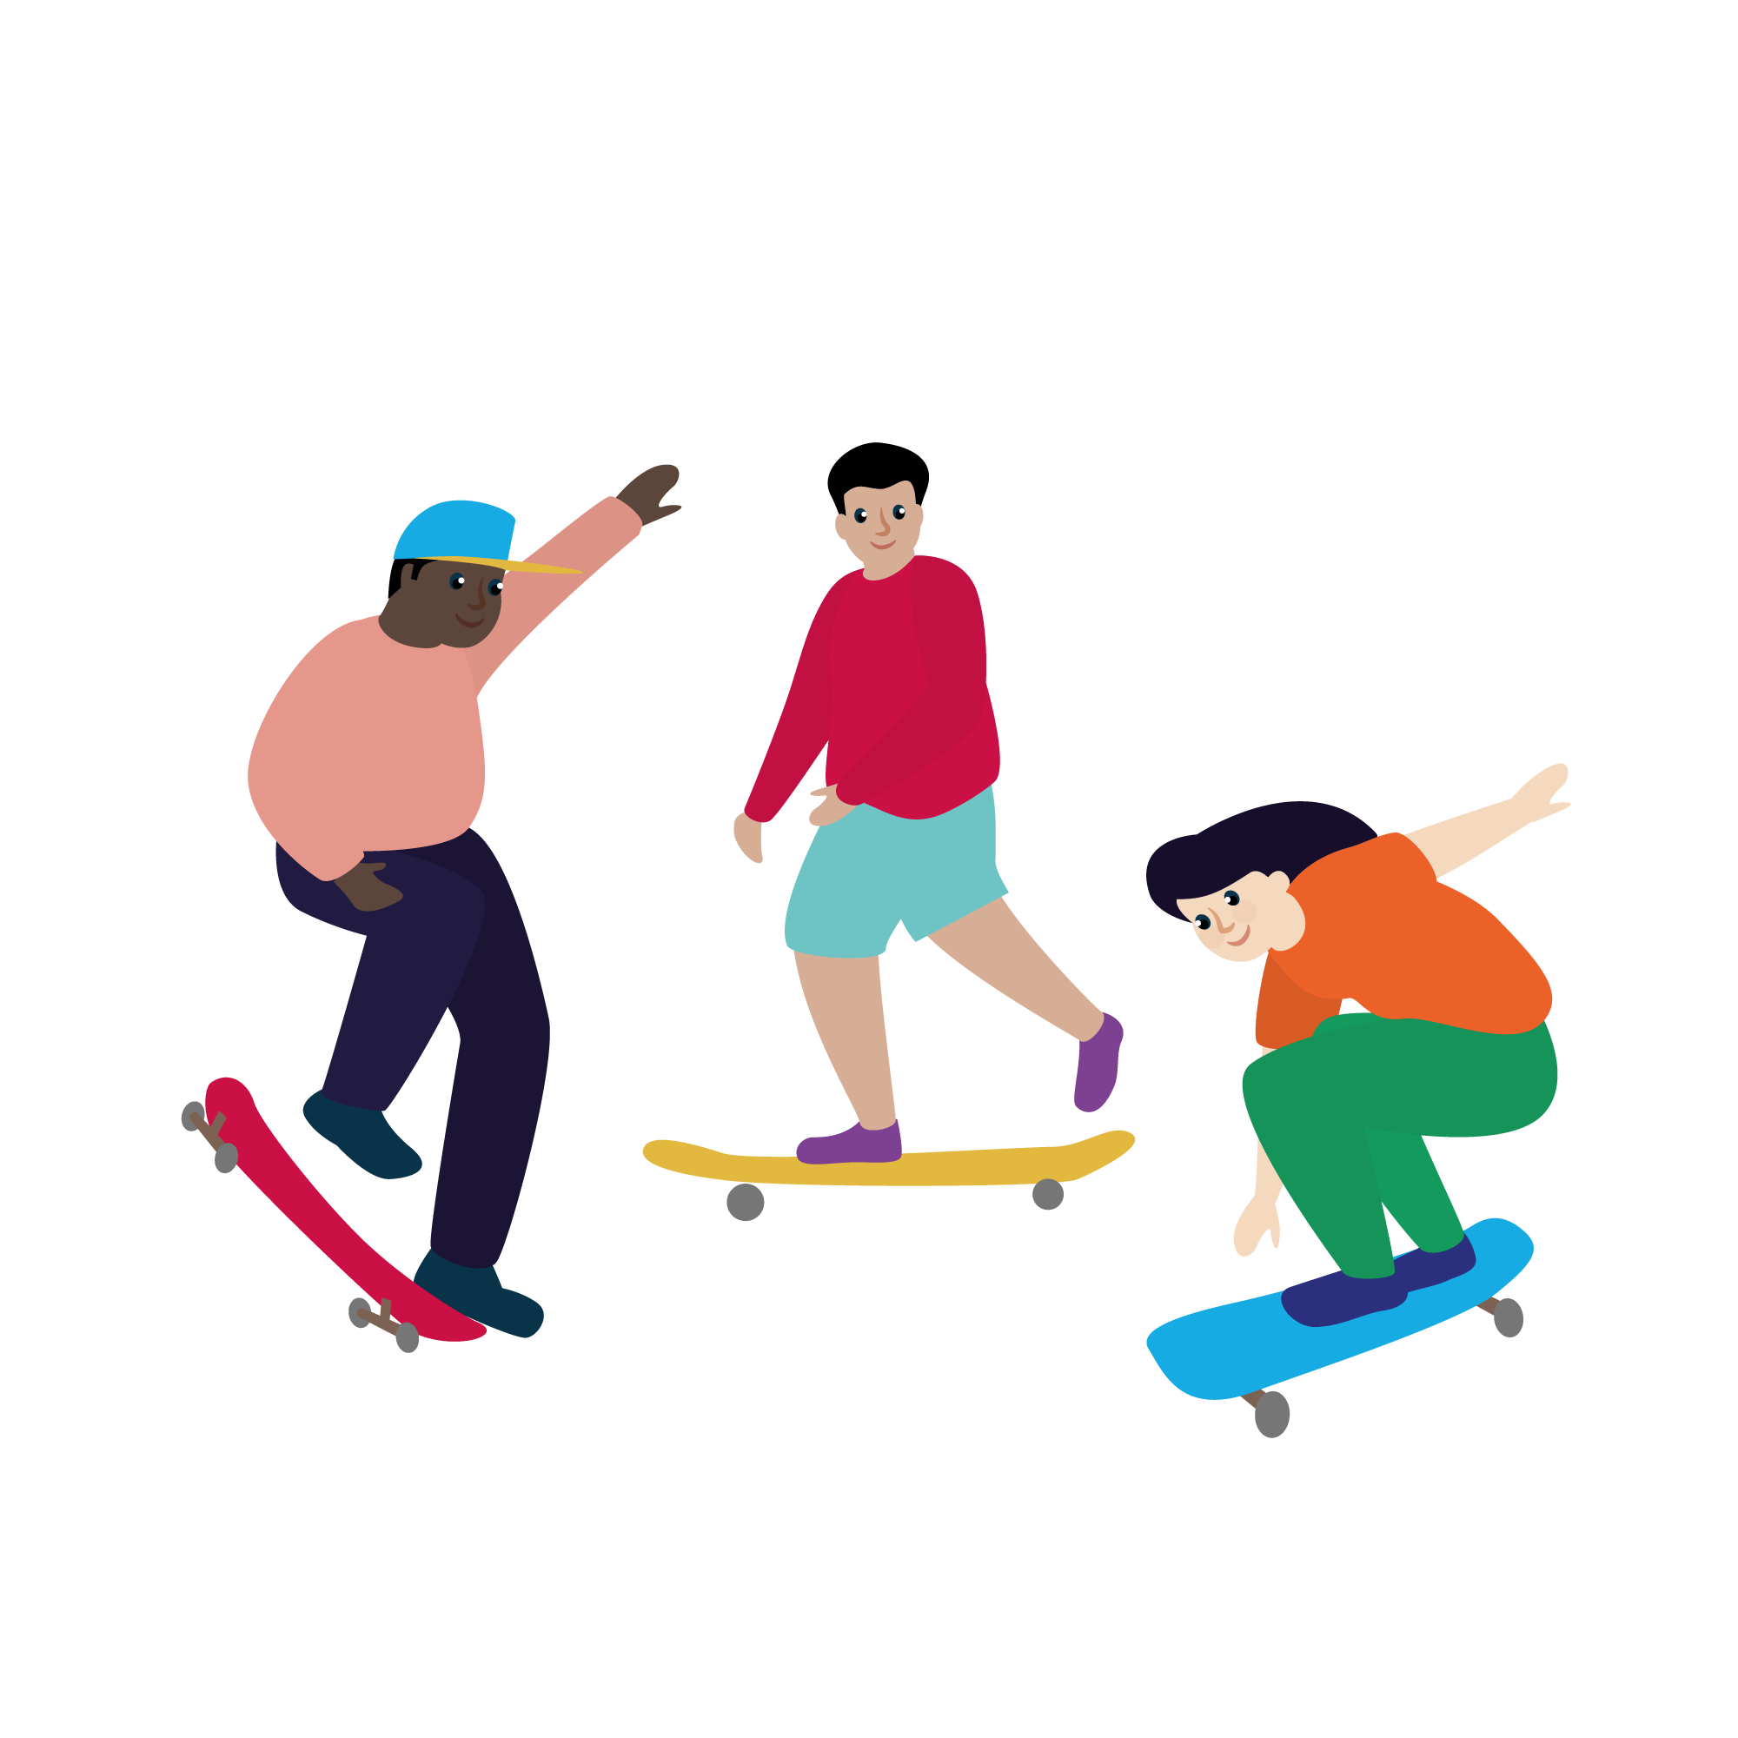
Icebreaker
What is your name?
What is your favourite sport or activity?
What is one interesting fact about yourself?

Slide 4
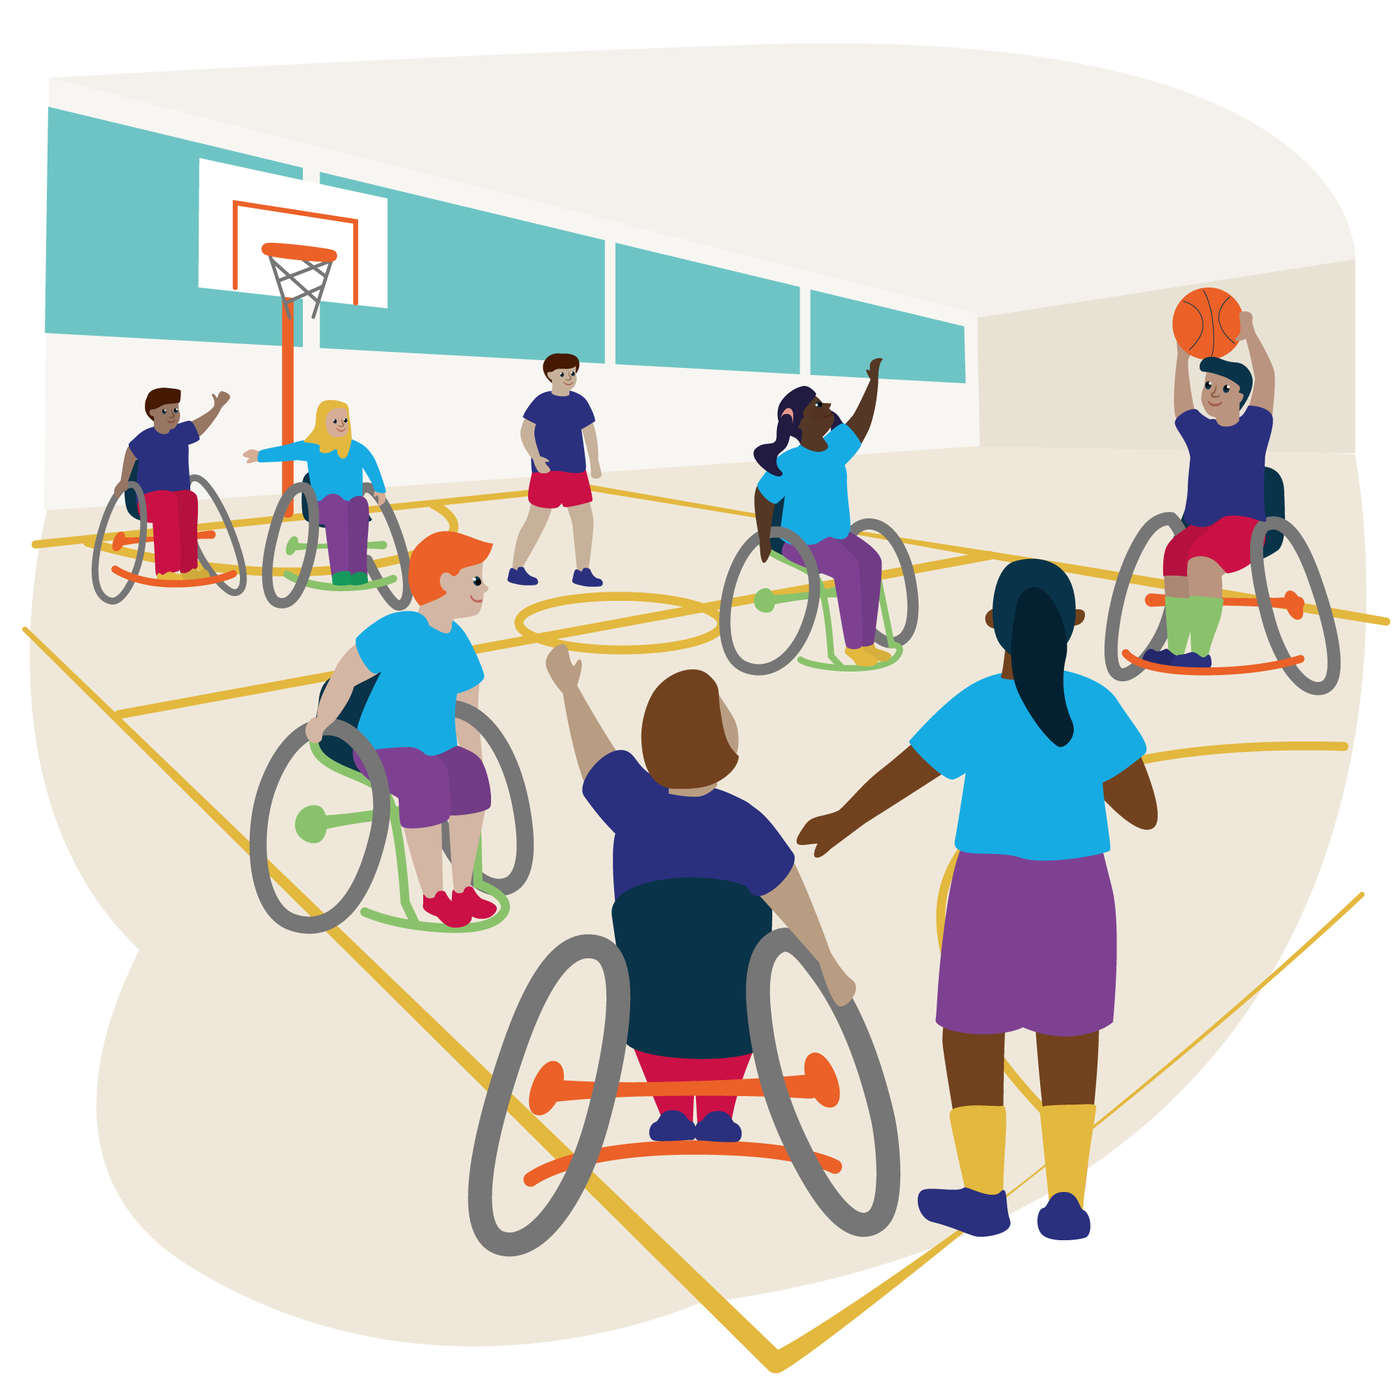
Aims
To develop knowledge and understanding of leadership skills
To be able to demonstrate leadership skills through the planning and delivery a Commonwealth Games themed festival for KS1/2 pupils

Slide 5
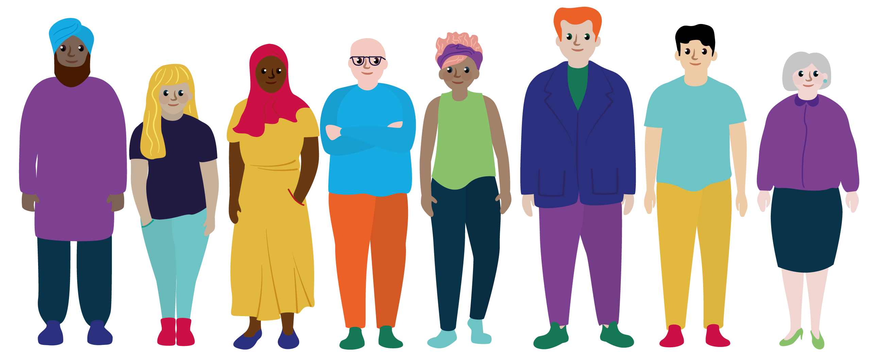
Skills, Qualities and Knowledge of a Leader
Task: In pairs, think of your favourite leader and make a list of their skills, qualities and knowledge. How many can you come up with?

Slide 6
How many did you get?
Skills and Qualities |  | Knowledge
Instruction | Communication | Rules
Demonstration | Organisation | Tactics
Observation | Adaptability | Techniques
Analysis | Compassion | Activities
Feedback | Honesty | Participants
Questioning | Ethics | Sport Pathway
Reflection | Teamwork | Local Competitions/Places to signpost participants
Can you think of any others?

Slide 7
Leadership Diamond

Slide 8
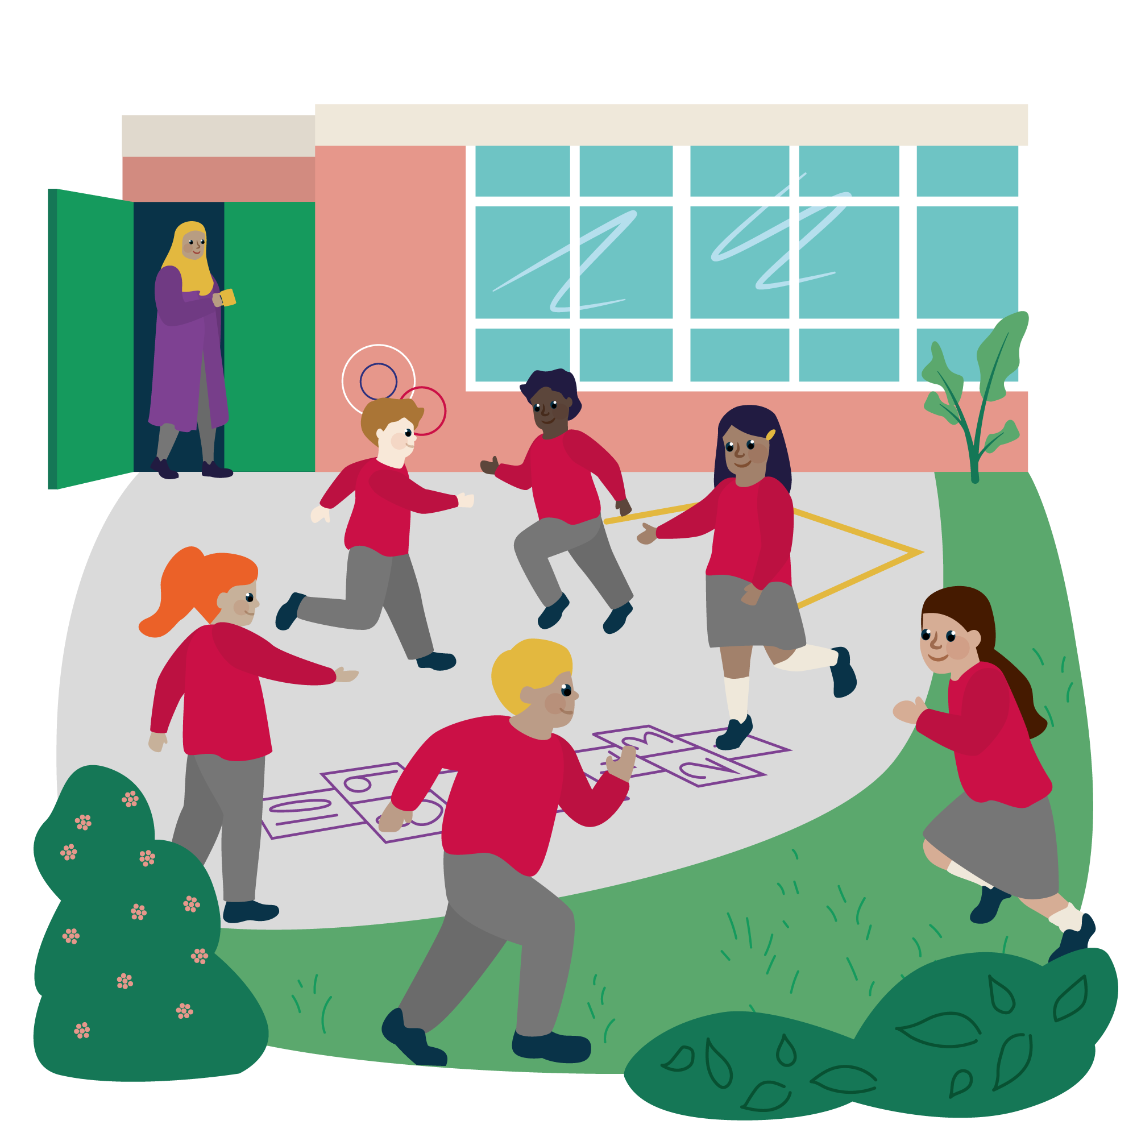
Communication and Problem Solving Skills
Stop the Game
Who Can Shout the Loudest
Bench Games
Cross the River
Human Knot
Moving the Ball from A to B

Slide 9
Using IDEAS to teach PE
Introduction
Demonstration
Explanation
Activity
Summary

Slide 10
Differentiation – the S.T.E.P. Principle
Space - Change the space; make it bigger / smaller / lower / higher / zone it
Task - Change the task; faster / slower / roll or bounce / walk / run / pairs / position / rules of the game
Equipment - Change the equipment; size / weight / shape / colour / texture
People - Change the people; size of team/ mixed gender/ mixed ability/ mixed mobility

Slide 11
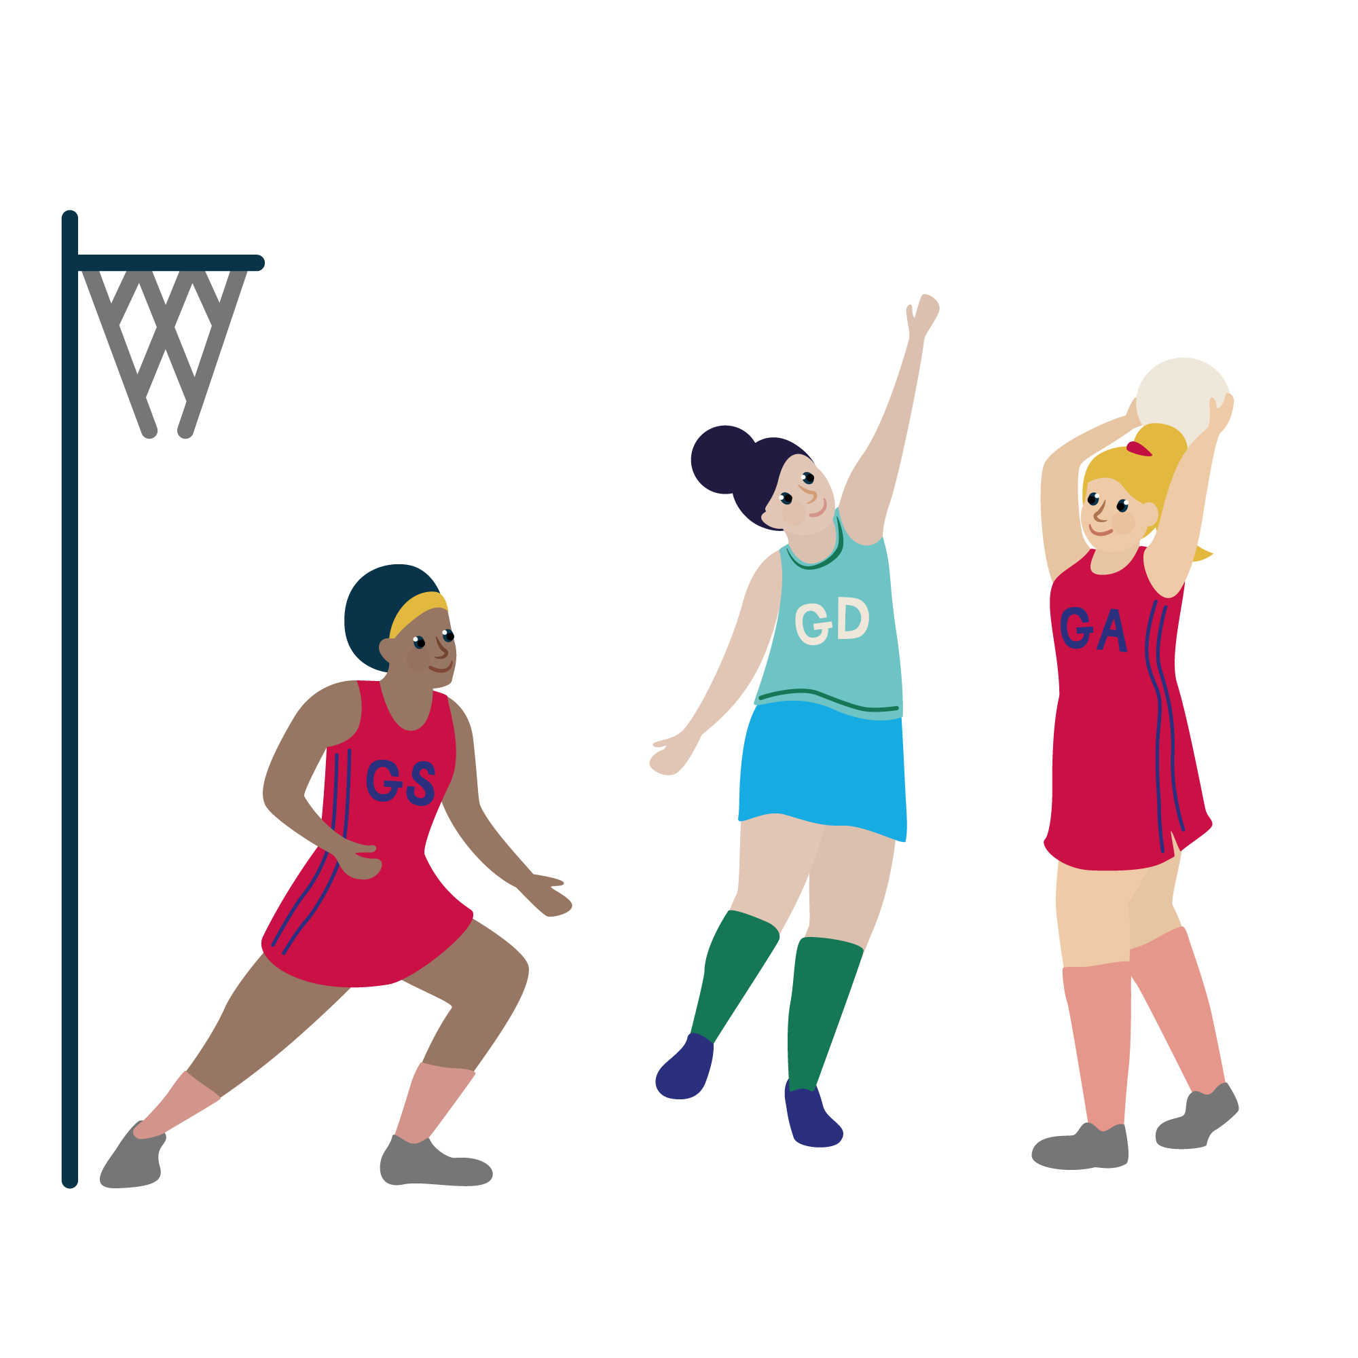
Evaluating Lessons - SMILES
Safety
Maximum Participation
Inclusion
Learning
Enjoyment
Success

Slide 12
Observation and Feedback
Instructions (were they clear?)
Use of names / demonstration (was it correct?/who demonstrated)
Questioning (did the coach ask questions/did the participants ask questions?)
Feedback (when was it given – straight away/during activity/at the end of session, was it suitable for those in the session?)
Positioning (could coach see everyone/did they move?)
Environment (What environment was created/was it right for the level of participant?)
Did all participants enjoy it?

Slide 13
Session Structure
Plan
Deliver
Review and Feedback

Slide 14
Planning a Session
Task:
With a partner, make a list of all of the things you need to consider before planning a session.
Some things to consider…
Who are you working with?
How old are they?
How many are there?
What is their skill level?
Where are you delivering your session?
What space have you got to work in?
What equipment have you got?
How long have you got?
Who have you got to support you?

Slide 15
Planning a Session
Task:
With a partner, make a list of all of the things you need to consider before planning a session.
Some things to consider…
Who are you working with?
How old are they?
How many are there?
What is their skill level?
Where are you delivering your session?
What space have you got to work in?
What equipment have you got?
How long have you got?
Who have you got to support you?

Slide 16
What things can we teach our pupils?
Example – Year 7 Football Beginners
Skills
Techniques
Tactics
Behaviours
Rules
Basic Laws of the Game
Positions and Pitch Markings
Fair Play and Sportsmanship
Safety
Fitness
Communication
Etiquette (Shaking Hands, Three Cheers)
How to Warm Up
How to Cool Down
Set Plays
Diet (incl. Fluid)
Passing Technique
Shooting Technique
Dribbling Technique
Tackling Technique

Slide 17
Planning Task
In pairs, you are going to have 15 minutes to plan a session using the template on the next slide.
Your session must include:
An introduction
A warm up activity
A skill activity
A game
Consider how you could adapt your session using the STEP Principle
You will be delivering your session to a group of your peers

Slide 18
Planning Task
In pairs, you are going to have 15 minutes to plan a session using the template on the next slide.
Your session must include:
An introduction
A warm up activity
A skill activity
A game
Consider how you could adapt your session using the STEP Principle
You will be delivering your session to a group of your peers

Slide 19
Delivery of Activities
Task:
In pairs, you are going to have 15 minutes to deliver your session.
Once you have finished you will evaluate your session using SMILES.

Slide 20
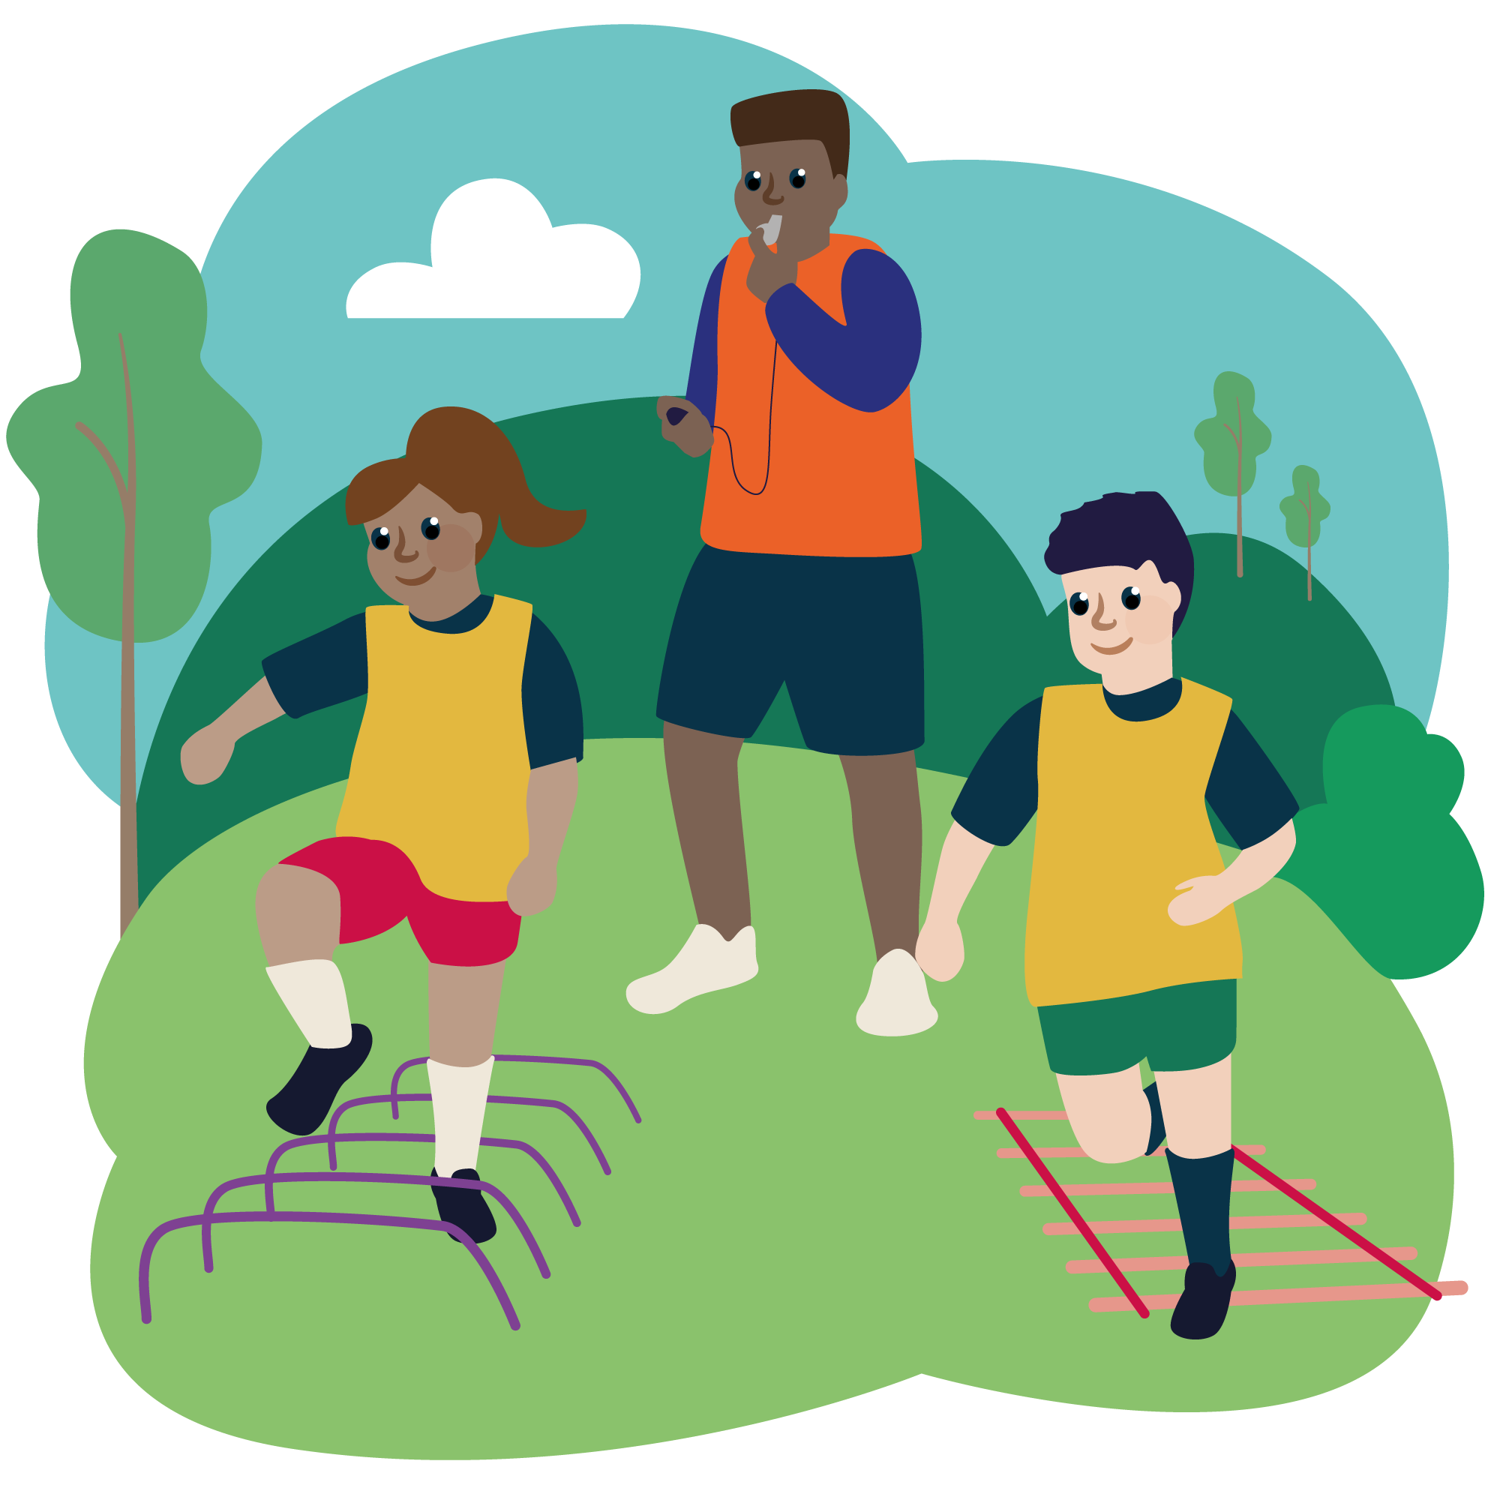
Summary
Task:
Write down three things that you have learnt about leadership.
What went well with the session that you delivered?
What could you do to make it better?

Slide 21
The Commonwealth Games – a brief history
Discuss in pairs or small groups what you know/understand/remember about the Commonwealth Games?
Why do you think it is an important event?
Where is the Commonwealth Games taking place this year?

Slide 22
The Commonwealth Games - a brief history
The Commonwealth Games bring nations together in a colourful celebration of sport and human performance. But the Games have evolved dramatically since its beginnings in 1930.
Held every four years, with a hiatus during World War II, the Games have grown from featuring 11 countries and 400 athletes, to a global spectacle of 6,600 sports men and women from across 72 nations and territories.
Underpinned by the core values of humanity, equality and destiny, the Games aim to unite the Commonwealth family through a glorious festival of sport. Often referred to as the ‘Friendly Games’, the event is renowned for inspiring athletes to compete in the spirit of friendship and fair play.

Slide 23
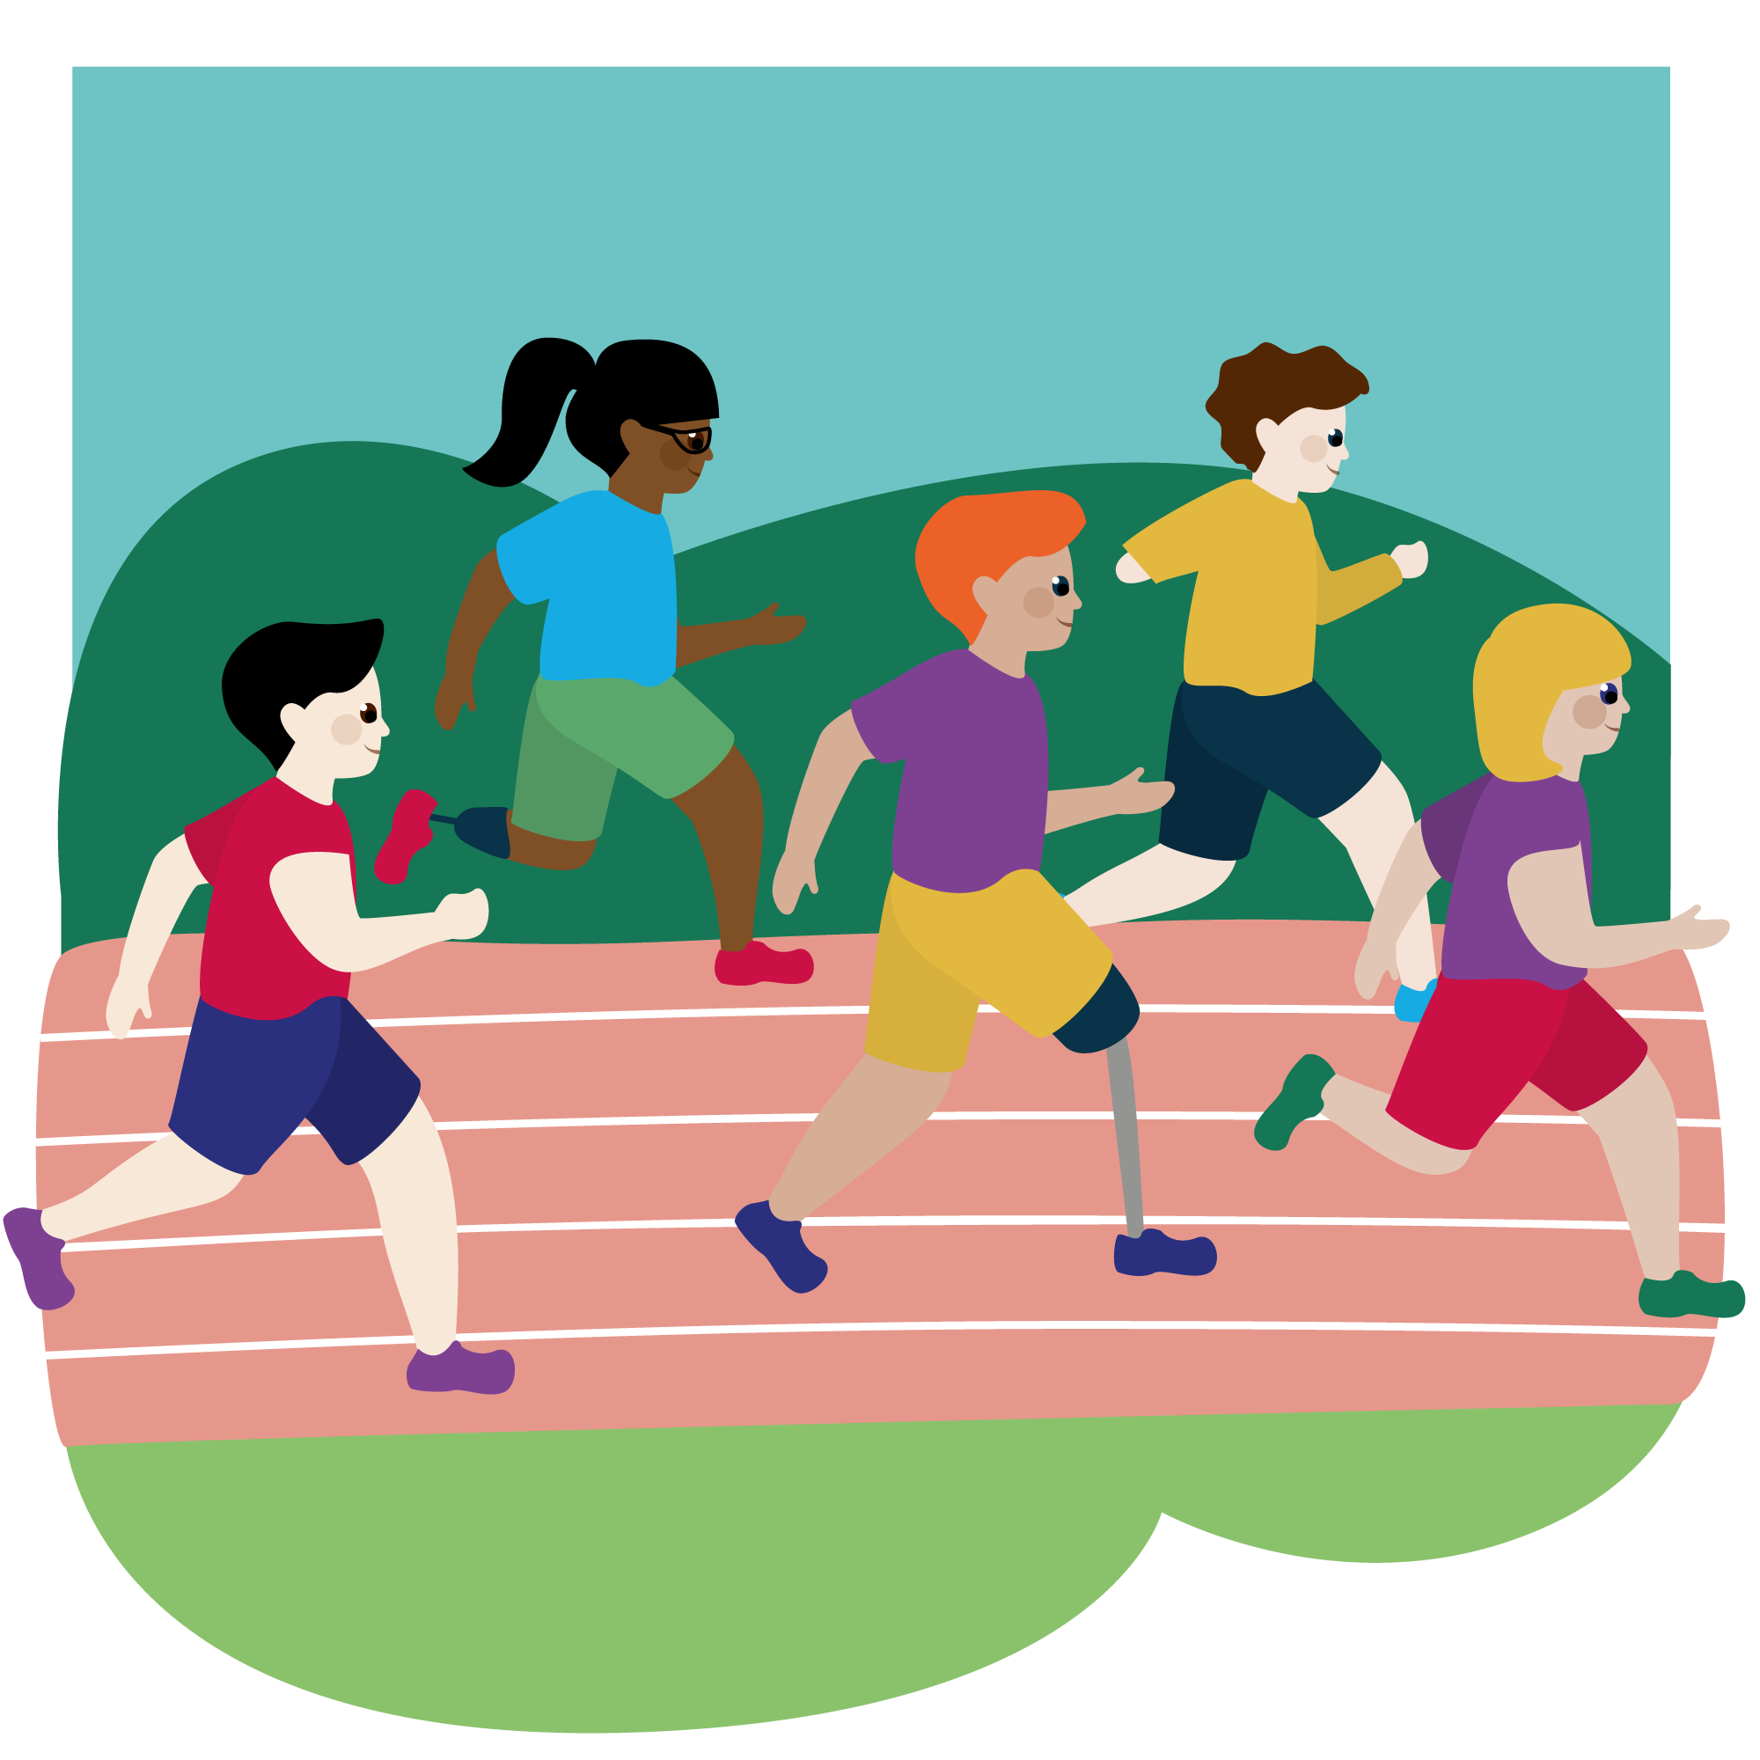
The Commonwealth Games - a brief history
Some of the most memorable sporting moments in history took place at the Commonwealth Games:
At the 1954 Vancouver Games, Roger Bannister and John Landy became the first people to break the four-minute mile in a race that became known as the ‘Miracle Mile’.
Chantal Petitclerc became the first gold medal winner in a para-sport in 2002. An occasion that marked the first time an event for an athlete with a disability had been part of the official programme.
And women’s boxing became a mainstay of the Commonwealth Games in 2014 with Team England’s Nicola Adams taking the first gold medal in the flyweight division.

Slide 24
Birmingham 2022 Commonwealth Games
The 2022 Games will be the first time West Midlands has played host to the event, following London 1934, and Manchester 2002. As preparations for the Birmingham 2022 Commonwealth Games take shape, the West Midlands become part of a lasting legacy. One that displays world-class teamwork, athleticism and friendship.

Slide 25
Commonwealth Games Legacy
Please discuss in pairs or small groups:
Which sports do you associate with the Commonwealth Games?
How could we use the inspiration of the Commonwealth Games in Birmingham to motivate young people to become more active?
What does the Commonwealth Games being in England mean to you ?

Slide 26
Your Challenge!
We would like you to plan, organise and deliver a Fun and Active Festival for either:
Younger students at your school
Children in your local area if you are part of a local SSP Academy
The festival should bring together all of the skills you have covered in the course and MUST be themed around the Birmingham 2022 Commonwealth Games.

Slide 27
Festival Planning
What will you need to consider in the planning of your festival? Please cover this topic in detail.
How will you embed the Commonwealth Games Legacy as a theme throughout the festival?
What are your aims for the festival? What would you like the young people to gain by attending?

Slide 28
Festival Planning
Possible things to consider:
Date, time , location and duration
Key people to liaise with
Roles and responsibilities – who will do what ?
Space and equipment required
Ages of the participant and how many can you accommodate
Health and safety considerations
Content – what activities? How will you theme it around the Commonwealth Games?

Slide 29
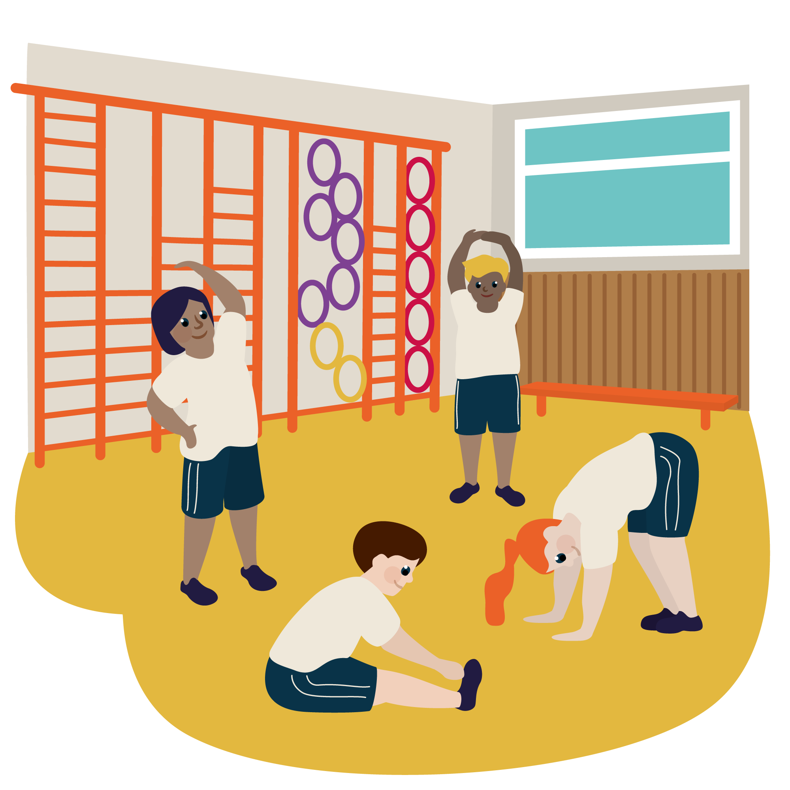
Festival Planning
Plan the Festival as a group
Allocate each member of your team a ‘station’ to plan and run. Try these activities out on each other. Will they achieve what you want?
Give each other feedback and support
Deliver the Festival! Have a great time and remember to reflect!

