Slide 1
PE and School Sport Updates
Steve Bish

Slide 2
Funding announcement – 8th March 2023
Over £600 million of ‘ring-fenced’ funding confirmed to continue the Primary PE and Sport Premium grant over the next two academic years (2023-24 and 2024-25)
Two further years of funding for the School Games Organiser national workforce – including a greater emphasis on School Games Mark
A recommendation for schools to provide 2 hours of curriculum PE
A focus on equal access
£57 million of Opening Schools Facilities funding confirmed

Slide 3
Primary PE and Sport Premium – reminders
- Increased confidence, knowledge and skills of all staff in teaching PE and sport
-Engagement of all pupils in regular physical activity
-The profile of PE and sport is raised across the school as a tool for whole school improvement
-Broader experience of a range of sports and physical activities offered to all pupils
-Increased participation in competitive sport

Slide 4
Primary PE and Sport Premium – reminders
- Online reporting
You must publish details of how you spend your PE and sport premium funding by 31 July 2023 at the latest.
Online reporting must clearly show:
the amount of PE and sport premium received
a full breakdown of how it has been spent or will be spent before of the end of the academic year
the impact the school has seen on pupils’ PE, physical activity, and sport participation and attainment
how the improvements will be sustainable in the future

Slide 5
Barclays Girls' Football School Partnerships
The Barclays investment will give girls the best chance to experience football in the PE curriculum, as well as the opportunity to participate, lead and compete – giving them the equal access to our much-loved national game as most boys currently enjoy.
-More girls being physically active with improved wellbeing
-Embedding girls’ football in secondary schools
-The growth in the women’s and girls’ football workforce
-Making the game more inclusive for all
-Collaboration with existing local football providers.

Slide 6
Barclays Girls' Football School Partnerships
Get involved , sign up
www/girlsfootballinschools.org
Vision:
Every girl has equal access to football in school by 2024.

Slide 7
School Games

Slide 8
School Games
What does this mean across Essex?
Essex School Games Strategy
14 School Games Organisers working with local areas
An annual county calendar of events, competitions and festivals
Active Essex strategic and operational role to support SGOs.
Wider links to the Essex wide CYP strategy
Support for School Games Mark applications (window is open)

Slide 9
3 Pillars Underlying all Work
Physical Literacy
Tackling Inequalities
Co Design

Slide 10
The 5 Outcomes

Slide 11
Daily Mile
What is it?
Aims at encouraging schools to get children running, jogging or walking 1 mile a day
No training or equipment needed
Free resources for latest campaigns for children to complete
What are the benefits?
Social, competitive and inclusive to all
Reenergises concentration levels
Improves fitness and promotes healthy weight
It’s simple, safe and fun!

Slide 12
Daily Mile
What free resources do you get?:
Maps, fact sheets, posters, stickers and achievement stickers
Essex Daily Mile Key Findings (schools):
90% identified improvement in physical health
90% identified improvement in mental wellbeing
80% improvement in levels of concentration
80% improvement in teacher pupil relationships

Slide 13
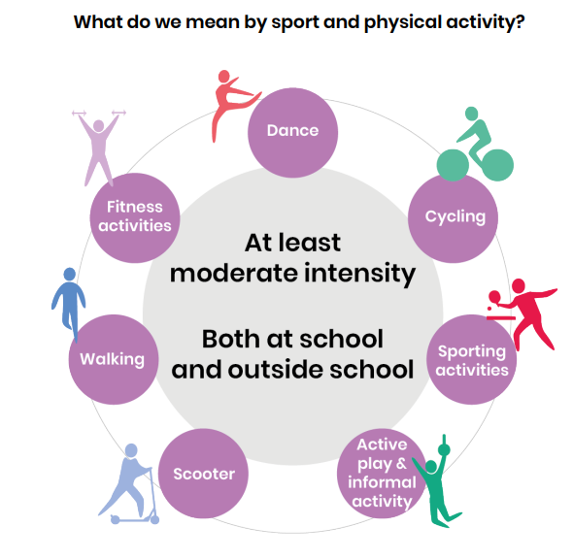
Active Lives Survey
Why is it important?
Crucial for providing on how children engage with sport and physical activity
Help understand children's attitudes and behaviours around sport and activity
42.5% of children in Greater Essex are active on average for 60 mins or more each day
The report tells that that children and young people that are physically active:
Feel happier and experience more enjoyment taking part in sport and PA than less active children
Feel safer and less lonely than less active children
Have higher motivation to achieve
Report higher school attainment levels
Next Deadline:
Friday 21st July
Notes:
How we can work together:
Provide the contact details for the schools selected
Help promote and explain the importance and benefits (Provides access to The Healthy Schools Rating Scheme)
Direct schools to our website or my contact details

Slide 14
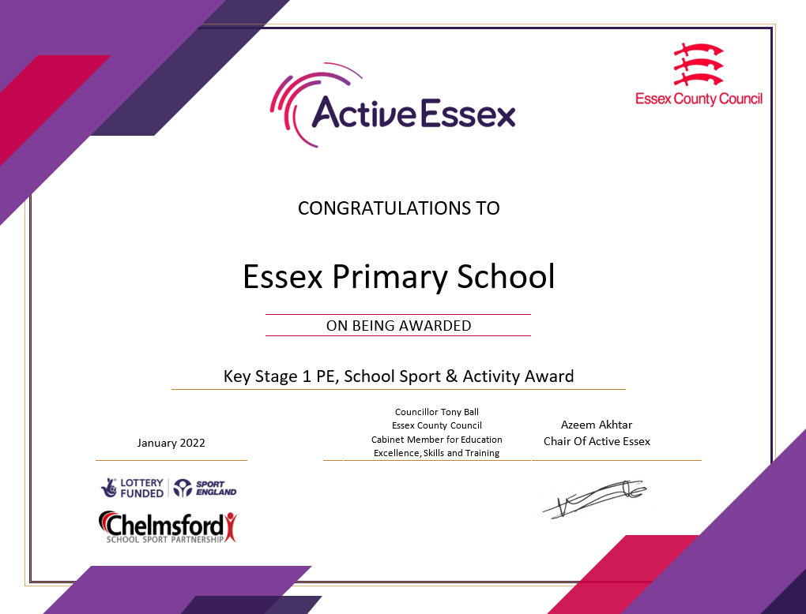
KS1 Physical Education, Sport & Activity Mark
The award officially recognises excellence in delivery of physical activity, school sport and physical education in Key Stage 1
Complementing the Youth Sports Trust School Games Mark, this is a rolling application and schools can apply for the Active Essex Key Stage 1 Award at any time of year. There are two panel review periods, Autumn and Summer half term, once approved this award will be valid for 2 years. Your school will receive a framed certificate and digital logo.
Your school can apply here.
The deadline for applications is November 2023.

