Slide 1
PE Deep Dives
Matt Atkins
9th June 2023

Slide 2
Aims/Learning Intentions
Develop knowledge and understanding of the Ofsted Subject Review and Ofsted PE Deep Dives.
Consider the relevance and relationship between the 3 I’s in your school context.
Identify next steps to move PE forwards in your setting.

Slide 3
Outline of Session
Ofsted PE Review
Overview of the Deep Dive Process
The 3 I’s
Key Considerations
Ofsted Myths
Next Steps

Slide 4
Ofsted PE Review
(March 2022)

Slide 5
Key findings from Ofsted PE Review 2022
PE for All
Competence –The aim of high-quality PE is not to create Elite Performers, but to enable all pupils to flourish.
Fundamental Movement Skills
Learning takes time- It’s important that the curriculum provides enough opportunity for pupils to master intended knowledge.
Content and Sequencing – Content needs to be sequenced so that pupils can develop their schema by building on secure pre-requisite knowledge.
Teaching Novices – Most pupils should be treated as novices.
Modelling – Teachers should provide concrete examples when demonstrating what success looks like.
Practice – Pupils require lots of repetition to learn intended movements and should not move on too quickly.
Feedback – focus on what’s going well and how to develop.
Competition – Competition can be useful but needs careful consideration.

Slide 6
Overview of the Deep Dive Process
The Deep Dive includes the following elements:
Discussion with Senior Leaders
Discussion with PE Lead
Visits to a sample of lessons
Work scrutiny
Discussions with teachers
Discussions with pupils

Slide 7
Intent (Curriculum)
Broad and Ambitious for ALL
Meets the aims of the NC
Considers Context
Quality content
Well sequenced
Enables pupils to Know more, Remember more and Do more

Slide 8
Pillars of Progression
MOTOR COMPETENCE
RULES, TACTICS AND STRATEGIES
HEALTHY PARTICIPATION

Slide 9
Types of Knowledge
Declarative Knowledge – Know what
Procedural Knowledge – Know how

Slide 11
Some questions on Intent
Is your curriculum logical, sequenced and progressive?
Is it inclusive?
Is it broad and balanced or are you narrowing it for some reason?
Is your curriculum owned and understood by all parties?
Are additional staff used in the right way?

Slide 12
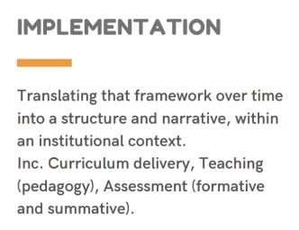
Implementation -
‘how you deliver/provide
that plan’
Breadth, Depth & Ambition in action!
Competence of pupils
Teacher Expertise
Theme/Scheme/Stimulus
Subject Leadership
Performance vs Learning

Slide 13
Implementation - Pedagogy and Assessment
Pedagogy
High Quality Instruction – teaching styles, models.
Purposeful Practice
Feedback
Assessment
Fit for purpose
Identify where pupils are at
Inform planning and teaching to get pupils to intended destination

Slide 14
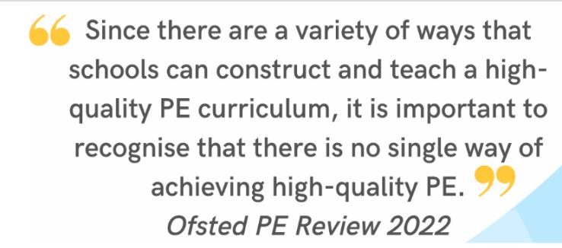

Slide 15
CONTENT SEQUENCING
Are links made between knowledge? How?
ASSESSMENT
How are expected outcomes judged? How is this translated to all?
CURRICULUM DESIGN
Does leaning link? How? Why?

Slide 16
Some questions on implementation
Do your teachers have good subject knowledge?
Are your teachers confident to deliver high quality PE and adapt their teaching to pupils’ needs?
How do you provide support for staff teaching outside their area of expertise?
Is your teaching designed so that pupils build on previous learning?
How do you monitor pupil progress?

Slide 17
Impact

Slide 18
Some questions on impact
Does your curriculum develop pupils’ knowledge, skills and understanding of…
Motor Competence?
Rules, Tactics and Strategies?
Healthy Participation?
Does your curriculum ensure that pupils know more, can do more and remember more?
How do you track pupil progress?
Does your curriculum prepare your pupils to lead healthy, active lives?

Slide 19
Key Considerations
Context
Justifications
Breadth and Depth

Slide 20
Ofsted Myths
Intent', 'implementation' and 'impact' won't be judged separately
Ofsted doesn't specify how you should lay out curriculum or lesson planning, how long it should take or the detail it should go into
You don't need to provide individual lesson plans
There doesn't need to be a particular frequency or quantity of work in pupils' books
Ofsted won't grade individual lessons, teachers, or books
You'll be judged fairly for taking a radically different approach to the curriculum, as long as it's got appropriate coverage, content, structure and sequencing and you've implemented it effectively.

Slide 21
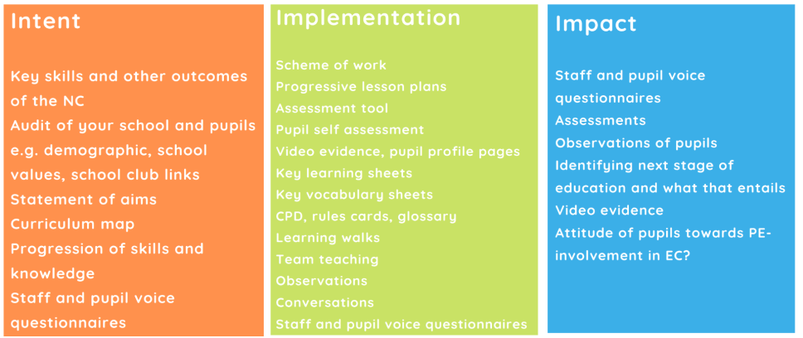
Next Steps

