Slide 1
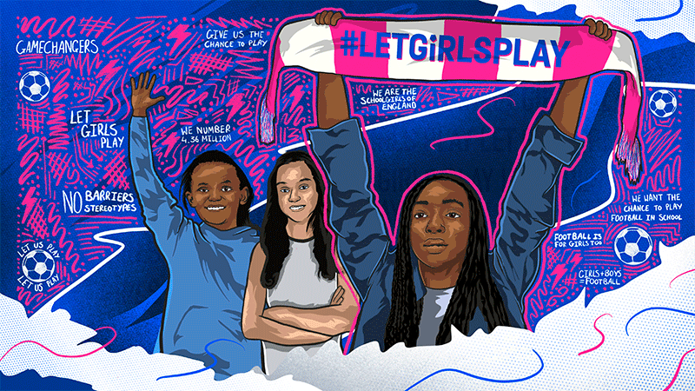

Slide 3
What is it?
The Girls' Football in Schools website provides a space for teachers and school staff to access free exclusive digital resources, CPD and much more to give girls equal access to football in schools by 2024.
Who can take part?
Any school in England can register and sign into the website. So, what are you waiting for? Complete these easy three steps:
1 Register to the correct programme for your school
2 Pledge to offer girls equal access to football within your school click here (you need to register on the correct programme above before you can pledge)
3 Book on to upcoming training dates https://girlsfootballinschools.org/
Email us at cyp@activeessex.org if you require any help or information
Primary |  | Secondary
Click image above or this link |  | Click image above or this link
Girls aged 5-11 can now unlock their imaginations with the magic of Disney inspired Shooting Stars at school! |  | A physical and digital resource to support schools to set up an extra-curricular football offer for girls in KS3.

Slide 4
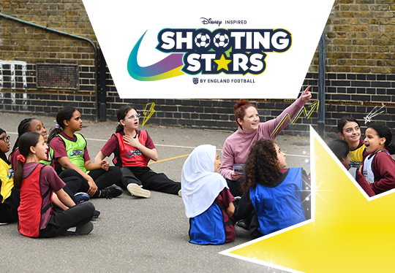
For Primary schools
All of the Shooting Stars resources and recordings are online so that you can work through them at your own pace.
New training has been designed to upskill practitioners on how to use the Marvel Inspired Shooting Stars SEND resources to engage more young people with SEND in football within their school setting. The resources have been developed in consultation with YST Lead Inclusion Schools with the aim of specifically engaging more young people with SEND in physical activity and football.
In addition to this a Disney Inspired Shooting Stars SEND online session is taking place on:
-Tuesday 6th February from 3.30-5.30pm- Link to book
-Tuesday 14th May from 3.30-5.30pm – Link to book
Disney inspired Shooting Stars, brings girls’ favourite stories from the screen to your playground.
Be one of the first 500 schools to complete your training (by 31 December 2023) to receive a free bundle of limited edition ‘Ella - A Modern Day Fairytale’ books for your cohort.

Slide 5
Barclays Game On: Go Teach for secondary schools
Barclays Game On Teacher has been designed to support teachers to develop a new approach to delivering PE in their schools through a life skills focus. Barclays Game On Teacher training will focus on exploring how teachers can engage girls in curriculum physical education through football, identify and develop life skills and support girls to be empowered to lead football-related activity for others. It will be delivered by members of the YST Learning Academy.
This programme is being delivered virtually through Zoom and may be recorded for future YST and FA programme development and staff training purposes. Please ensure you read the Youth Sport Trust Virtual Events Terms and Conditions which can be found here.
Dates for your diary (attendance only needed at one): Cohort 1 - Tuesday 7th November from 9.30-11.30am- Link to book
Cohort 2 - Wednesday15th November from 1.00-3.00pm- Link to book
Cohort 3 - Wednesday 6th December from 3.30-5.30pm- Link to book
Cohort 4 - Thursday 7th December from 9.30am-11.30am- Link to book
Cohort 5 - Tuesday 6th February from 12.45-2.45pm- Link to book
Cohort 6- Thursday 14th March from 12.45-2.45pm- Link to book
Cohort 7- Wednesday 17th April from 1.00-3.00pm- Link to book
Cohort 8- Thursday 8th May from 3.30-5.30pm – Link to book

Slide 6
Barclays Game on: Whistlers Teacher Training for secondary schools
Why Whistlers? -Increase in girls’ participation has resulted in an increase in demand for referees.
-More young girls officiating to help role model and increase girls’ participation in football. -Improve the skills of young people who take on refereeing duties -Safe place to practice and develop their skills. Who is Whistlers for?
-Girls who are 11 to 14 years old in schools across England.
Dates for your diary (attendance only needed at one):
Tuesday 21st November from 3.30pm-5.30pm – Link to book
Thursday 23rd November from 3.30-5.30pm – Link to book
Wednesday 29th November from 3.30-5.30pm – Link to book
Monday 4th December from 3.30-5.30pm – Link to book
Tuesday 12th December from 3.30-5.30pm –Link to book
Thursday 25th January from 3.30-5.30pm – Link to book
Wednesday 7th February from 3.30-5.30pm – Link to book
Monday 12th February from 3.30-5.30pm – Link to book
Wednesday 6th March from 3.30-5.30pm –Link to book
Tuesday 12th March from 3.30pm-5.30pm – Link to book

Slide 7
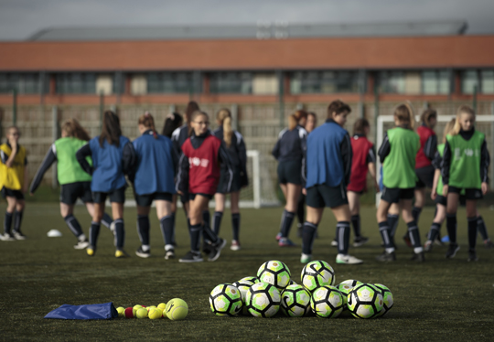
#LETGIRLSPLAY Biggest ever football session- 8th March 2024
On Friday 8th March 2024, the Biggest Ever Football Session is back and what an incredible way to celebrate International Women’s Day at your school.
To sign up your school today click here and complete the short online form

Slide 8
Be Part Of The Movement…..
Sign Your Pledge Today!
Pledge to offer girls equal access to football within your school click here
Email us at cyp@activeessex.org if you require any help or visit our website:
Barclays Girls' Football School Partnership - Active Essex

