Slide 2
Outline of Day
Welcome and introductions
Aims
Skills, Qualities and Knowledge of a Leader
Communication and Problem Solving Skills
Delivering a session to include IDEAS, STEP and SMILES
Planning A Session
Planning Time
Delivery of Activities
Summary
History of the Olympic Games
Olympic Games Legacy
Festival Planning

Slide 3
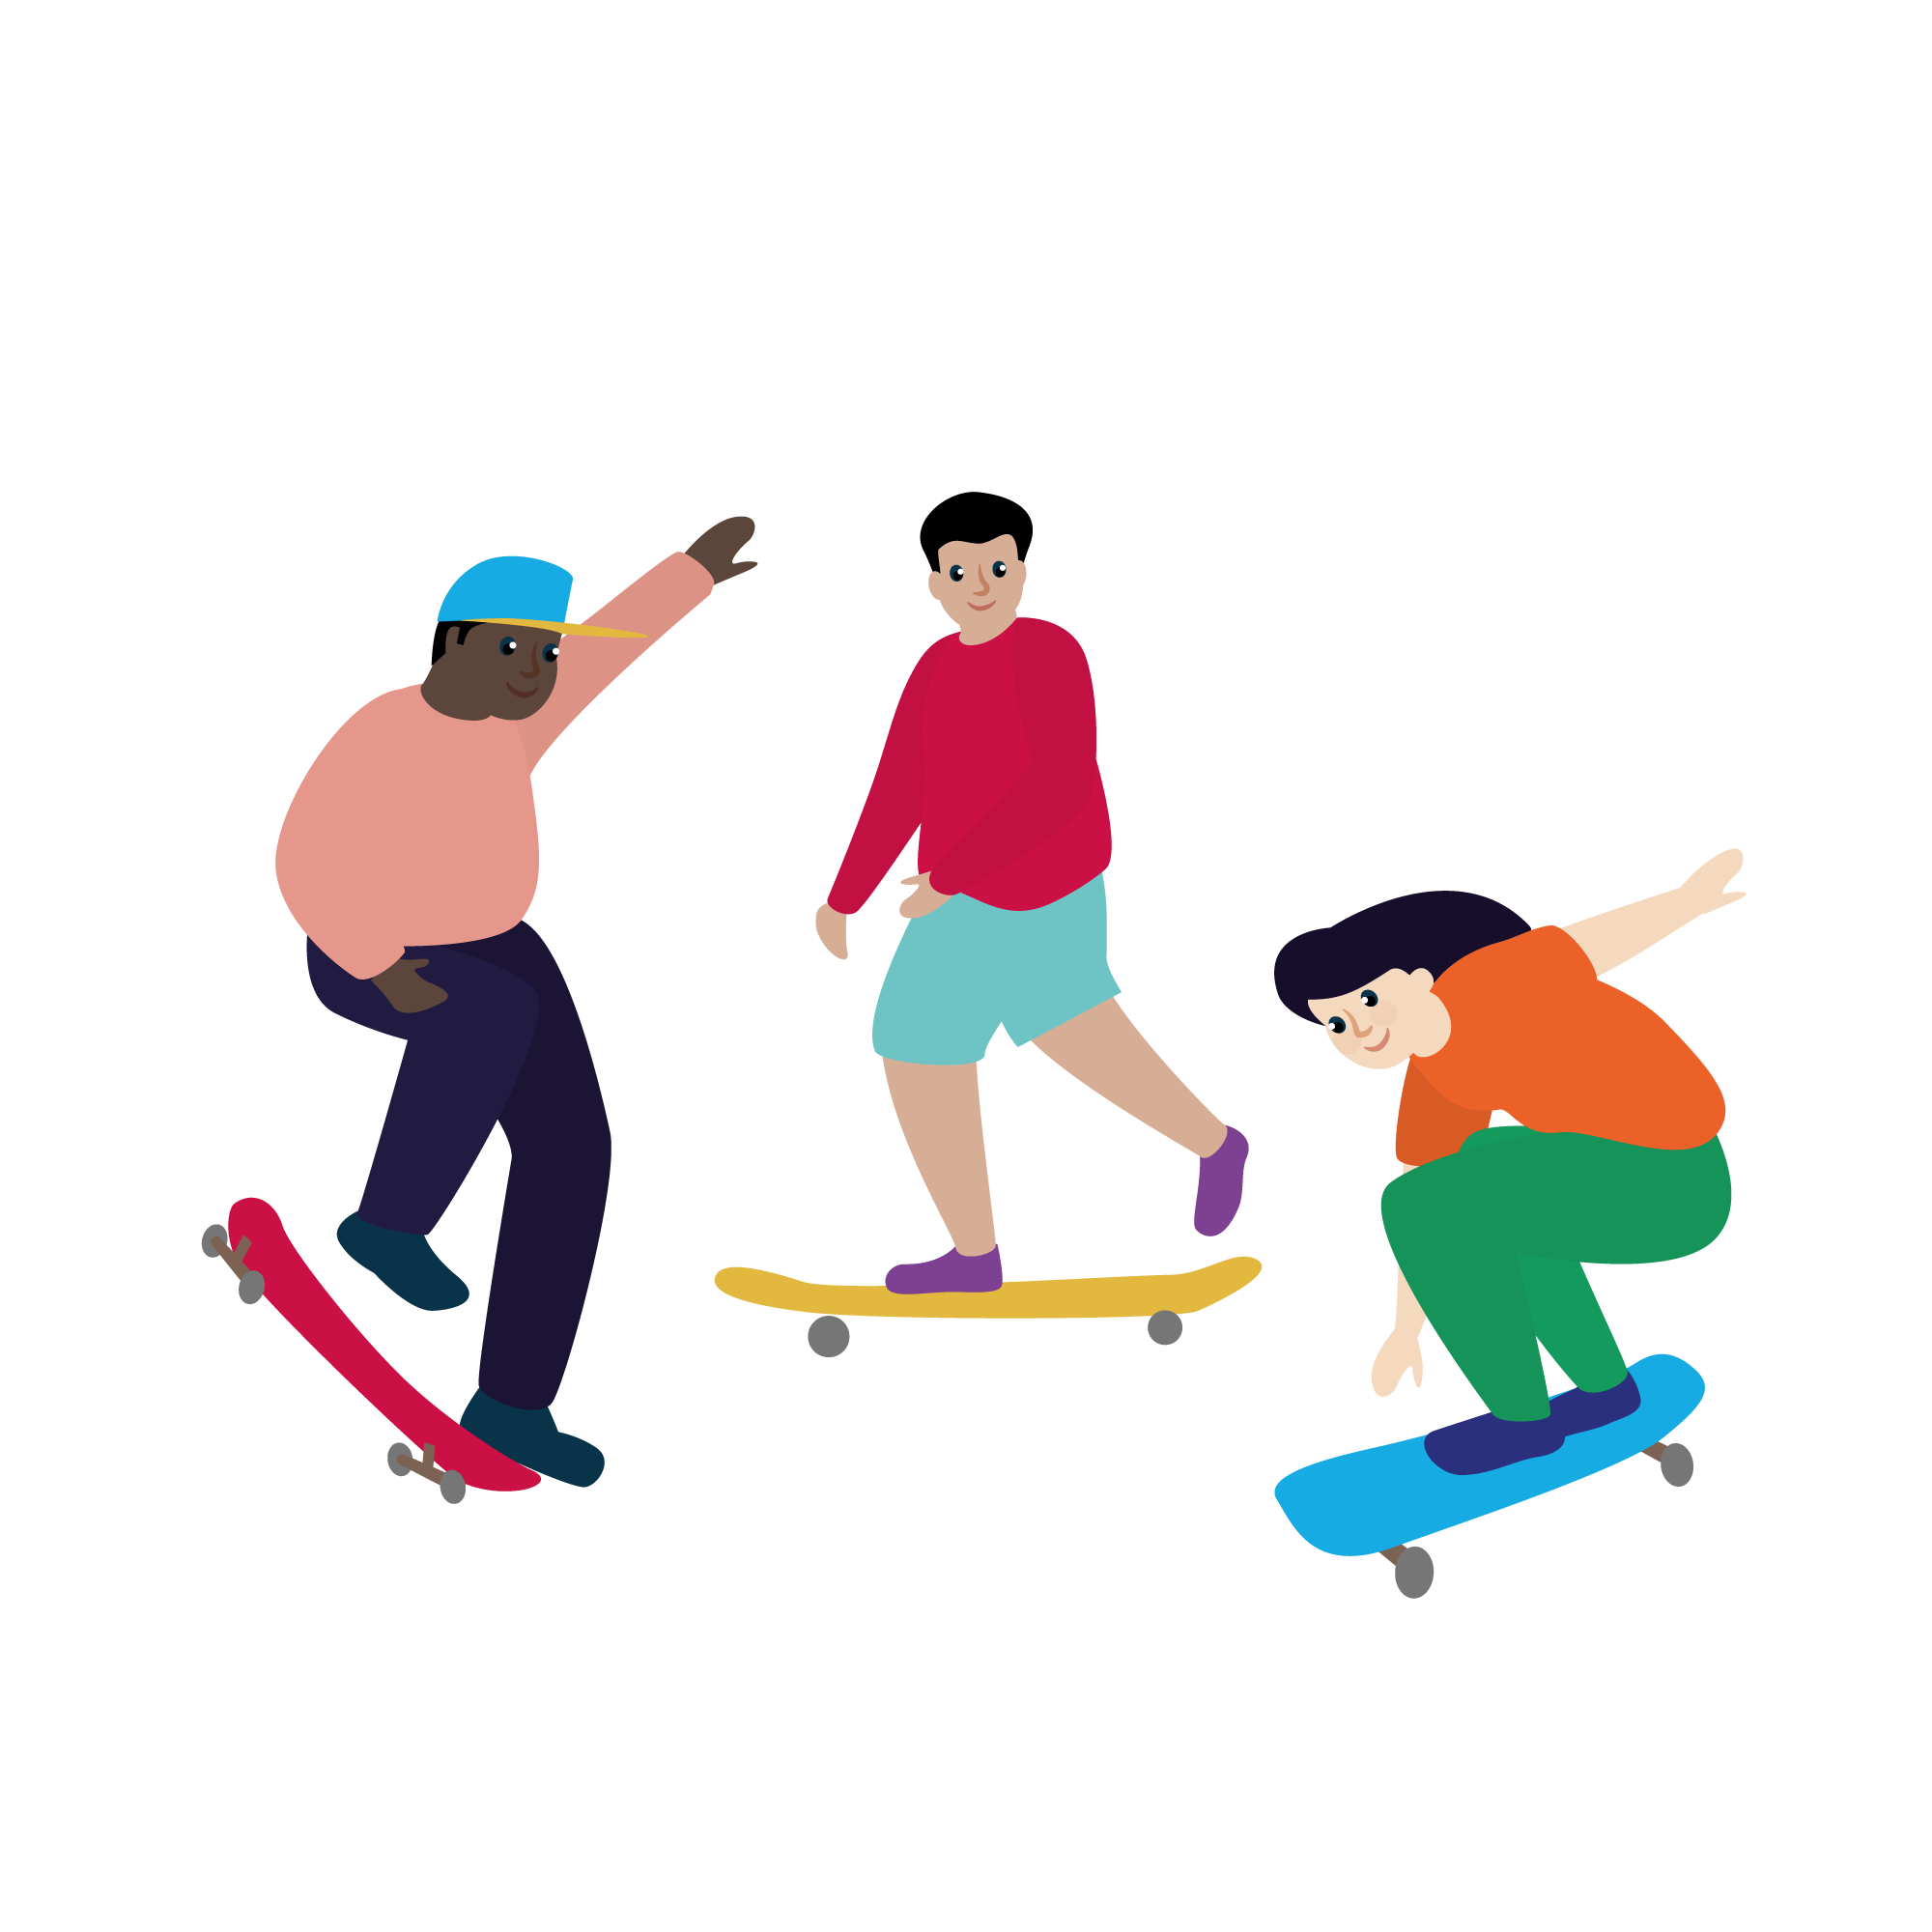
Icebreaker
What is your name?
What is your favourite sport or activity?
What is one interesting fact about yourself?

Slide 4
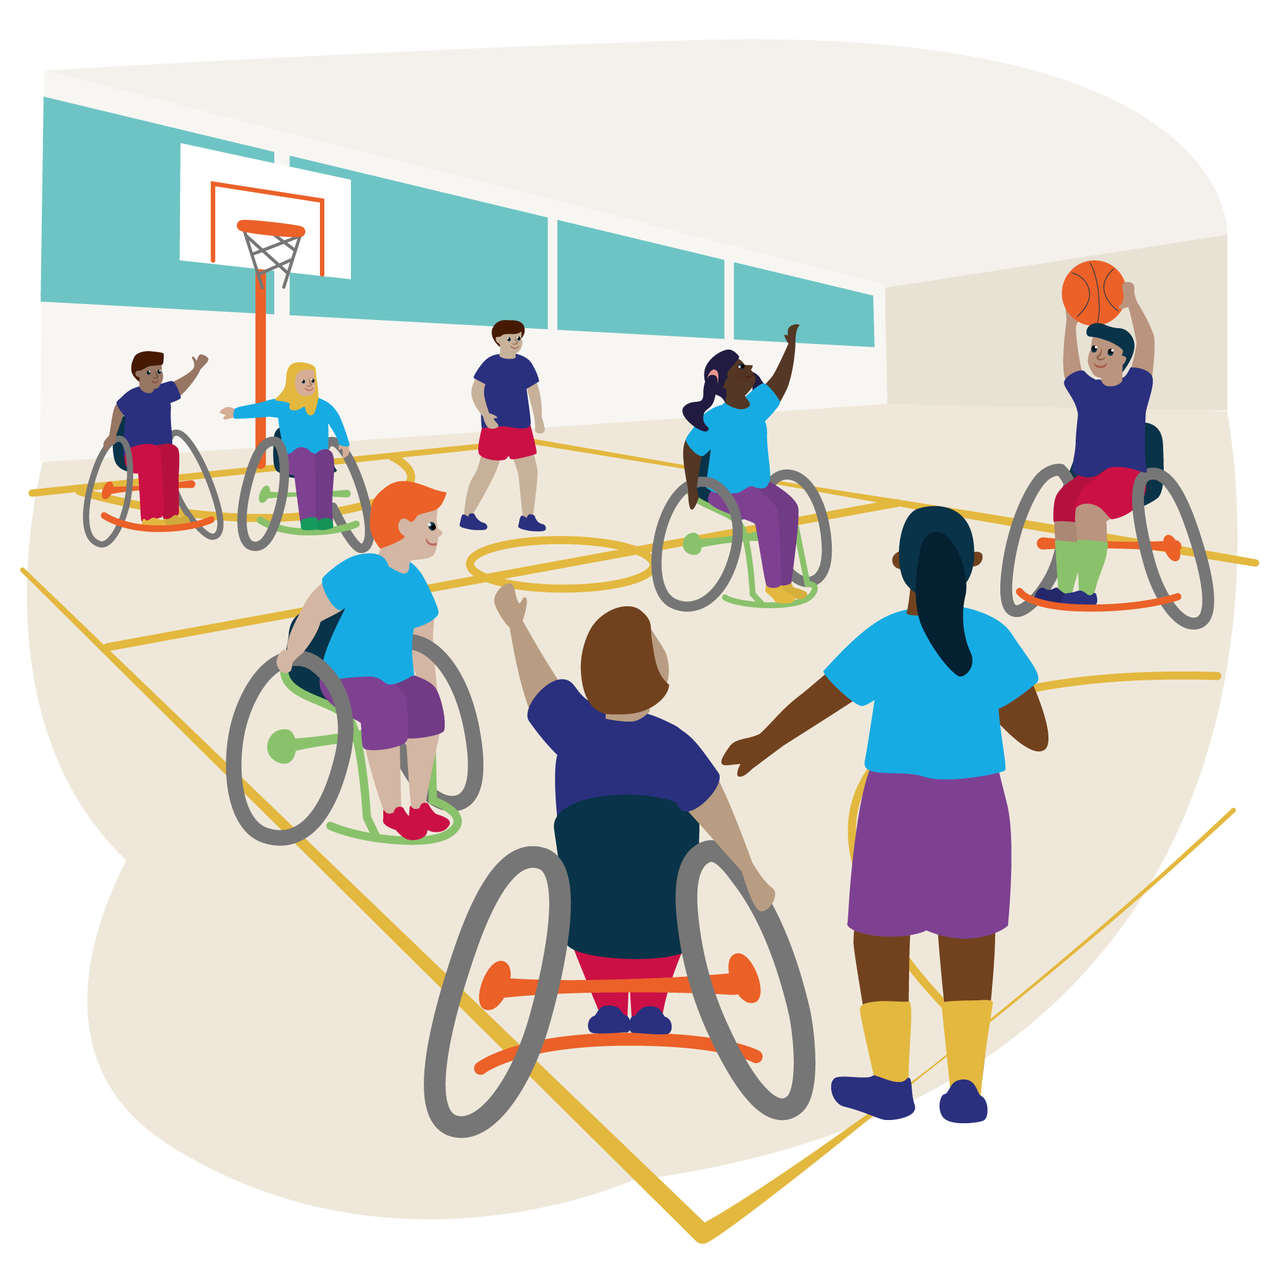
Aims
To develop knowledge and understanding of leadership skills
To be able to demonstrate leadership skills through the planning and delivery of an Olympic Games themed festival for KS1/2 pupils

Slide 5
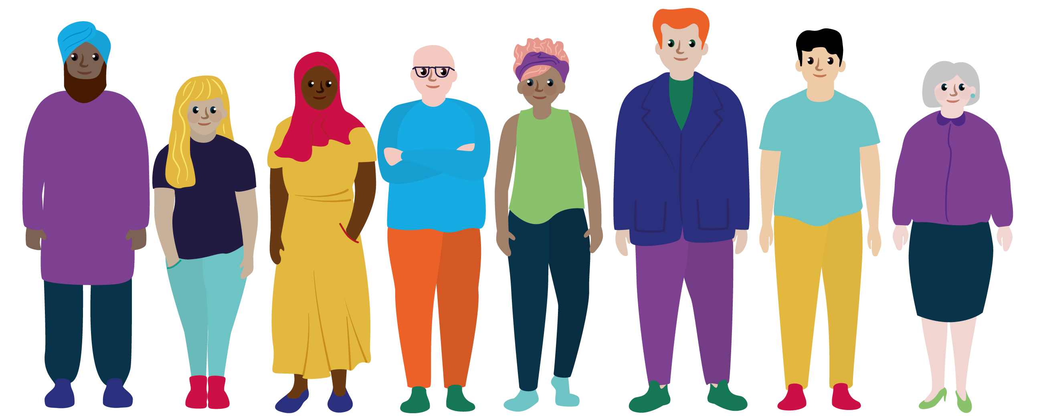
Skills, Qualities and Knowledge of a Leader
Task: In pairs, think of your favourite leader and make a list of their skills, qualities and knowledge. How many can you come up with?

Slide 6
How many did you get?
Skills and Qualities |  | Knowledge
Instruction | Communication | Rules
Demonstration | Organisation | Tactics
Observation | Adaptability | Techniques
Analysis | Compassion | Activities
Feedback | Honesty | Participants
Questioning | Ethics | Sport Pathway
Reflection | Teamwork | Local Competitions/Places to signpost participants
Can you think of any others?

Slide 7
Leadership Diamond

Slide 8
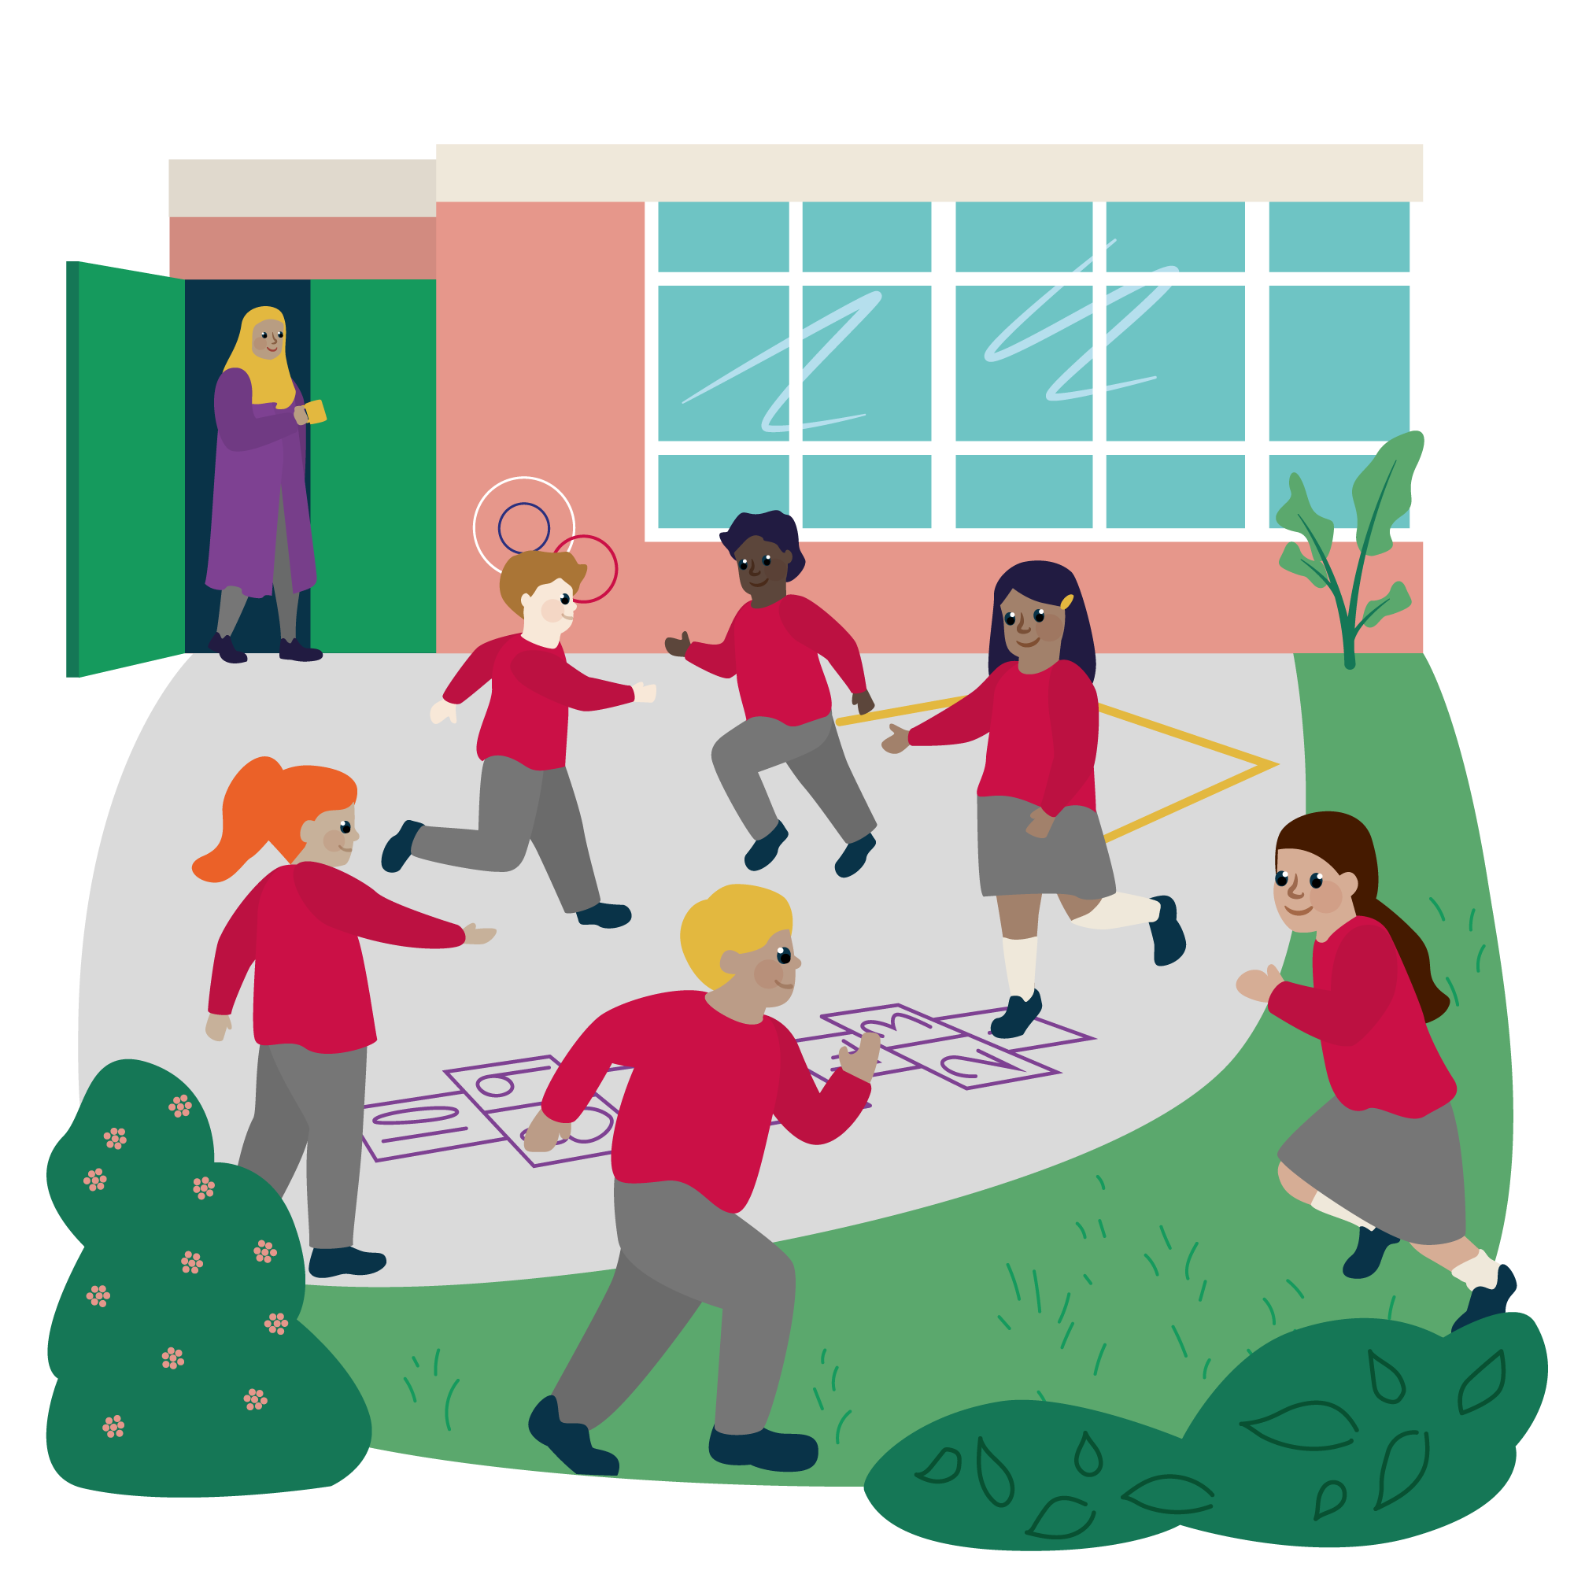
Communication and Problem Solving Skills
Stop the Game
Who Can Shout the Loudest
Bench Games
Cross the River
Human Knot
Moving the Ball from A to B

Slide 9
Delivering a Session
Warm-up
Skill
Game

Slide 10
Using IDEAS to teach PE
Introduction
Demonstration
Explanation
Activity
Summary

Slide 11
Differentiation – the S.T.E.P. Principle
Space - Change the space; make it bigger / smaller / lower / higher / zone it
Task - Change the task; faster / slower / roll or bounce / walk / run / pairs / position / rules of the game
Equipment - Change the equipment; size / weight / shape / colour / texture
People - Change the people; size of team/ mixed gender/ mixed ability/ mixed mobility

Slide 12
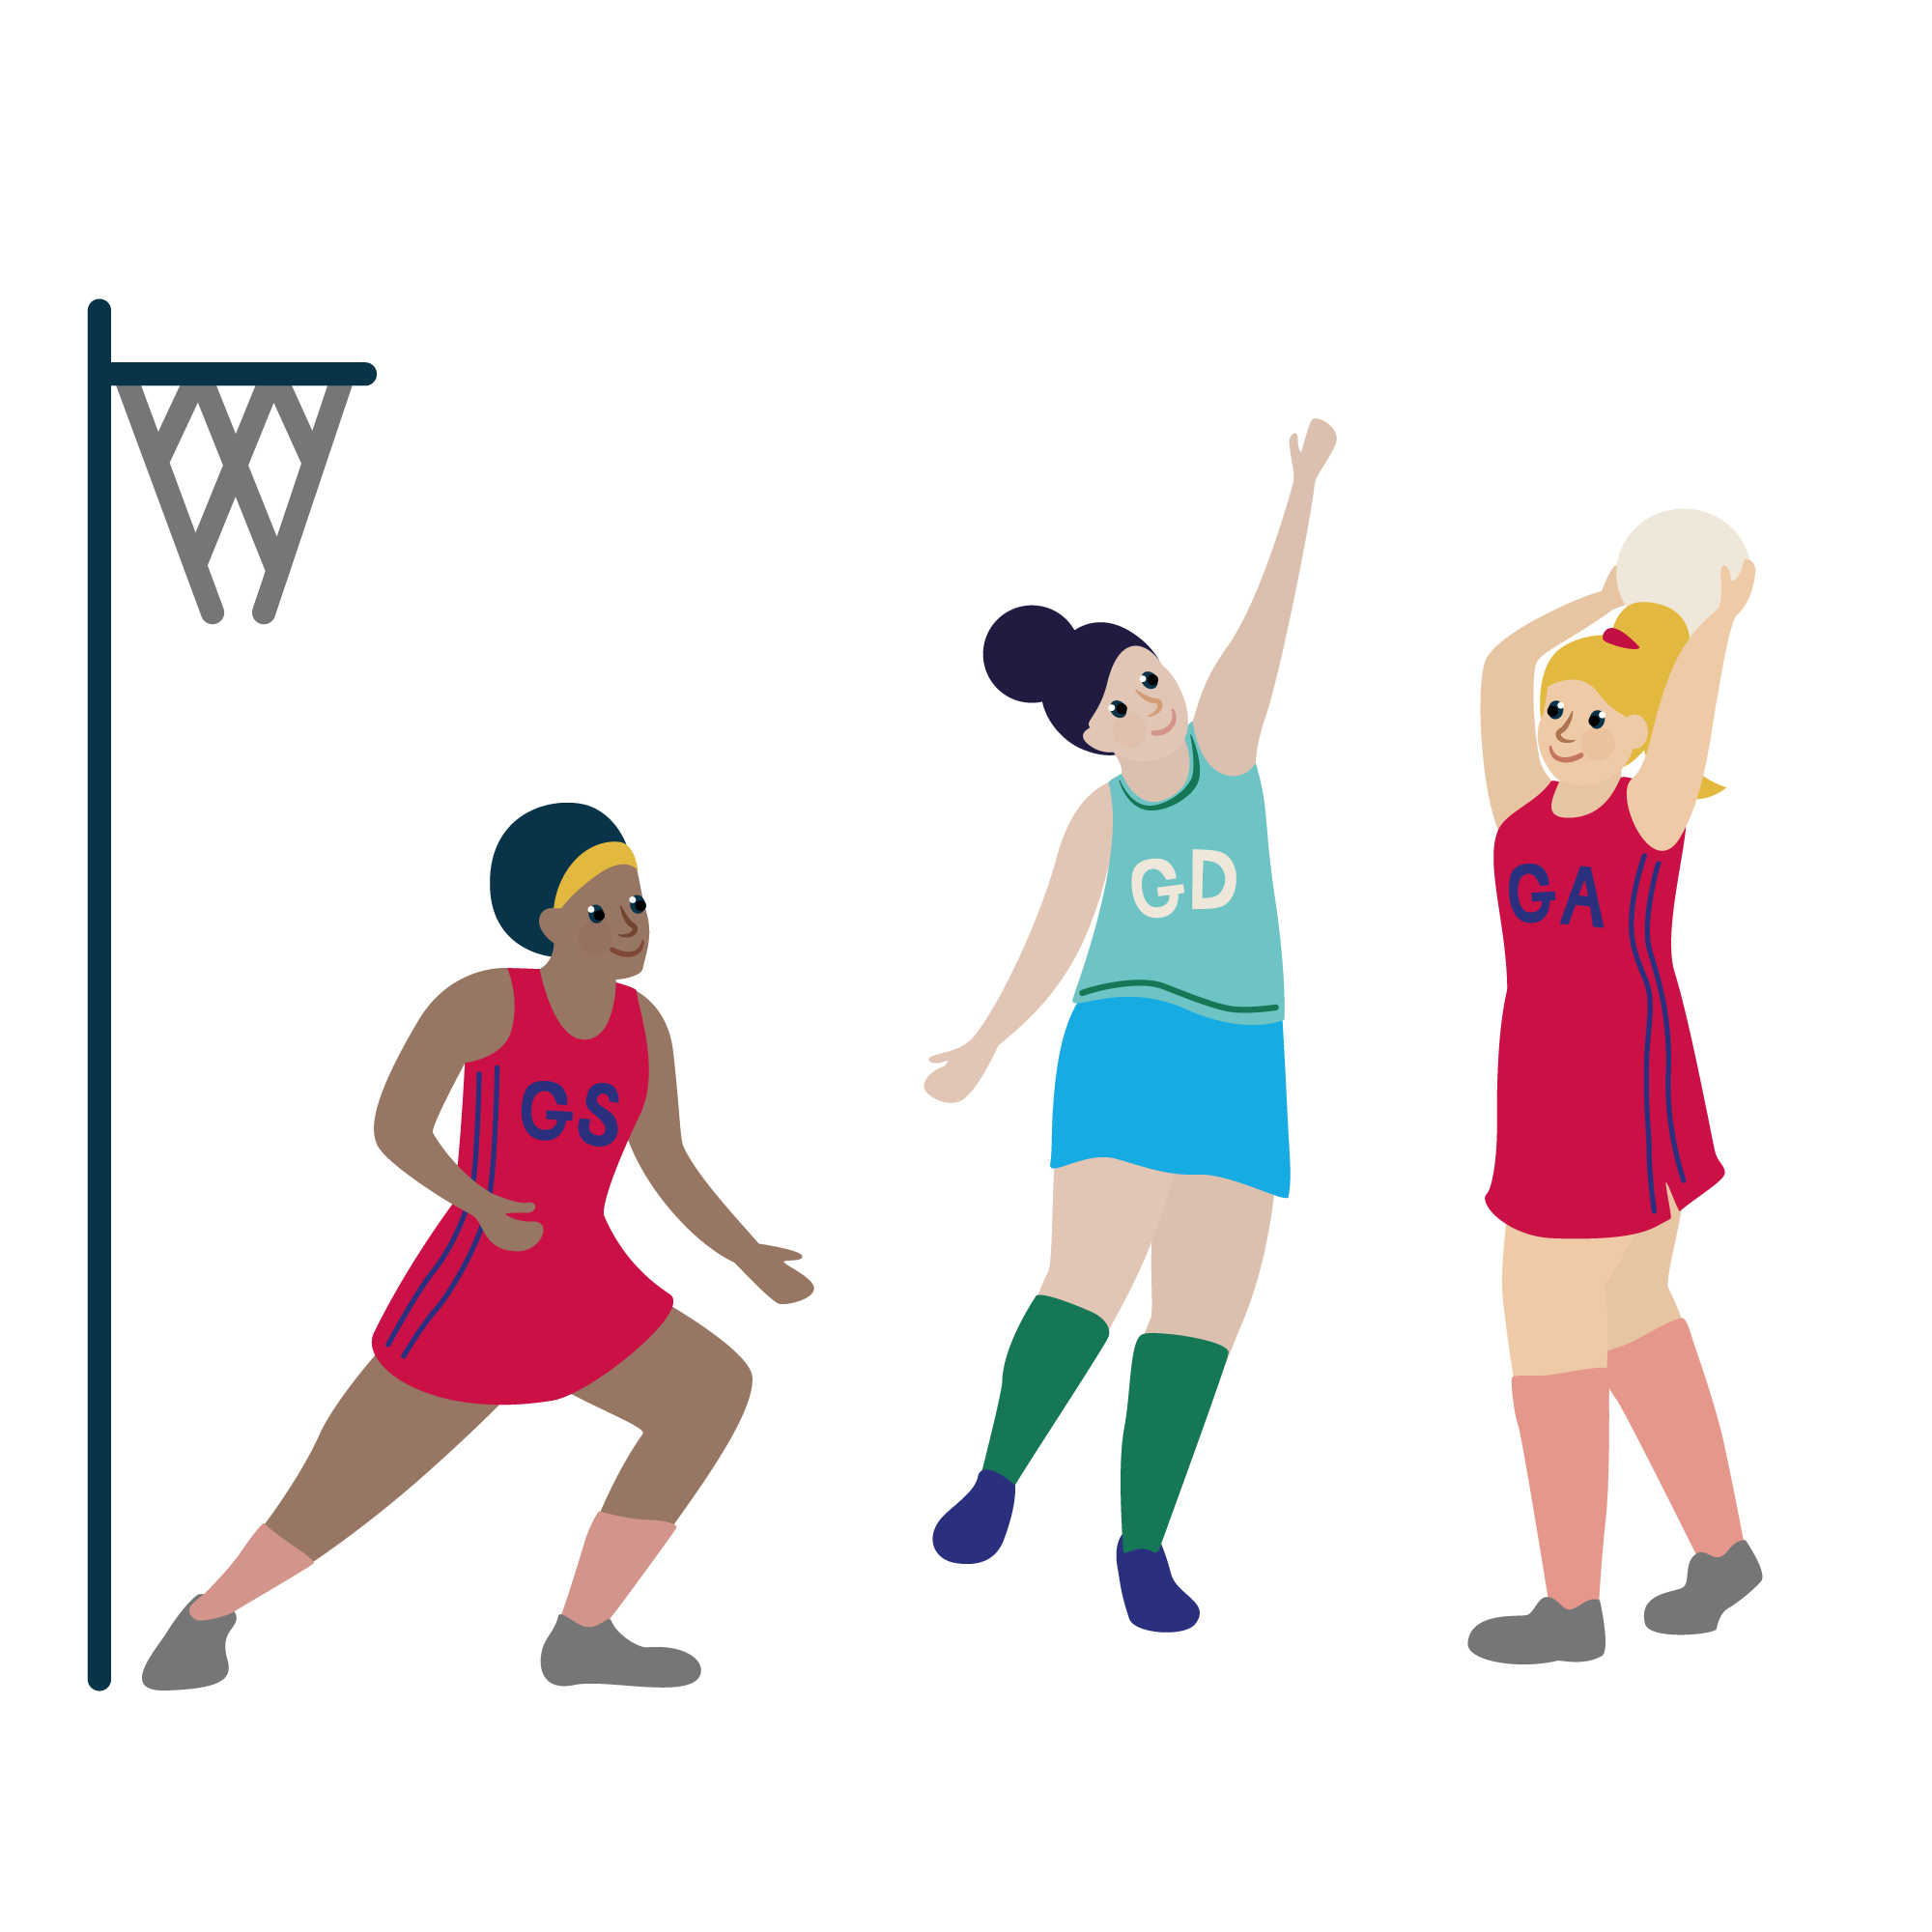
Evaluating Lessons - SMILES
Safety
Maximum Participation
Inclusion
Learning
Enjoyment
Success

Slide 13
Observation and Feedback
Instructions (were they clear?)
Use of names / demonstration (was it correct?/who demonstrated)
Questioning (did the coach ask questions/did the participants ask questions?)
Feedback (when was it given – straight away/during activity/at the end of session, was it suitable for those in the session?)
Positioning (could coach see everyone/did they move?)
Environment (What environment was created/was it right for the level of participant?)
Did all participants enjoy it?

Slide 14
Session Structure
Plan
Deliver
Review and Feedback

Slide 15
Planning a Session
Task:
With a partner, make a list of all of the things you need to consider before planning a session.
Some things to consider…
Who are you working with?
How old are they?
How many are there?
What is their skill level?
Where are you delivering your session?
What space have you got to work in?
What equipment have you got?
How long have you got?
Who have you got to support you?

Slide 16
What things can we teach our pupils?
Example – Year 7 Football Beginners
Skills
Techniques
Tactics
Behaviours
Rules
Basic Laws of the Game
Positions and Pitch Markings
Fair Play and Sportsmanship
Safety
Fitness
Communication
Etiquette (Shaking Hands, Three Cheers)
How to Warm Up
How to Cool Down
Set Plays
Diet (incl. Fluid)
Passing Technique
Shooting Technique
Dribbling Technique
Tackling Technique

Slide 17
Planning Task
In pairs, you are going to have 15 minutes to plan a session using the template on the next slide.
Your session must include:
An introduction
A warm up activity
A skill activity
A game
Consider how you could adapt your session using the STEP Principle
You will be delivering your session to a group of your peers

Slide 18
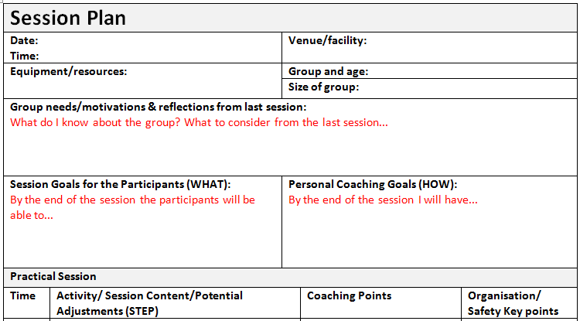
Session Plan Template

Slide 19
Delivery of Activities
Task:
In pairs, you are going to have 15 minutes to deliver your session.
Once you have finished you will evaluate your session using SMILES.

Slide 20
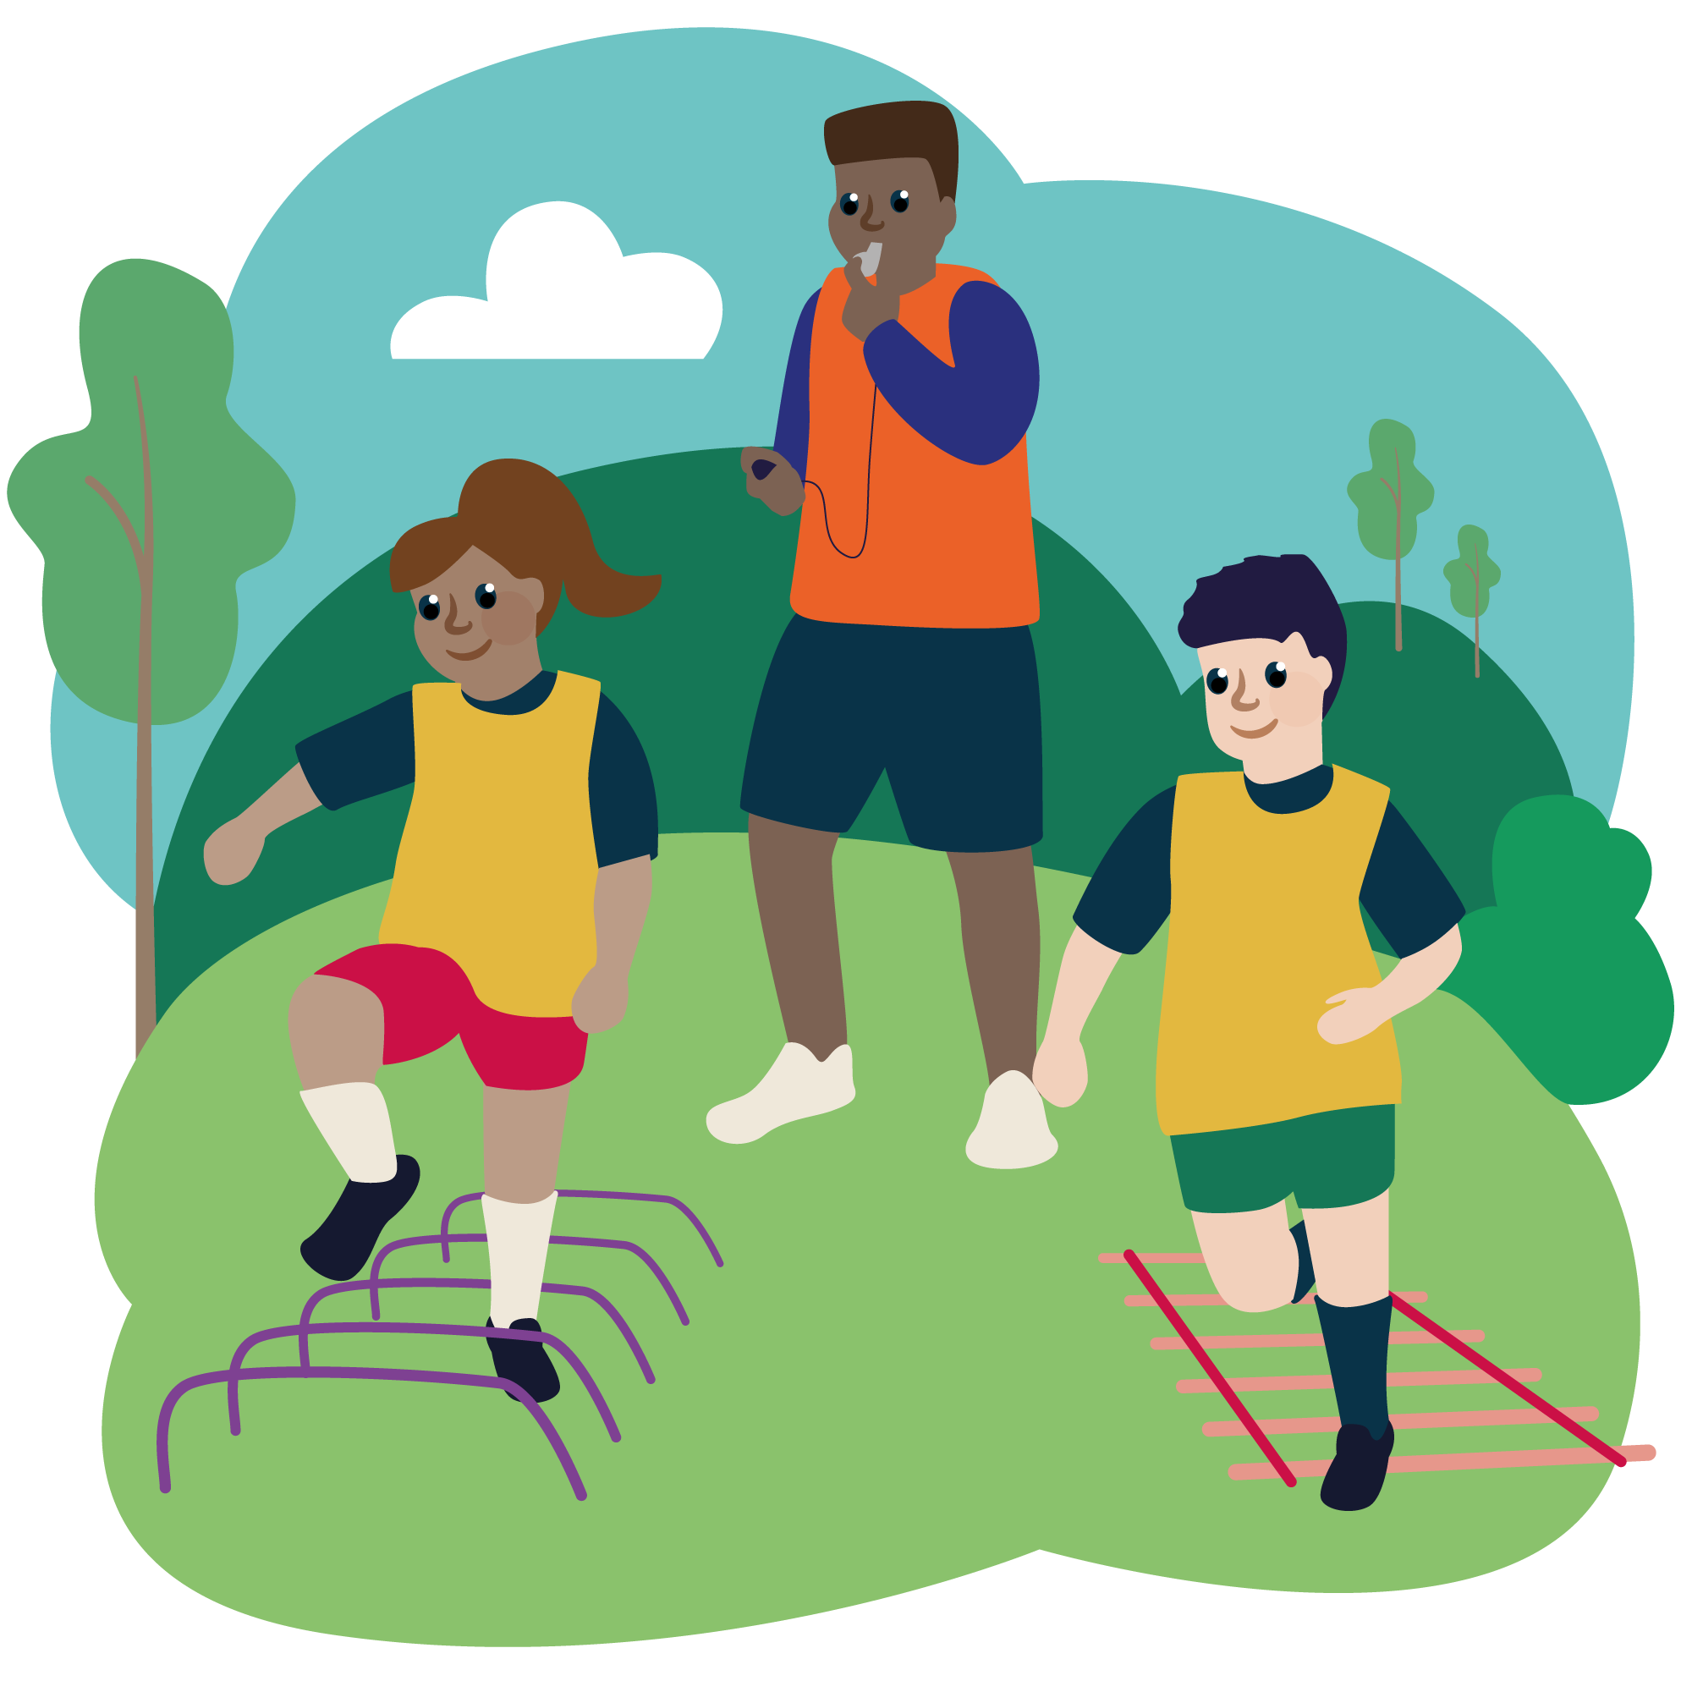
Summary
Task:
Write down three things that you have learnt about leadership.
What went well with the session that you delivered?
What could you do to make it better?

Slide 21
The Olympic Games – a brief history
Discuss in pairs or small groups what you know/understand/remember about the Olympic Games?
Why do you think it is an important event?
Where are the Olympic Games taking place this year?

Slide 22
The Olympic Games - a brief history
The first modern Olympics were held in Athens, Greece, in 1896. In the opening ceremony, King Georgios I and a crowd of 60,000 spectators welcomed 280 participants from 12 nations (all male), who would compete in 43 events, including track and field, gymnastics, swimming, wrestling, cycling, tennis, weightlifting, shooting and fencing. All subsequent Olympiads have been numbered even when no Games take place (as in 1916, during World War I, and in 1940 and 1944, during World War II).
The official symbol of the modern Games is five interlocking colored rings, representing the continents of North and South America, Asia, Africa, Europe and Australia. The Olympic flag, featuring this symbol on a white background, flew for the first time at the Antwerp Games in 1920.
The Olympic Games is built upon the three values of excellence, friendship and respect.

Slide 23
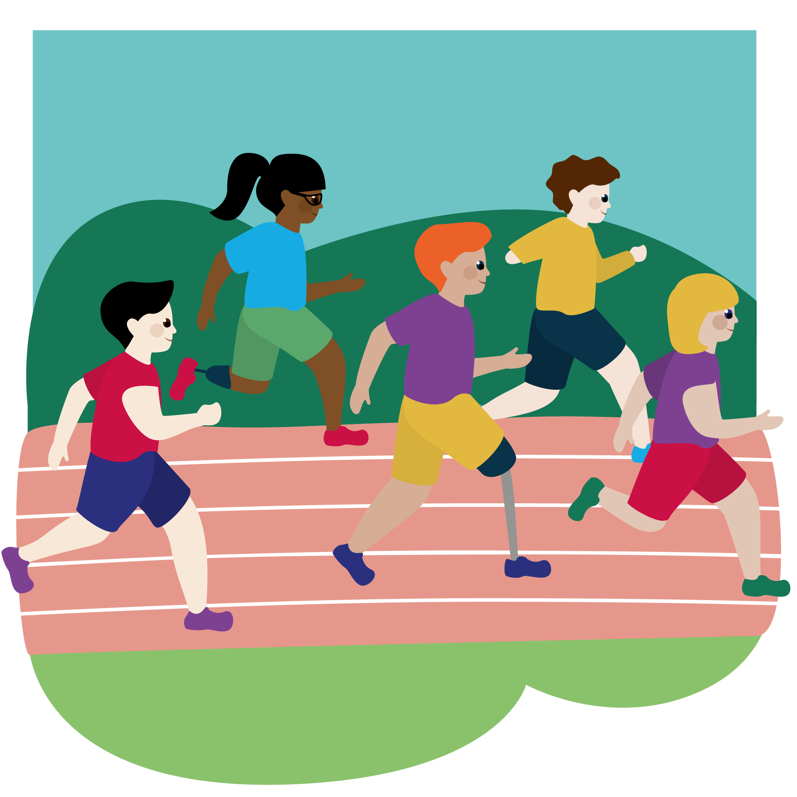
The Olympic Games - a brief history
The Olympics truly took off as an international sporting event after 1924, when the VIII Games were held in Paris. Some 3,000 athletes (with more than 100 women among them) from 44 nations competed that year, and for the first time the Games featured a closing ceremony.
Eighty years later, when the 2004 Summer Olympics returned to Athens for the first time in more than a century, nearly 11,000 athletes from a record 201 countries competed. In a gesture that joined both ancient and modern Olympic traditions, the shotput competition that year was held at the site of the classical Games in Olympia.

Slide 24
Paris 2024 Olympic Games
The Paris 2024 Olympic Games will be the XXXIII Olympiad. There will be 19 days of competition with 329 events, 206 nations, 41 sports and 10500 athletes.
There will be 4 additional sports – breakdancing, sport climbing, skateboarding and surfing.
GB’s 15-year-old Sky Brown is looking to compete in both the skateboarding and the surfing which would make her the first athlete to compete in two events at the same Olympics in more than a century.

Slide 25
Olympic Games Legacy
Discuss in pairs or small groups:
Which sports do you associate with the Olympic Games?
How could we use the inspiration of the Olympic Games to motivate young people to become more active?
What do the Olympic Games mean to you?

Slide 26
Your Challenge!
We would like you to plan, organise and deliver a Fun and Active Festival for either:
Younger students at your school
Children in your local area if you are part of a local SSP Academy
The festival should bring together all of the skills you have covered in the course and MUST be themed around the Paris 2024 Olympic Games.

Slide 27
Festival Planning
What will you need to consider in the planning of your festival? Please cover this topic in detail.
How will you embed the Olympic Games Legacy as a theme throughout the festival?
What are your aims for the festival? What would you like the young people to gain by attending?

Slide 28
Festival Planning
Possible things to consider:
Date, time , location and duration
Key people to liaise with
Roles and responsibilities – who will do what ?
Space and equipment required
Ages of the participant and how many can you accommodate
Health and safety considerations
Content – what activities? How will you theme it around the Olympic Games?

Slide 29
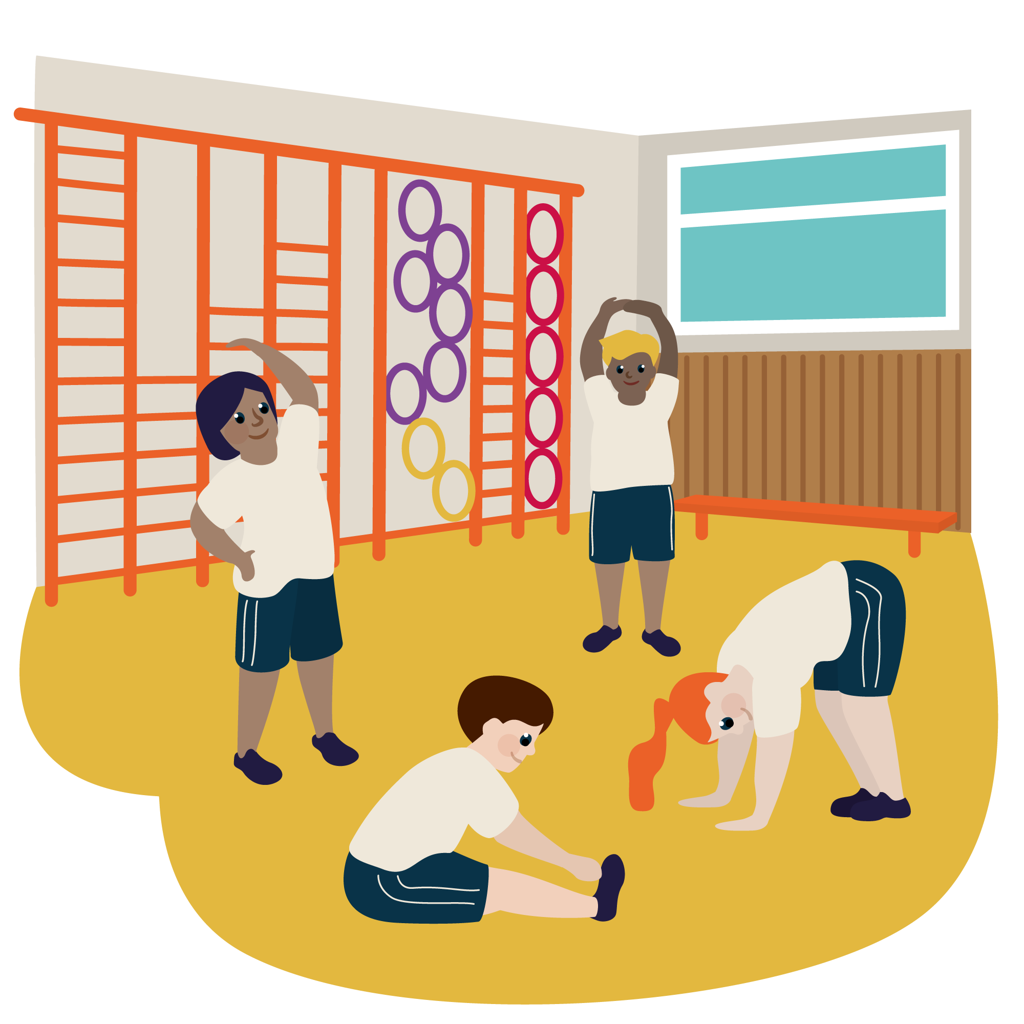
Festival Planning
Plan the Festival as a group
Allocate each member of your team a ‘station’ to plan and run. Try these activities out on each other. Will they achieve what you want?
Give each other feedback and support
Deliver the Festival! Have a great time and remember to reflect!

