Slide 1
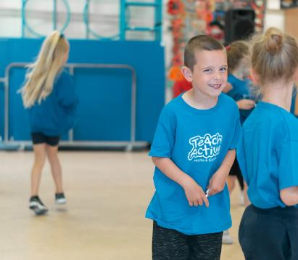
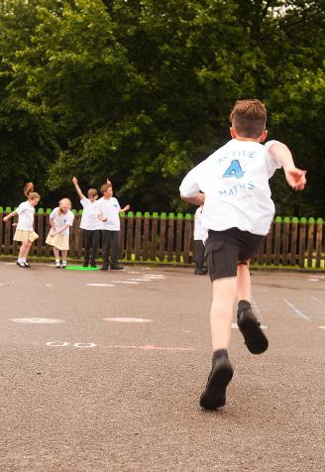
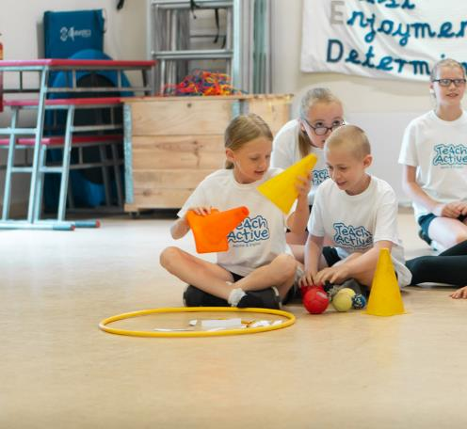
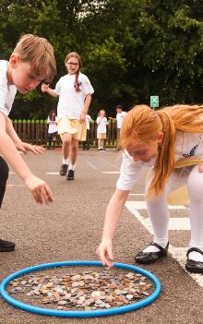
Using physical activity as a catalyst to raising attitudes and attainment in Maths and English
In Partnership With

Slide 2
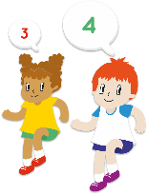
Active Maths
“100% of teachers said they had seen a positive impact on children’s learning.”
Nigel Mosaid,
St Oswald’s Primary School, Liverpool
2000 lesson plans and resources designed to deliver the Maths curriculum through physically active learning
Covers every objective under the maths curriculum
Mapped to the national curriculum
Foundation Stage to Year 6
Complements any scheme of work
“Proven to increase attainment... outstanding progress and achievement
in SATs levels.”
Steve Tindall
Holy Family Catholic Primary School, Surrey

Slide 3
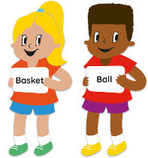
Active English
“Not only will it impact on your data, your standards, your outcomes – but you will also see a renewed vigour, enthusiasm and enjoyment across both pupils and staff.”
Nicola Booth,
Gwladys Street Primary and Nursery School, Liverpool
1500 lesson plans and resources designed to deliver the English curriculum through physically active learning
Covers key reading skills (all texts included)
Covers writing objectives (all areas of spag)
Foundation Stage to Year 6
Complements any scheme of work

Slide 4
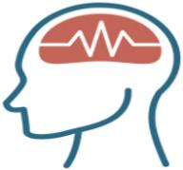
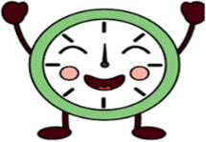
Things we already know…
School Benefits
Physical Activity
Attitudes
Attainment
Whole Child
Physical Health
Engagement
Behaviour
Attention
Brain Function
Cognition
Academic
Performance
Mental Health / Social Development
In partnership with

Slide 5
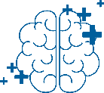
Creating an active school day can benefit
children in many ways…
Physical Health
Social Wellbeing
Mental Health
Brain Function

Slide 6
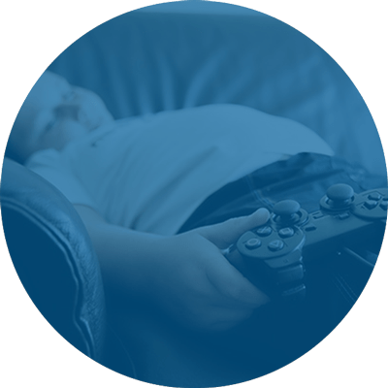
We are not unlocking our children’s potential
*Data sourced from The Youth Sport Trust – Annual Report 2023
This generation of children are the least active
Less than half of young people are meeting minimum physical activity levels
70% of the school day
is sedentary

Slide 7
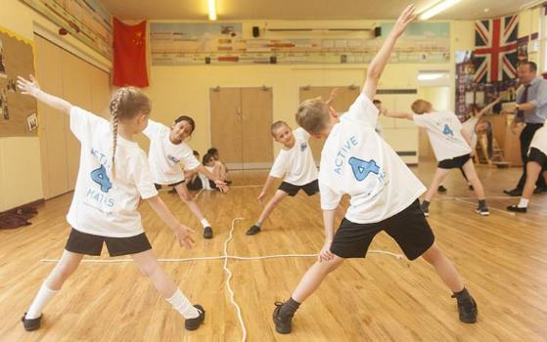
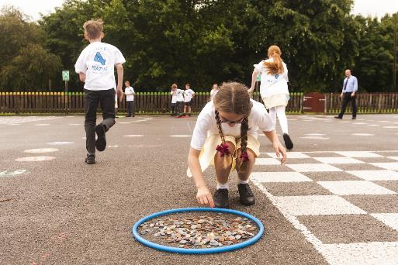
Active Learning is the solution!
Teach Active is the “most impactful” and “most sustainable” strategy

Slide 8
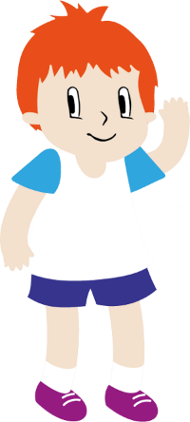
Benefits of Physically Active Learning
Promotes responsibility
Strengthens learning
Improves memory and retrieval
Enhances learner motivation and morale
Improves behaviour
Improves health
Promotes collaboration
Develops social skills
Enhances social skills, emotional intelligence and resilience
Changes attitudes
Raises attainment

Slide 9
Attitudes
“Children are enjoying their lessons more”
“Active Maths has supported a love of learning”
“We have seen an increase in confidence”
“They voted Active Maths as their favourite lesson!”
“Children are significantly happier”
“It is great to see such engagement”
“Better attitudes towards work”
“It makes me happy to see children loving maths”

Slide 10
Attainment
“A measurable increase in attainment”
“Teachers report more progress within lessons”
“Maths results have increased 21% in the space of 12 months”
“Active Maths has really supported children’s recall”
“Children are retaining concepts”
“Children have made exceptional progress”
“More work produced!”
“Increased understanding”

Slide 11
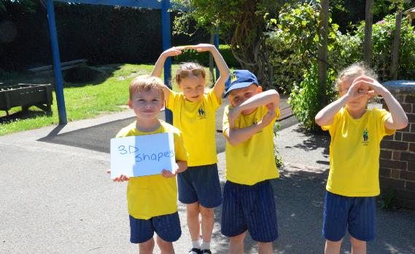
Holy Family Catholic School
They are learning so many math's concepts without realising they’re doing maths. It’s fabulous to see so many smiling faces and increase in achievement in the subject.
Steve Tindall, Headteacher
Increase in attainment
Real impact with pupils
Increase in confidence and self esteem
Outstanding progress
(* School top 2% of maths results nationwide)
Impact on teamwork, leadership and problem solving skills

Slide 12
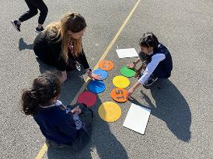
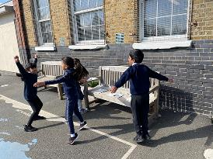
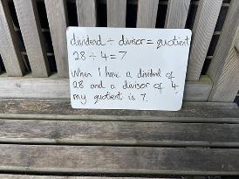
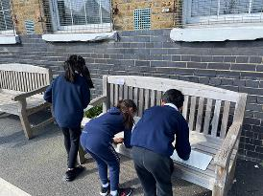
Kensington Primary School
Teach Active provides a structure and resource to help teachers. It really helps children to engage and focus on their learning – who we find are then more likely to retain that information.
I would recommend Teach Active to any school.
Ben Levinson OBE, Headteacher
Winner of ‘Primary School of the Year’
TES ‘Health and Wellbeing School of the Year’
School went from RI to Outstanding
Headteacher Ben Levinson awarded OBE

Slide 13
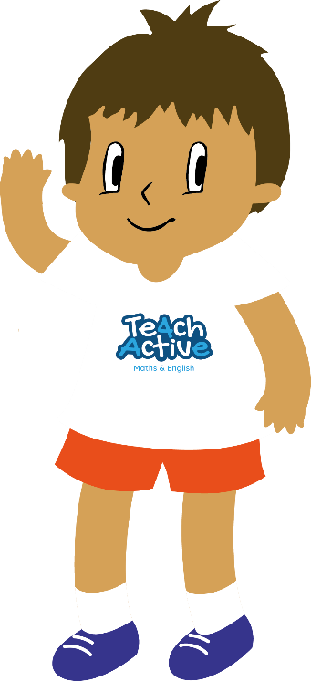
Develops focus
Lifts self esteem
Improves brain functioning
Increases confidence
Improves memory
Reduce anxiety
Improves concentration
Improves social skills
Improves mood
Increases energy levels
Reduces stress
Reduces fatigue
Improves body image
Improves sleep
Promotes a healthy,
active lifestyles
Improves blood flow
Reduces coronary heart disease
Boosts immune system
Helps to maintain weight
Improves cholesterol levels
Helps reduce obesity
Improves breathing
Improves reflexes
Improves posture
Helps coordination
Develops stronger bones & joints
Develops gross motor skills

Slide 14
Thank you
“Unhealthy and unhappy children don’t learn”

