Slide 1
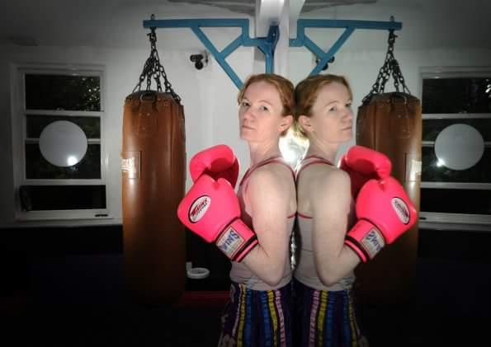
Moving Minds
Rachael Mackenzie

Slide 2
The theory
What does the science say about:
neuroplasticity
physical literacy and the link to readiness to learn
the stress response and impact on learning
physiological responses to movement linked to learning
Notes:
Four key concepts – some sort of combined practical and theoretical activity to illustrate and bring each one to life

Slide 3
Neuroplasticity
The brain’s capacity to re-organise pathways, create new connections, and create new neurons
Influenced by:
Traumatic brain injury
Positive and negative experiences, especially in childhood
Learning new skills
Physical activity
Notes:
neuroplasticity is needed for effective learning, for adapting to stress, meeting new challenges and for mental wellbeing

Slide 4
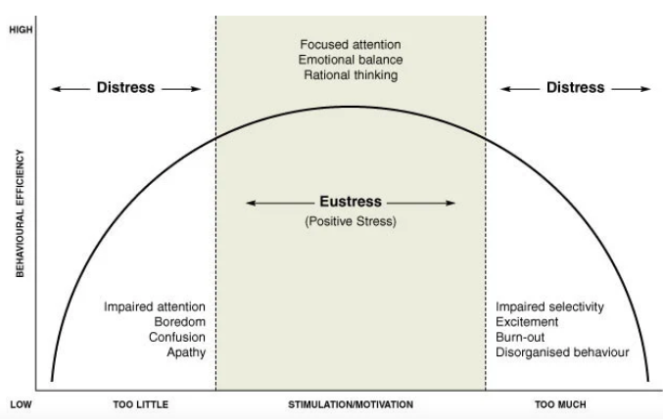
Eustress and distress
Notes:
Small, ‘everyday’ stresses have much less of a negative impact on young people than persistent stress (reported by 20% of UK young people.)
Very low and very high levels of cortisol can cause weight gain, depression, slow cognitive development. All caused by persistent stress and childhood instability and trauma
Physical activity can balance cortisol levels

Slide 5
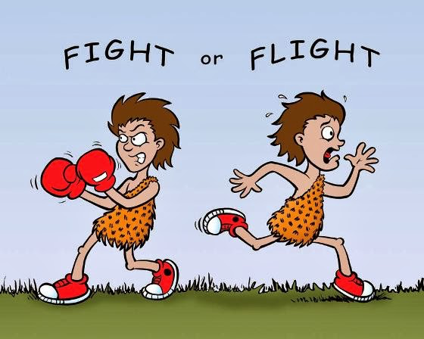

Slide 6
Physical Literacy and Readiness to Learn
Fundamental movement skills are essential for readiness to learn because they improve executive function
inhibitory control: ignore distractions and resist competing stimuli to stay focused on a task
working memory: ability to temporarily hold and manipulate information
cognitive flexibility: switch between and consider multiple perspectives and concepts at once
Notes:
deficits in executive function are associated with unhealthy weight and addiction issues; high levels are associated with academic achievement and overall quality of life

Slide 7
Physical Literacy and Readiness to Learn
Quantitate changes in motor behavior = Autonomic Nervous System activation. Qualitative changes in motor behavior = proprioceptive input changes. Muscle based activation strategies induce different emotional states.

Slide 8
Effects of exercise
HPA axis
antioxidant activity (mitochondria)
Cerebral blood flow
Regulation of neurotransmitters
GABA, norepinefrine, dopamine, serotonine
Neurogenesis
Activity in the opioid system
endorphin, anandamide, enkephalin
Neuroprotective effect
Positive effects on cognition
Mental and neurodegenerative
disease incidence
Inflammatory cytokines
Cortisol production

Slide 9
CONTROL THE CONTROLABLE
"We are what we repeatedly do. Excellence, then, is not an act, but a habit" Durant

Slide 10
A child who is not embraced by the village will burn it down to feel it’s warmth

Slide 11
Any Questions?
@rachfmackenzie
Rachael@workathlete.com
Notes:
deficits in executive function are associated with unhealthy weight and addiction issues; high levels are associated with academic achievement and overall quality of life

Slide 12
Section 2:
Theory into Action
Notes:
Highlight the decline in YP wellbeing before and since COVID

Slide 13
Connecting moving and learning
Posture activity
Balance activity
Arousal activity
Self-talk & visualisation activity
Strategies for decreasing sedentary behaviour
Increased respiratory rate examples
Notes:
Six activities
Participate in each practical activity and after each one, consider how you could apply this in your own teaching and how you could share it with colleagues to apply more widely in school.
I’ve got suitable classroom activities for all except the self-talk and visualisation task, and I’m sure you’ve got loads too.

Slide 14
Implementation in the teaching space
the classroom environment
incorporating physical activity into learning
helping young people to manage their behaviour
teacher wellbeing
teachers as role models
Notes:
5 areas for reflection – we can pose the following questions to pairs or threes and they can share their thoughts with the rest of the group, or we could allow everyone to contribute to a ‘gallery’ walk where they add ideas under each heading?

Slide 15
The classroom environment
How do we organise the classroom to prevent sitting from being the default state?

Slide 17
The classroom environment
How do we organise the classroom to prevent sitting from being the default state?

Slide 18
The classroom environment
How do we organise the classroom to prevent sitting from being the default state?

Slide 19
The classroom environment
How do we organise the classroom to prevent sitting from being the default state?

