Slide 1
The Jack Petchey Foundation Grant Opportunities
If you think you can, you can!

Slide 2
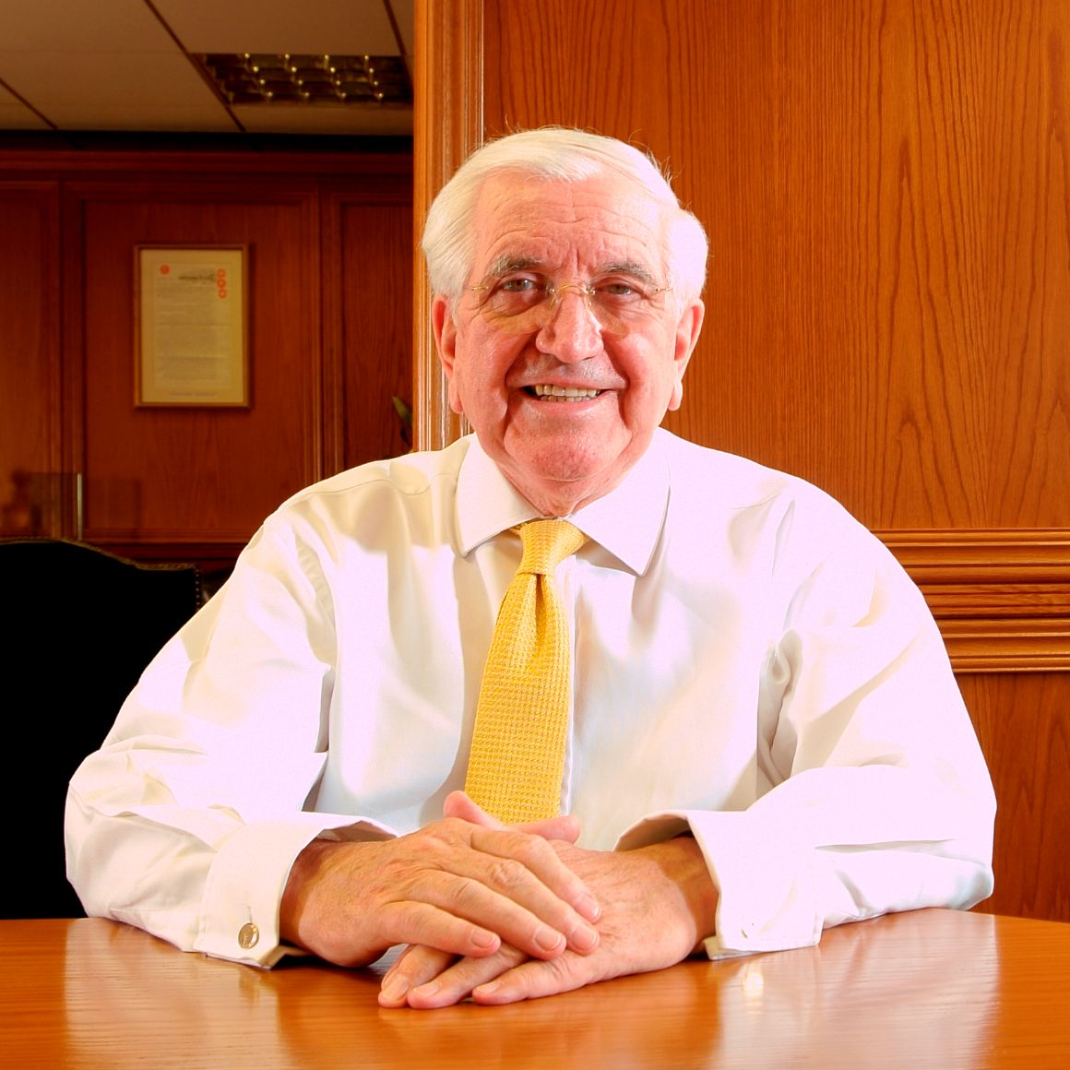
Sir Jack Petchey
Sir Jack Petchey came from humble beginnings in the East End of London
Rose to become one of Britain’s most successful businessmen.
He set up the Jack Petchey Foundation in 1999 to inspire and motivate young people and recognise them for their achievements.
‘I want young people to learn to believe in themselves’,
Sir Jack Petchey
If you think you can, you can!

Slide 3
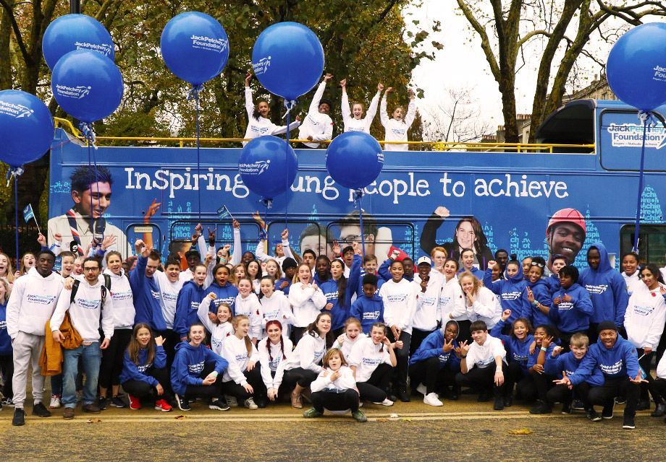
The Jack Petchey Foundation
We offer a variety of programmes and opportunities to celebrate, motivate and inspire 11-25 year olds in London and Essex.
Over £160 million invested in young people since 1999.
The Jack Petchey Achievement Award Scheme runs in 1,700 youth clubs, youth organisations and secondary schools.

Slide 4
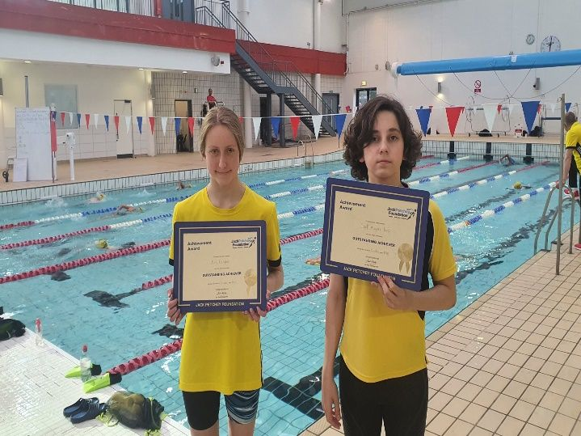
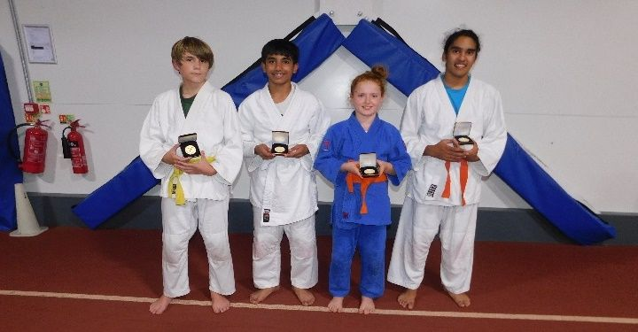
The Achievement Award Scheme
Allows you to celebrate young people in your club/ youth organisation.
These awards aren’t about ‘being the best’, they are about ‘doing your best’.
Youth involvement in nomination process.
Could be for those who are:
Helping others, being a good role model, coping with adversity, or maybe just trying really hard!
To date, over 200,000 Achievement Awards have been presented!
If you think you can, you can!

Slide 5
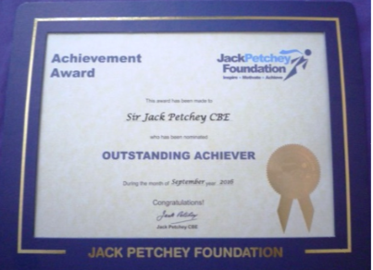
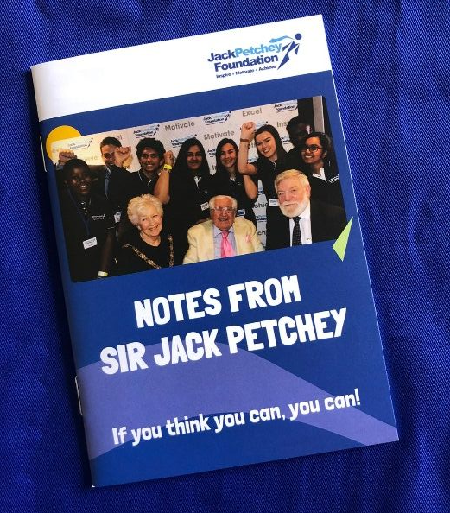
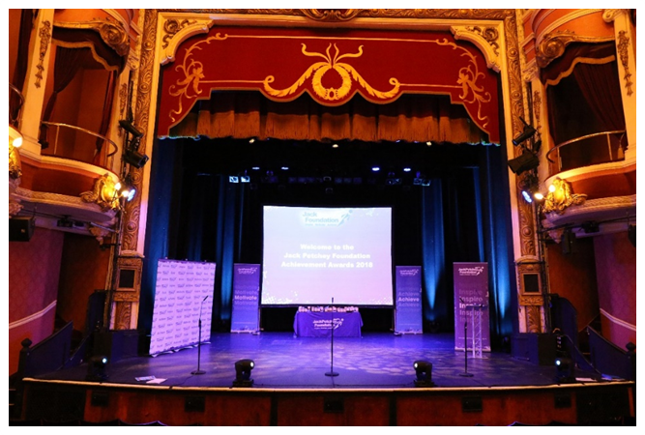
Winners receive:
Certificate
Pin Badge
Congratulations Letter
Notes from Sir Jack Petchey
Medallion
Invitation to Celebration Evening
£300 Grant to benefit their peers
If you think you can, you can!

Slide 6
How many award winners
can you nominate each year?
If you think you can, you can!

Slide 7
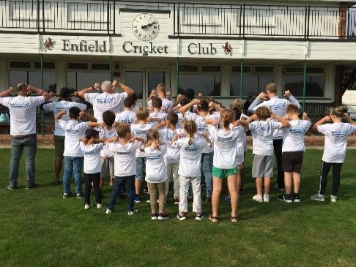
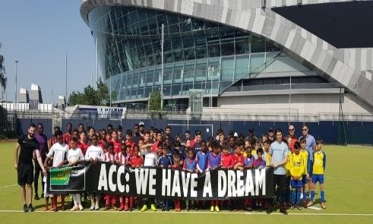
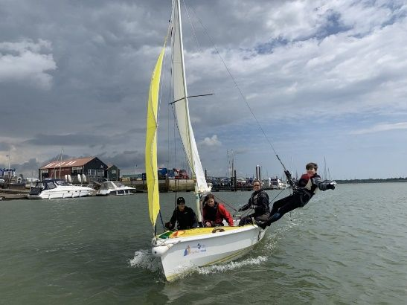
Examples of Grant Spends
Equipment
(e.g. sports, camping, arts, outside space, furniture, specialist training kit, training kit)
Trips
(e.g. camping, residentials, theatre trips, restaurant visit, bowling, cinema, Theme Park)
Opportunities
(e.g. training, learning a new skill, young person taking coaching qualifications, bringing in a specialist coach, after school clubs)
Projects
(e.g. creating a video, end of season disco, fundraising event, tournament with other clubs, environmental project)
If you think you can, you can!

Slide 8
Eligibility Criteria
Registered Charity/ state secondary school/ ‘not for profit’ organisation.
Be based in London or Essex.
Have been operating for at least one year.
Regularly work with young people aged 11 – 25.
Active attendance of more than 12 young people.
Cannot be a profit-making company, private school or group established to promote a specific political/religious belief.
If you think you can, you can!

Slide 9
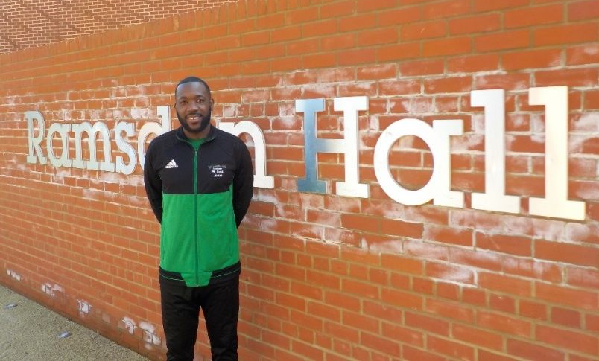
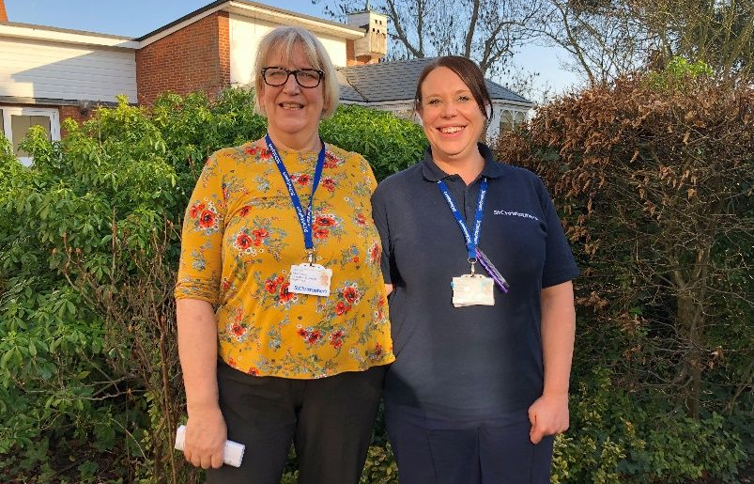
Other Jack Petchey Opportunities
Leader Award – recognise staff, volunteer, parent, manager or other significant adult aged 18+ in your organisation.
Leader Award Grant - You then have 6 months to apply for a grant of up to £1000 for a project that benefits your young people.
Educational Visit Grant – funding for two educational trips to cover transport costs and admission fees. Up to £1,200 available for each trip. Funding up to £20 per head for up to 60 people – higher rates for Pupil Referral Units, Alternative Provisions and SEND groups.
If you think you can, you can!

Slide 10
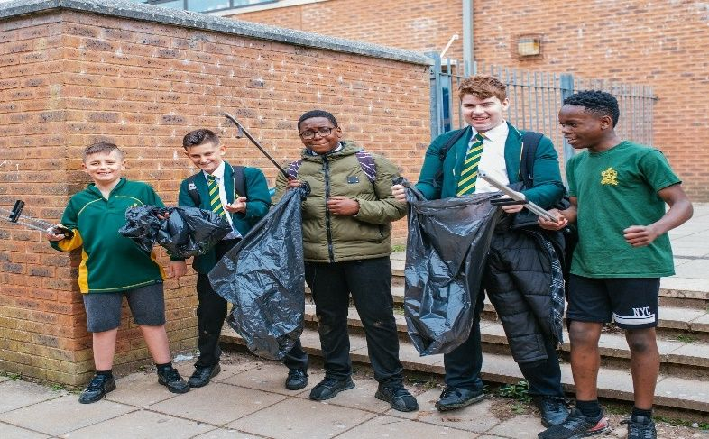
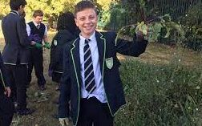
Other Jack Petchey Opportunities
Environmental Award – recognise a young person in your organisation for their work on the environment.
Environmental Award Grant - They can then apply for a grant of up to £300 to conduct an environmental project, in conjunction with the coordinator.
Individual Grant For Volunteering – up to £400 for a young person to take part in a volunteering project. Young person applies directly via our website.
If you think you can, you can!

Slide 11
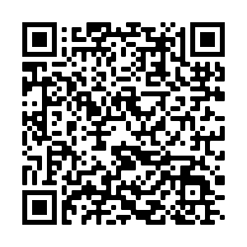
Apply to the scheme today!
Visit Our Website: www.jackpetcheyfoundation.org.uk
Get in touch:
Email: jparmenter@jackpetchey.org.uk
Phone: 020 8252 8000
If you think you can, you can!

