Slide 1
Year of Opportunity/Active Essex 6.6.25
Aims of National Curriculum: Physical Education – all pupils:
Lead healthy, active lives
Engage in competitive sports and activities
Are physically active for sustained periods of time
Develop competence to excel in a broad range of physical activities.
Roy Blatchford. royb88@gmail.com www.blinks.education

Slide 2
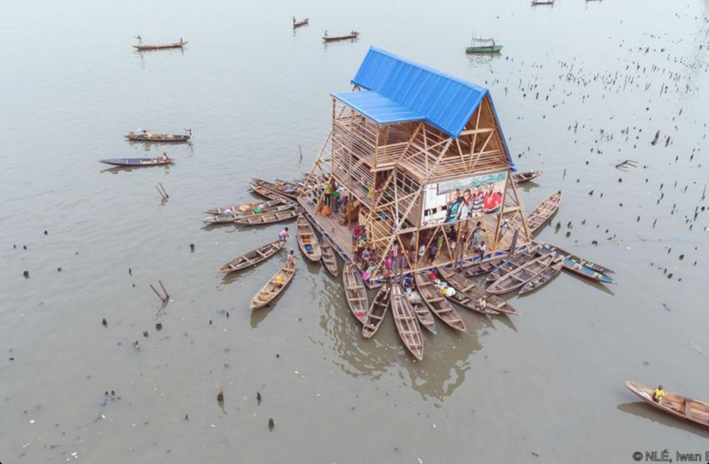

Slide 3
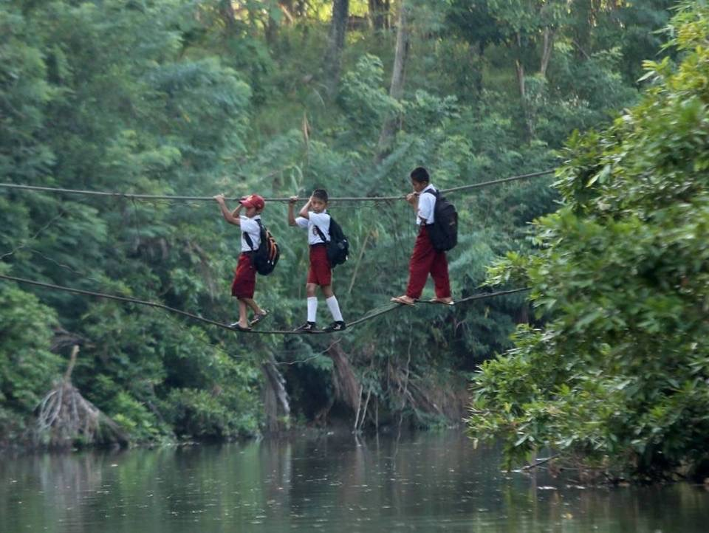

Slide 4
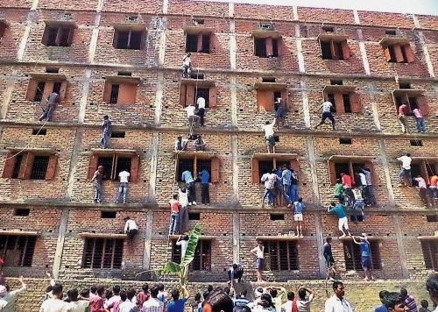

Slide 5
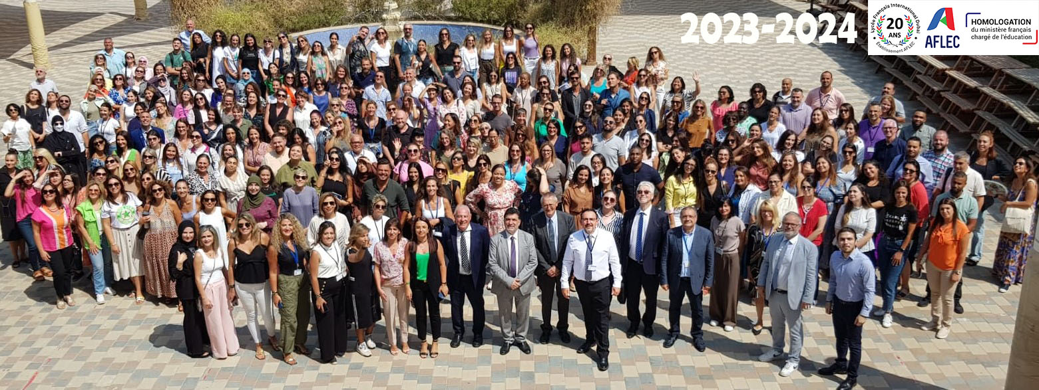
Lycée Français International de l’AFLEC à Dubaï.

Slide 8
What are you most proud of this year?
Participation
Self-esteem
Leadership
Teams
Role-models
Breadth
Depth
PE/Sports for all, excellence for some

Slide 9
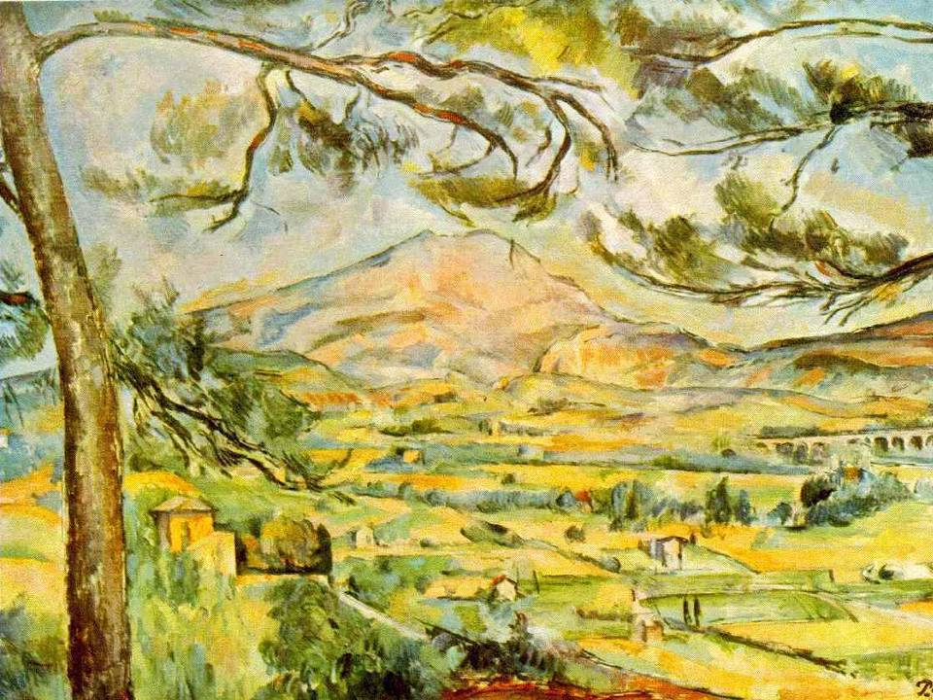

Slide 10
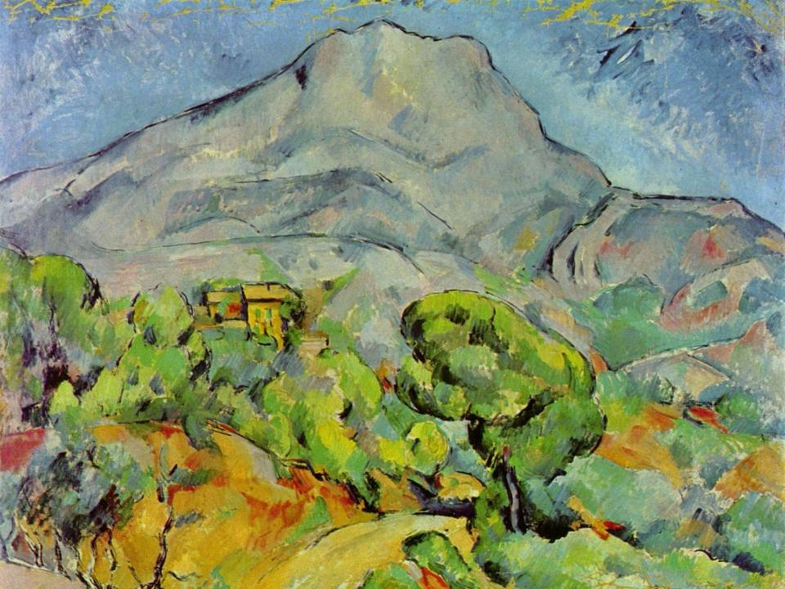

Slide 11
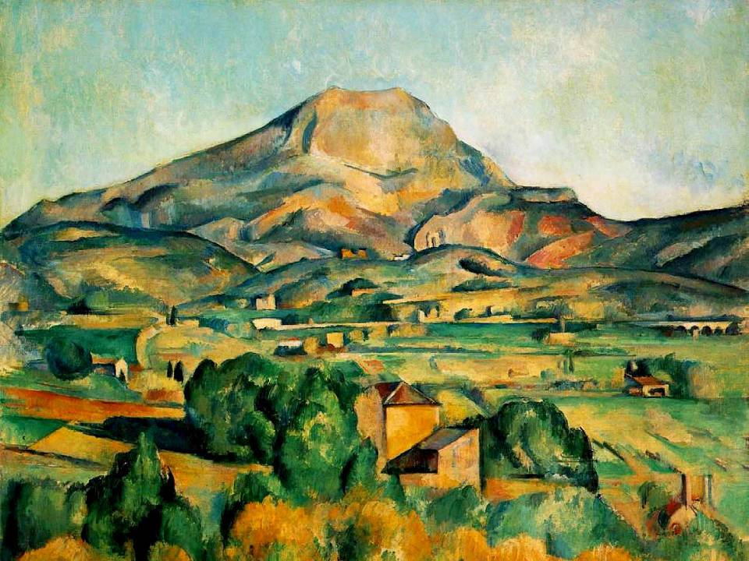

Slide 12
GBS, 1903
This is the true joy in life, being used for a purpose recognised by yourself as a mighty one. Being a force of nature instead of a feverish, selfish little clod of ailments and grievances, complaining that the world will not devote itself to making you happy.
I want to be thoroughly used up when I die, for the harder I work, the more I live. I rejoice in life for its own sake. Life is no brief candle to me. It is a sort of splendid torch which I have got hold of for the moment and I want to make it burn as brightly as possible before handing it on to future generations.

