Slide 1

.

Slide 2
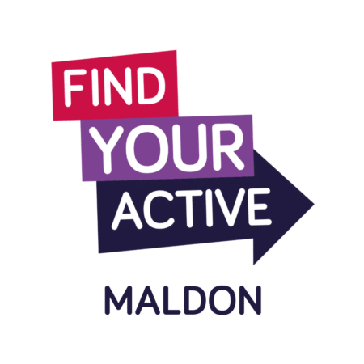



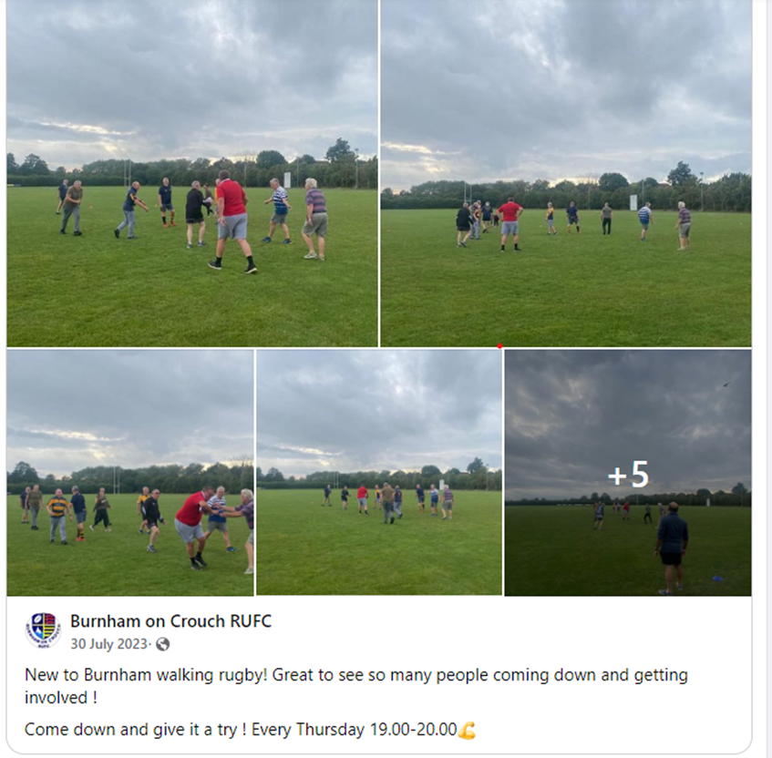
Active Maldon
Active Maldon Grants
Can apply for up to £2000
Anyone is eligible to apply
Projects that improve the health and wellbeing of residents
Encourage more people to become active
What we look for in application
How will this project get more people active
How sustainable is it past the initial funding
There is nothing similar already
Evidence to show the demand for your project
What can the funding be used for?
Promotion
Equipment
Facility hire costs
Coaching costs
To discuss a project please contact Ben.thornett@maldon.gov.uk
'Where Quality of Life Matters'
05

Slide 3

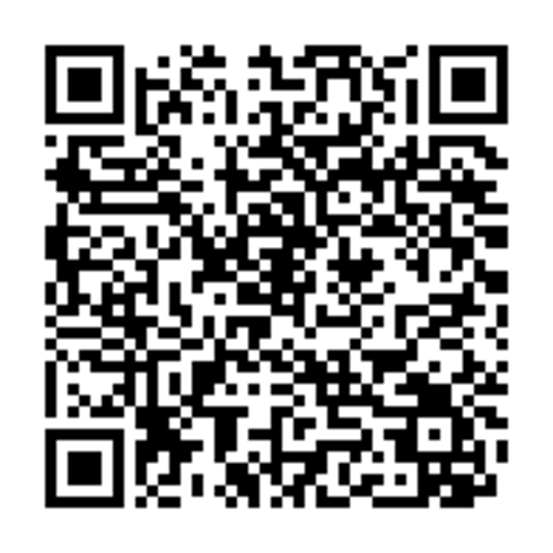
Applications are currently open for small grants (up to £2000) to support our Livewell priority areas:
Obesity and Physical Activity
Social Isolation
Mental Health
This funding can be used for Health & Wellbeing initiatives / projects taking place within Maldon District for the benefit of our residents.
Priority project areas for 2026/27 include:
Healthy Weight – Food and Mental wellbeing
Children, families a and youth support
Creative Health
Livewell Public Health Grants
Who can apply?
VCS organisations
Charitable Incorporated organisations (CIO)
Not-for-profit company limited by guarantee
Community Interest Company (CIC)
Educational Settings
Statutory body (including NHS ICB's, Local authorities, town, parish or community council)
Examples of previously funded projects
Healthy Cooking Programs
Falls Prevention support
Community Gardens and vegetable patches
Social groups / activities
Scarn here for guidance notes and to apply
If you have any questions or would like to discuss a possible application, please contact ryan.pegrum@maldon.gov.uk
'Where Quality of Life Matters'
05

Slide 4
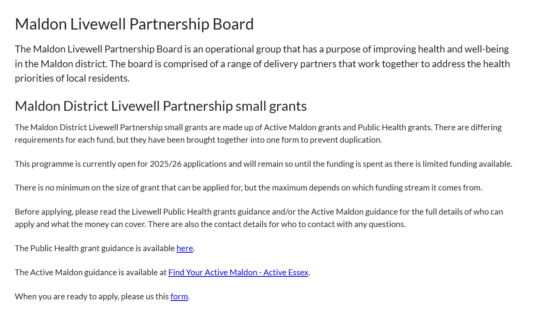

https://www.maldon.gov.uk/info/206005/health_and_wellbeing/9907/maldon_livewell_partnership_board
maldon.gov.uk
'Where Quality of Life Matters'

