Slide 1

FREE TENNIS TEACHER TRAINING & FREE
£250 FOR EVERY SCHOOL
Designed specifically for schools to support the curriculum and wider school outcomes, our FREE tennis for schools programme can be accessed by completing teacher training.
What can you expect?
£250 voucher for equipment or coaching
£150 top up voucher also now available
Detailed PE lesson plans
Developing fundamental movement skills
Accompanying videos for further training
Personal development challenges
Cross-curricular STEM resources
Intra & inter school competitions

Slide 2
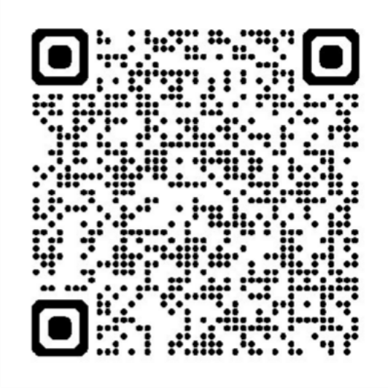

IF YOU WOULD BE INTERESTED IN ATTENDING AND/OR HOSTING A FREE TRAINING COURSE & RECEIVING £250, REGISTER AN INTEREST HERE:

